Slide 1
Numerical model for simulation of the Micro-Channel Plates
Valentin Ivanov
Muons, Inc.
06 January 2009

Slide 2
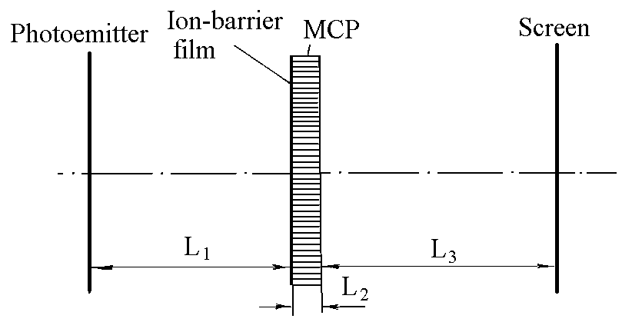
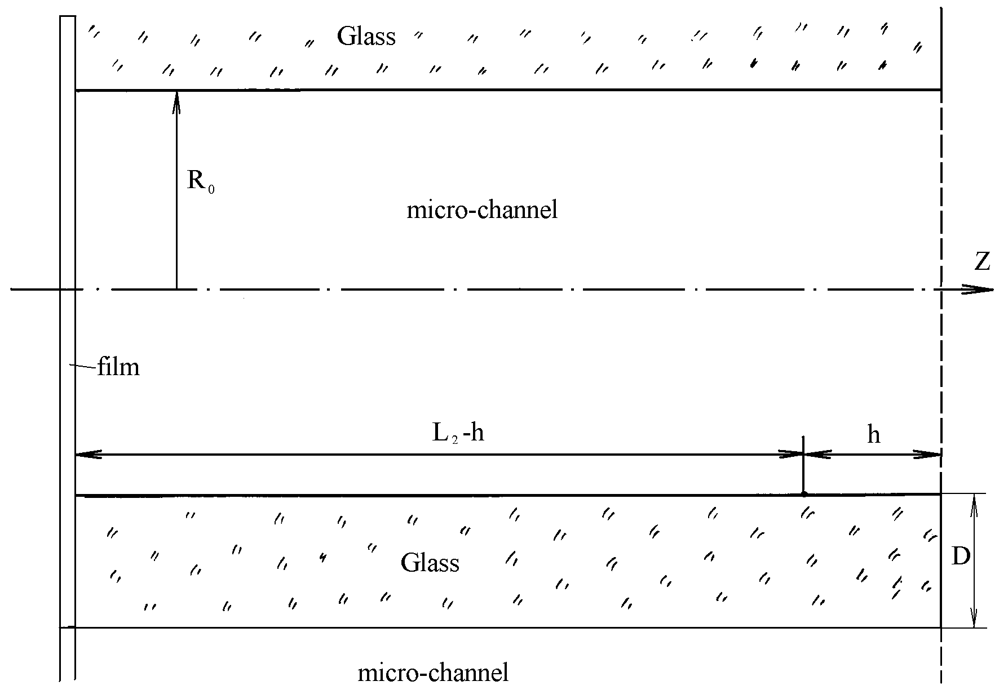
Electron optical system with the micro channel plate
Schematic model of the 3rd-generation EOS
The gap “ion-barrier film-MCP

Slide 3
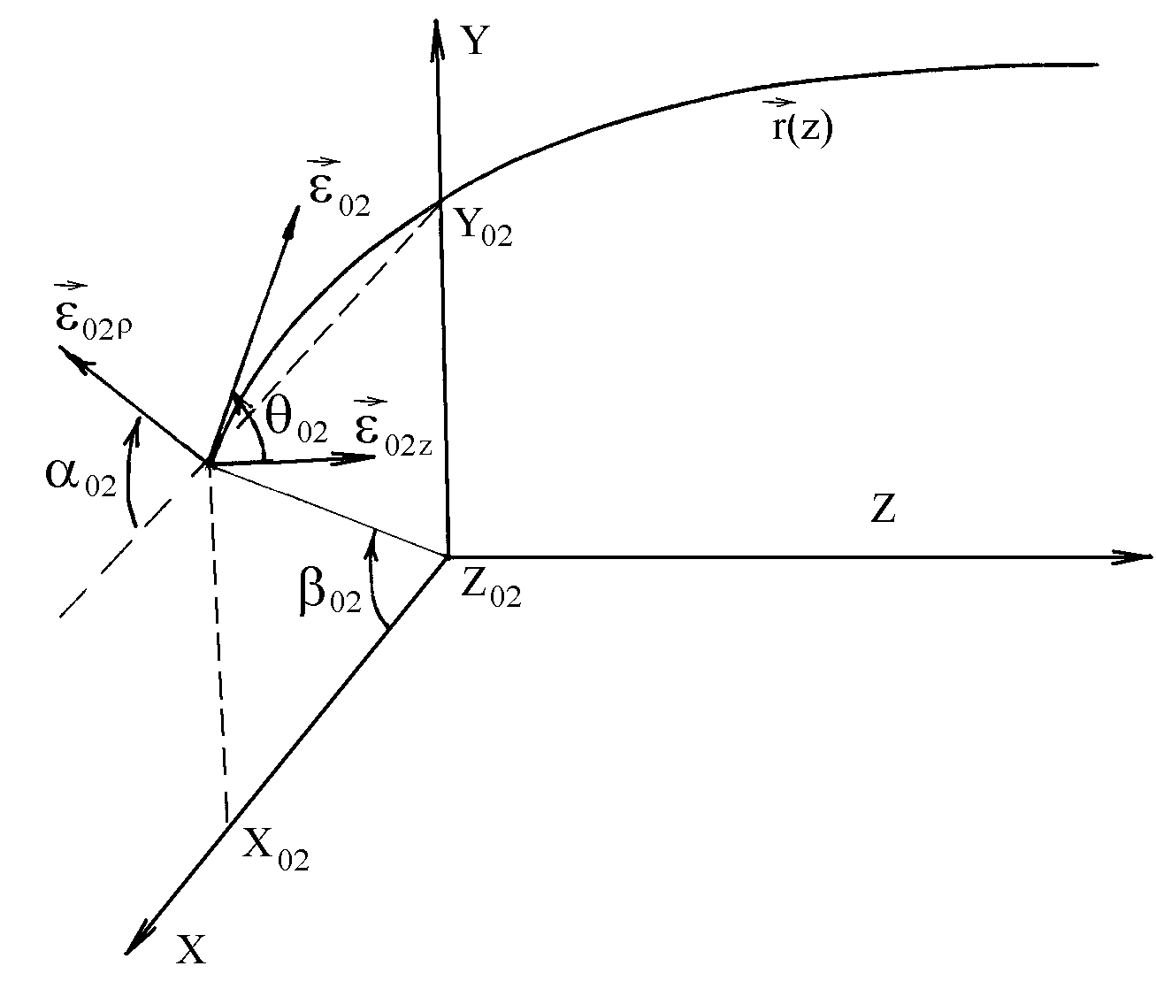
Basic correlations
The elementary current coming to the channel surface is
The current per unit length of the channel
creates the secondary particles emitted by the channel wall.
The surface part subjected to the bombarding
by the primary electrons is the 1st cascade of amplification,
which is characterized by the current distribution
and by the amplification ratio
The correlation between the film current and the 1st cascade current
Coordinate system is used for
the micro channel area
and the current coming to the surface of 2nd cascade is
The elementary current before the 2nd cascade is
The current-distribution function on the surface before the 2nd cascade is described by a formula
but the current-distribution function on the surface after the 2nd cascade is
As the result we obtain the recurrent correlations

Slide 4
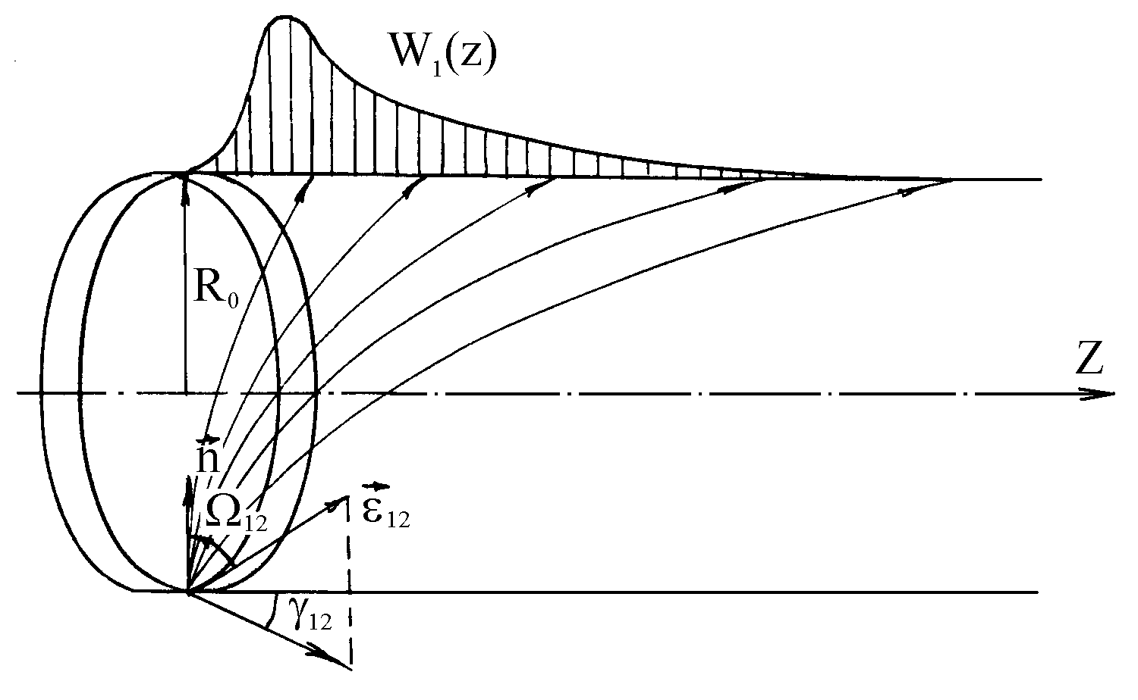
Analytical representation for the particle trajectories, angular/energy distributions and secondary emission
The particle trajectory in the uniform field is
Distribution functions for the initial angles and energy
current-density distribution from the elementary ring emitter
The Guest’s formula for true secondary electrons

Slide 5
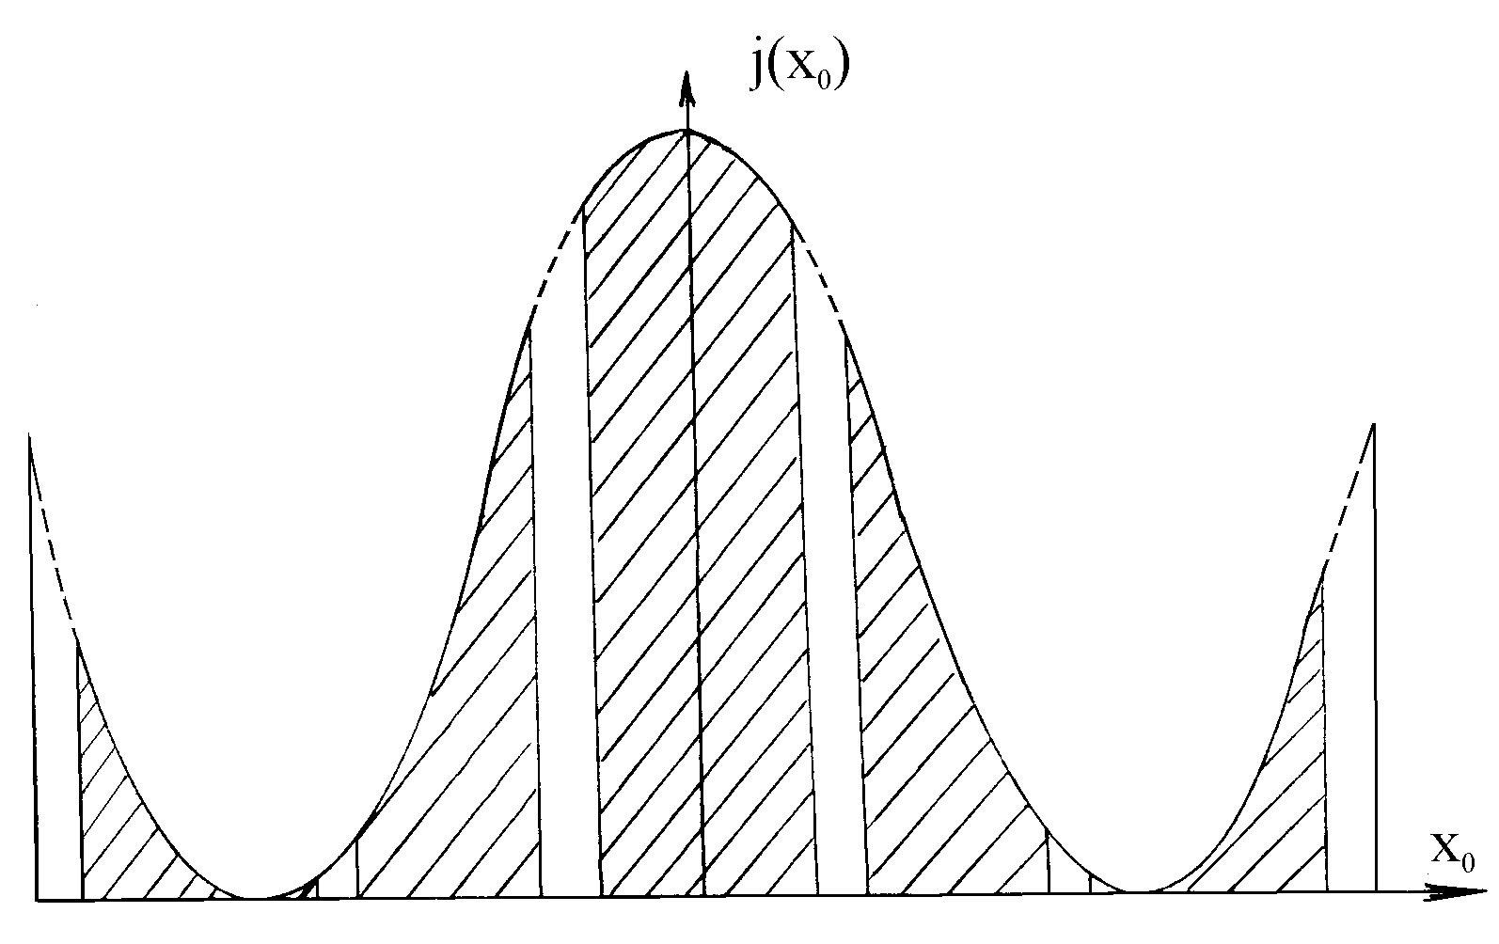
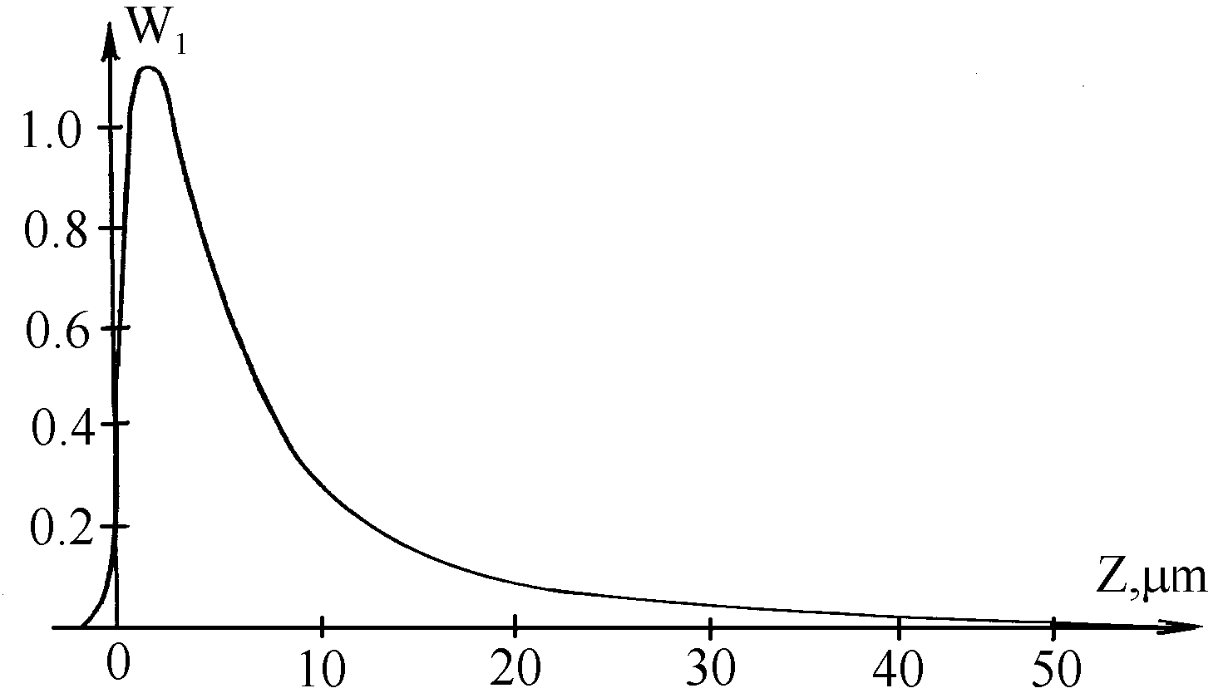
The results of numerical modeling
Current-density modulation by the micro-channell walls for a sinusoidal mira
Transfer function for the channel wall from the unit current

Slide 6
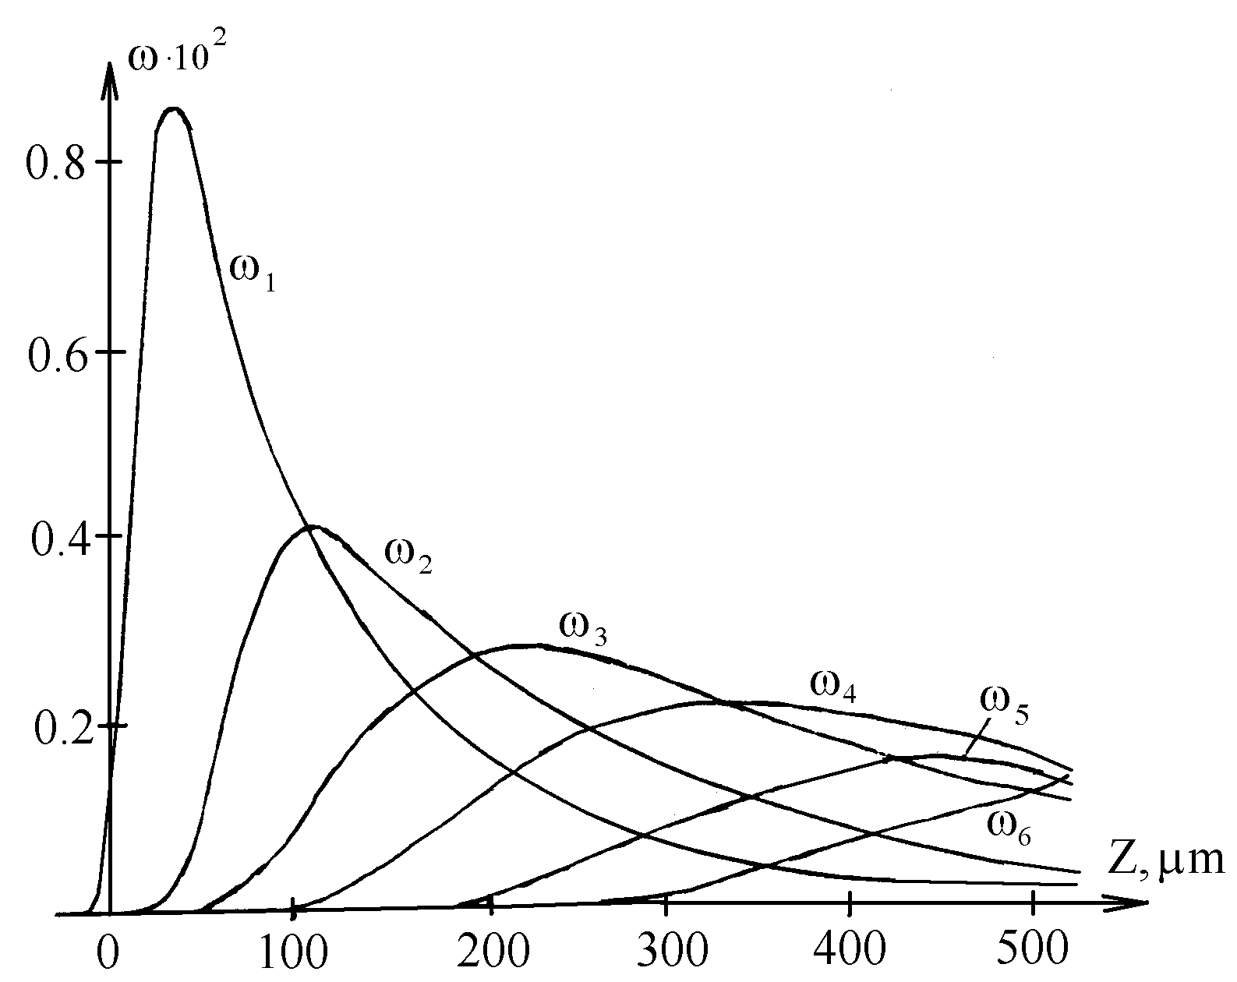
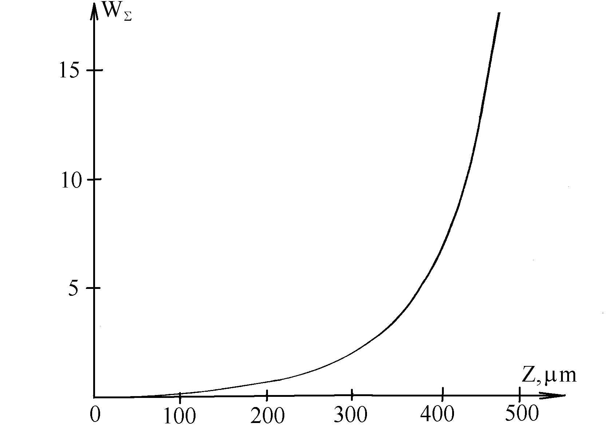
Secondary emission current distribution
Secondary-emission distribution for the individual cascades
Total distribution of secondary emission over
the channel wall for all cascades

Slide 7
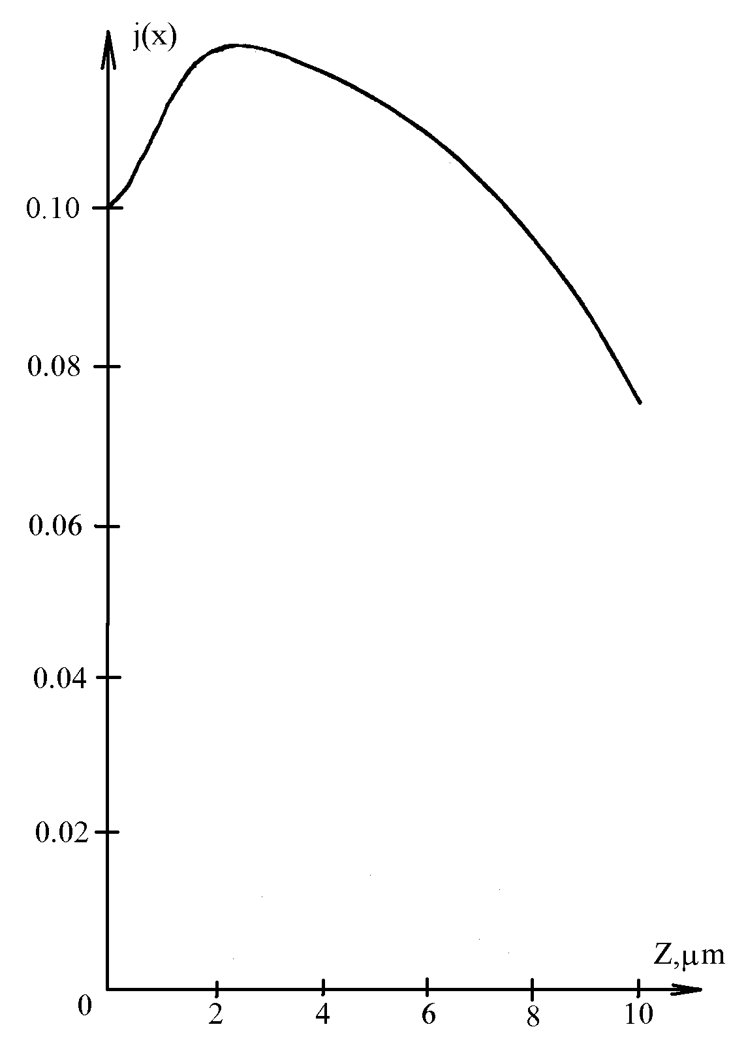
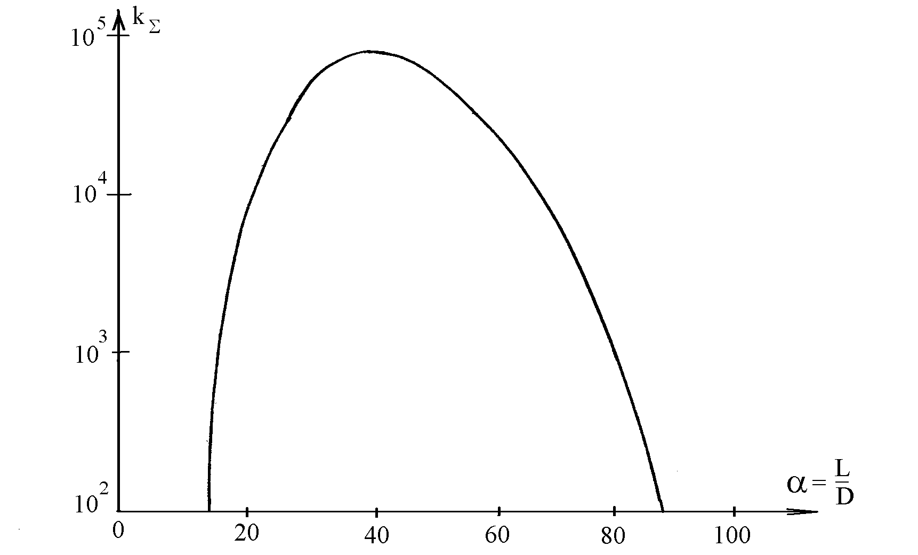
Amplification factor and the current density distribution
Dependence of the amplification factor vs. the gauge factor
for the constant voltage
Current-density distribution
at the end of MCP

Slide 8
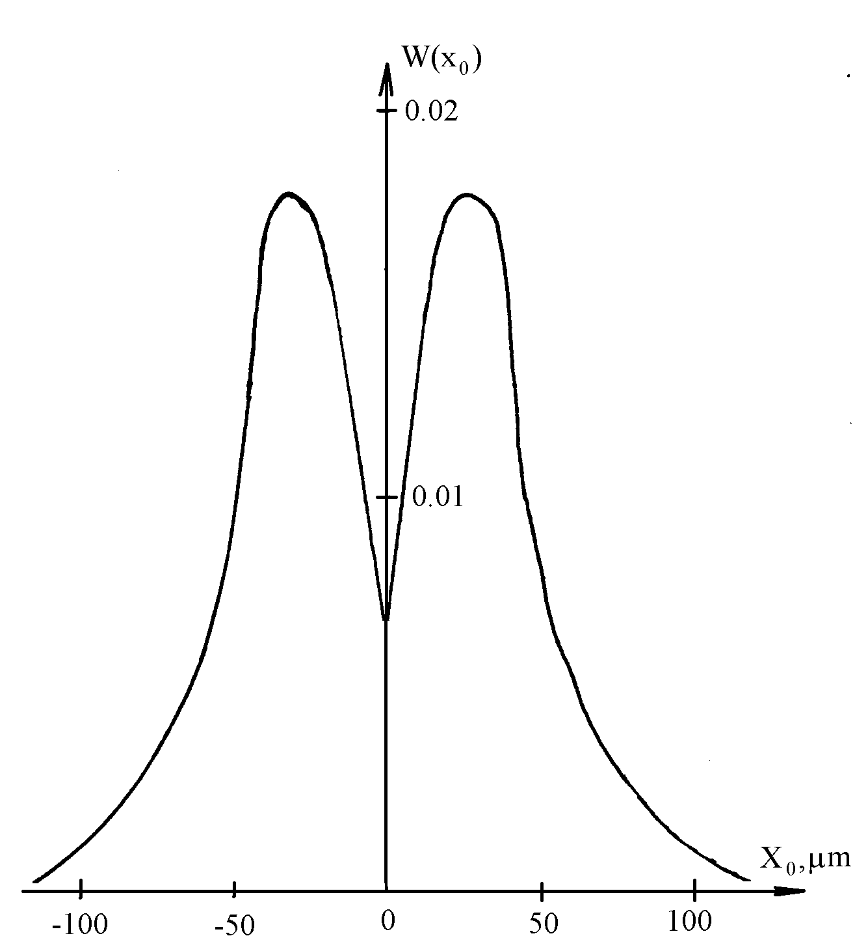
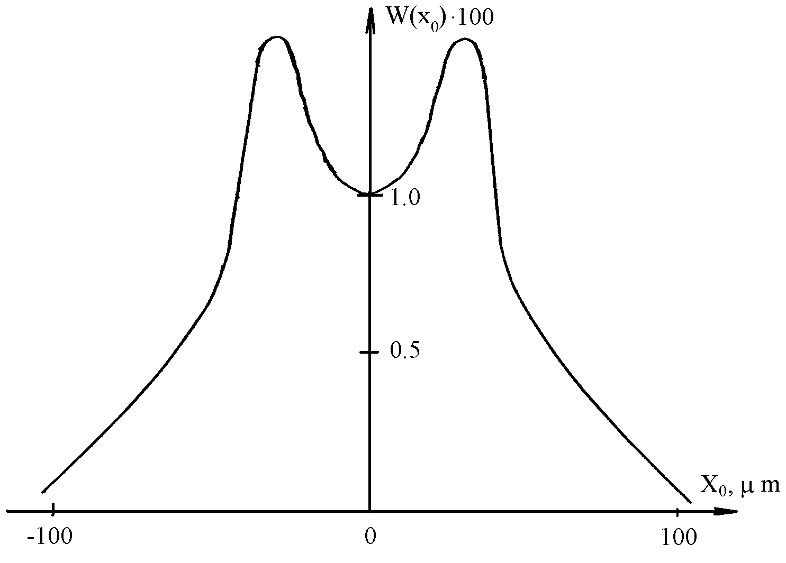
The images for the point- and line sources
Point-dispersion function
Line-dispersion function

Slide 9
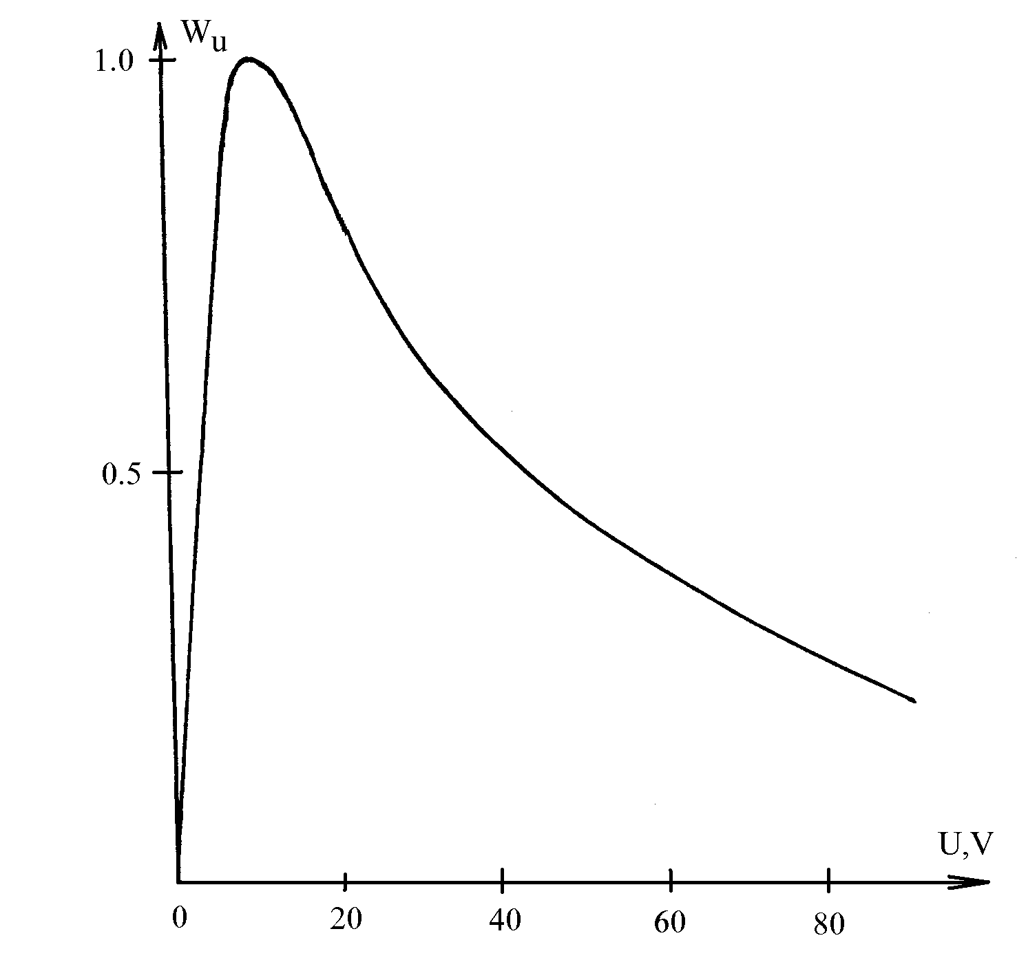
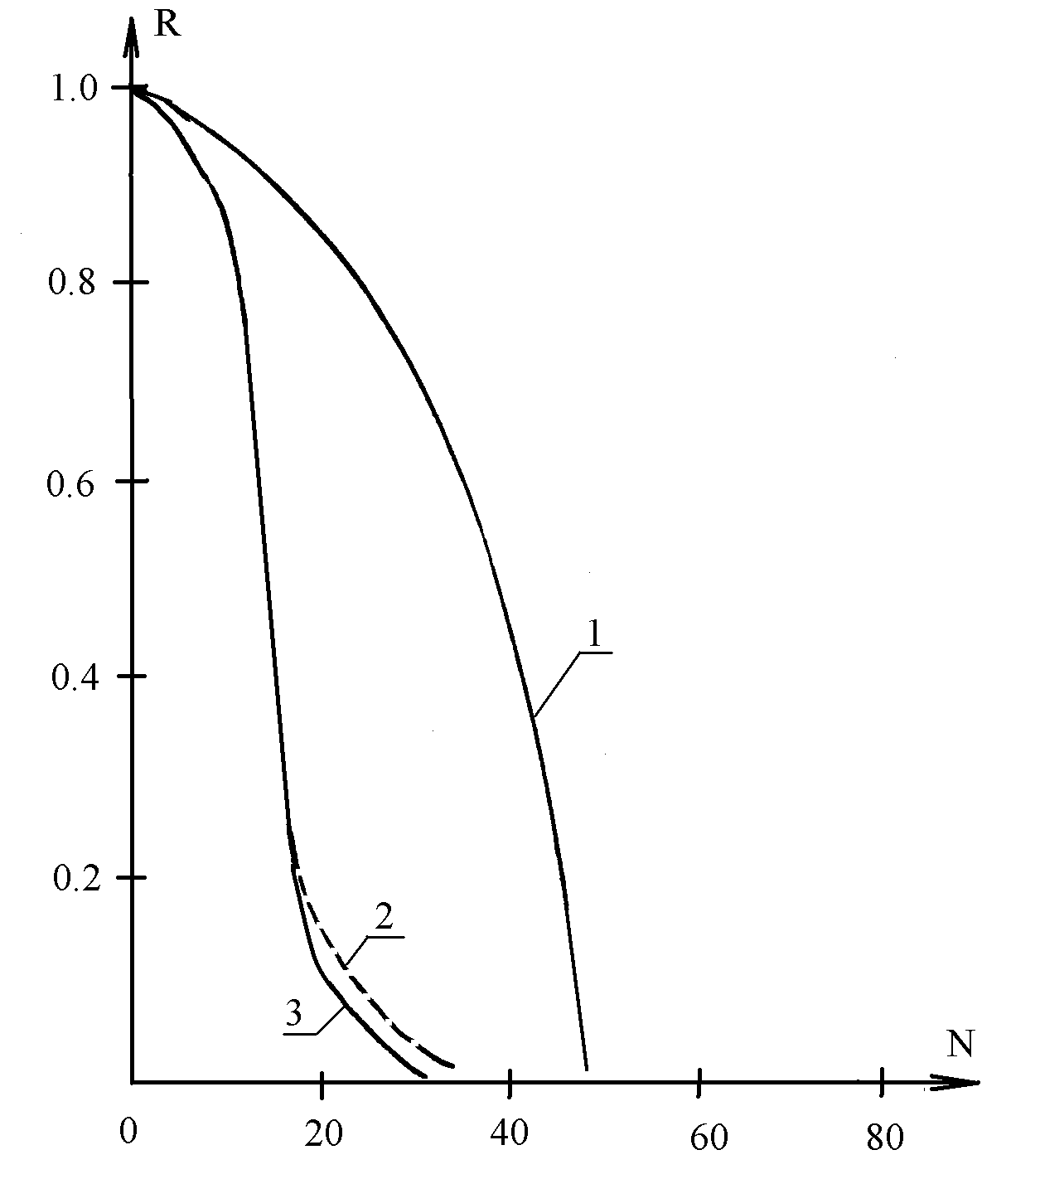
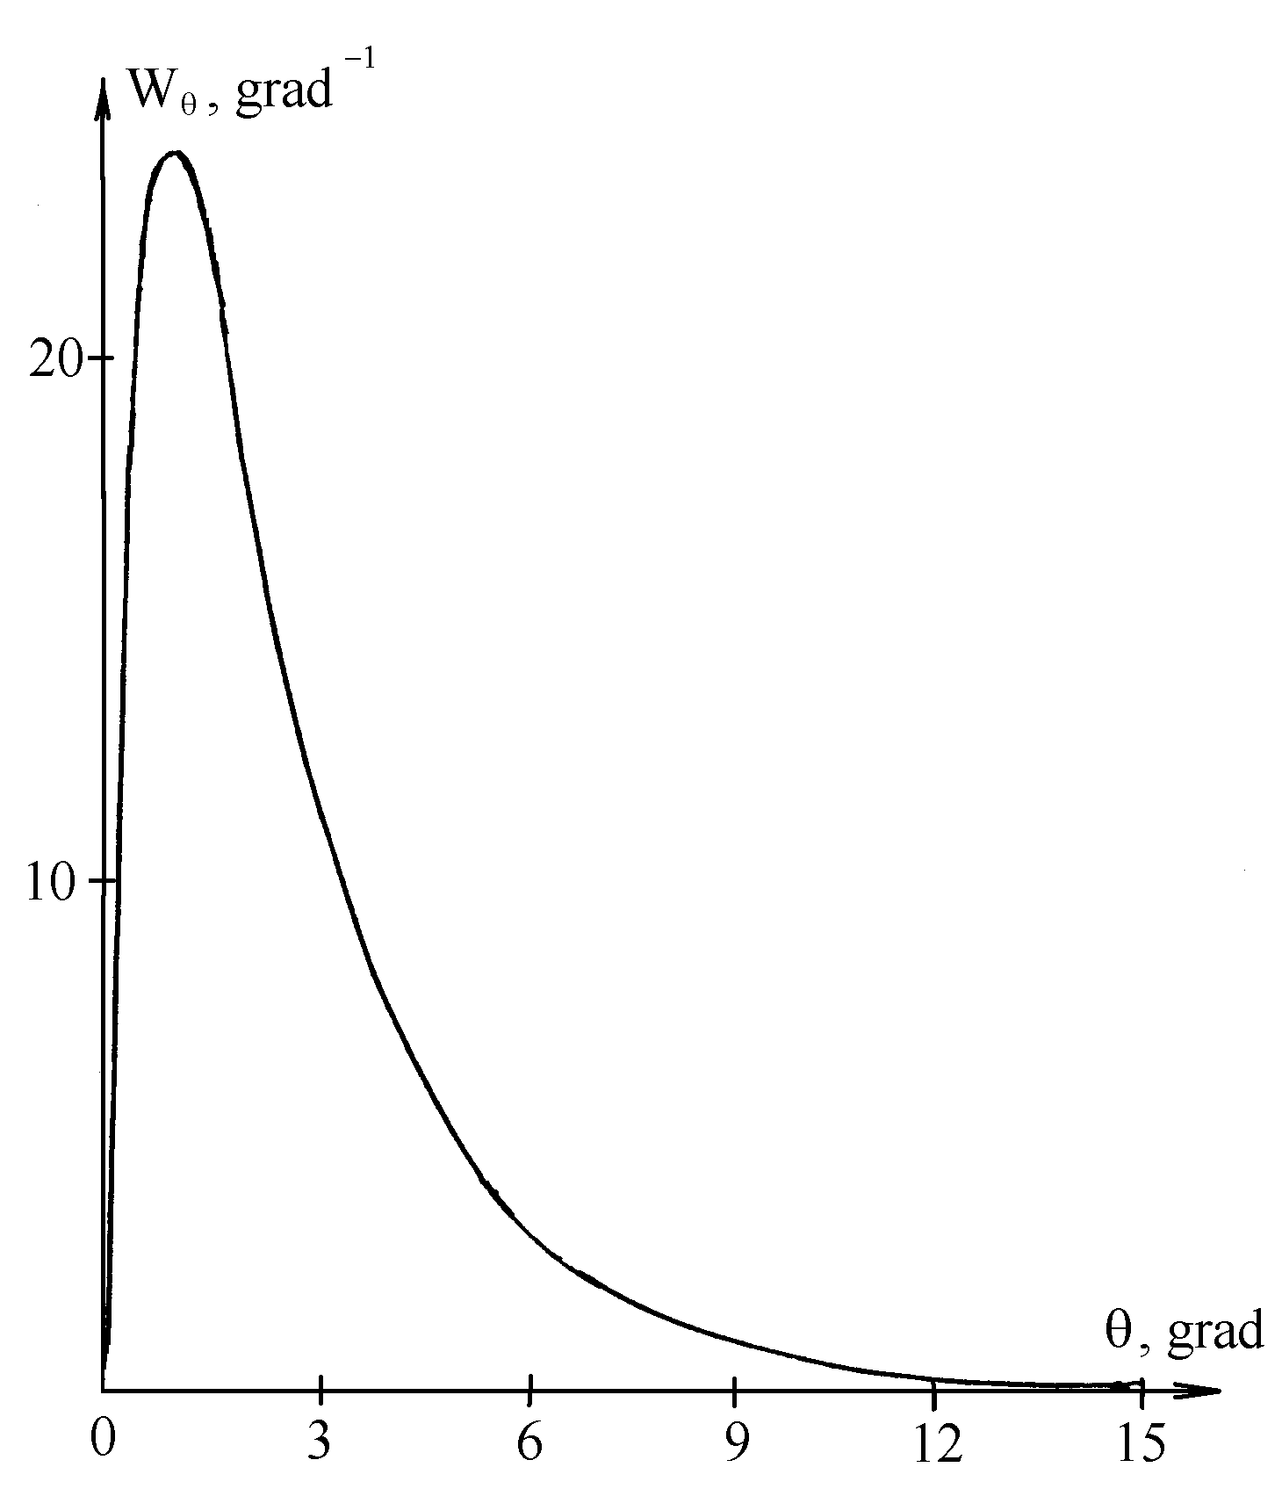
Angular, energy distributions and the modulation transfer function
Energy distribution at the MCP end.
Angular distribution of the
electrons at the MCP end
MTF for the parts: 1 – MCP+screen,
2- MCP+photocathode,
3 – total MTF of the device

Slide 10
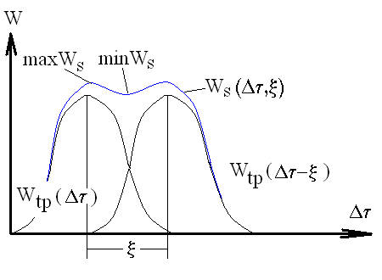
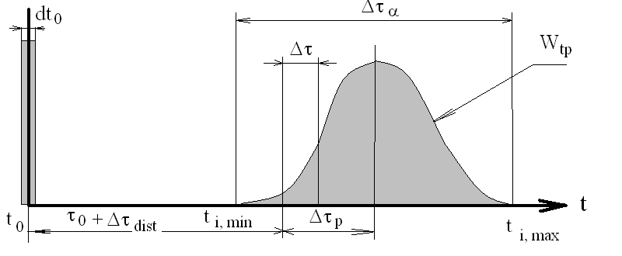
On determination of temporal resolution
The apparatus function W_{tp,}
To the definition of physical temporal resolution R

Slide 11
Summary
The numerical model for simulation of secondary emission cascades in the micro channel plates (MCP) was implemented;
The numerical technique for evaluation of the image quality was developed;
The Fortran version of the simulation code was tested, and the results of numerical modeling have good agreement with experimental data;
Further works assume to improve the code by adding the components for time-resolution calculations in order to simulate the properties of large-area photo-detectors of picosecond resolution.

