Slide 1
Overview and a little history ofLAPPD
HJF
Dec 8,2011
Thanks to everybody!

Slide 2
Outline
A little history- some old slides (shows how far we’ve come)
The Power of Correlated Time/Space Points
Enabling Technologies: ALD-glass MCP’s, Transmission Lines & Waveform Sampling, Surface science , Glass techniques (Joe), Material science, Simulation and analysis
The 4 Determinants of Time Resolution
Signal/Noise (S/N)
Analog Band-width (ABW)
Sampling Rate
Signal statistics
What is the ultimate resolution at a given area & cost (frugal)?
Where we can go: Water Cherenkov Counters; PET Cameras; TOF at Colliders; TOF for Fixed Target; Security; and New Ideas
Challenges- Cost, Schedule, Commercialization

Slide 3
Our Situation Pre-LAPPD
Packaging- had 2”-square ceramic Planacon
Substrates- options: standard Pb-glass, AAO, B33/B270 Glass- many questions
Electronics- Superfast IBM-8RF bi-CMOS; expensive anodes, no back-end, no $$
Coatings- no measurements of our own- many question as to best materials
Simulation – very little understanding of MCP
Funding, personnel, home, etc.- pretty minimal

Slide 4
Some Old Slides for fun
Feb 08, mostly…

Slide 5
From 2005 slide
Now with Karen Byrum (physicist) and Gary Drake (Elec. Engineer) of Argonne National Lab, and Prof.’s Chin-Tu Chen and Chien-Minh Kao of the Dept of Radiology, Univ. of Chicago. Also have a MOU in progress with Saclay in France, and a close working relationship to Jerry Va’vra at SLAC. Have developed a community (e.g. Saclay workshop)

Slide 6
The Future of Psec Timing-
From the work of the Nagoya Group, Jerry Va’vra, and ourselves it looks that the psec goal is not impossible. It’s a new field, and we have made first forays, and understand some fundamentals (e.g. need no bounces and short distances), but it’s entirely possible, even likely, that there are still much better ideas out there.
Big Questions:
What determines the ultimate limits?
Are there other techniques? (e.g. all Silicon)?
Old slide

Slide 7
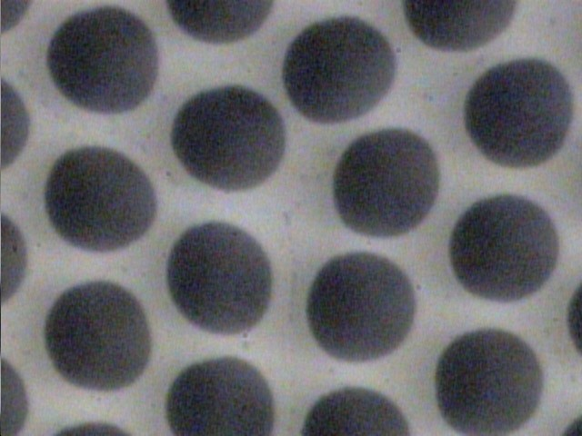
Design Goals
Colliders: ~ 1 psec resolution, < 100K$/m²
Neutrino H2O: ~100 psec resolution, < 1K$/m²
PET: ~ 30 psec resolution, < 20% of crystal cost
Micro-photograph of Burle 25 micron tube- Greg Sellberg (Fermilab)- ~2M$/m²- not including readout

Slide 8
Characteristics we need
Feature size <~ 300 microns (= 1 psec at c)
Homogeneity (ability to make uniform large-area- think amorphous semicndtr solar-panel)
Fast rise-time and/or constant signal shape
Lifetime/robustness/simplicity
Cost/unit-area << that for photo-multipliers
Note to Howard- you were/are right!

Slide 9
Large-area Micro-Channel Plate Panel “Cartoon”
N.B.- this is a `cartoon’- working on workable designs-join us…
Front Window and Radiator
Photocathode
Pump Gap
High Emissivity Material
Low Emissivity Material
`Normal’ MCP pore material
Gold Anode
50 Ohm Transmission Line
Rogers PC Card
Capacitive Pickup to Sampling Readout

Slide 10
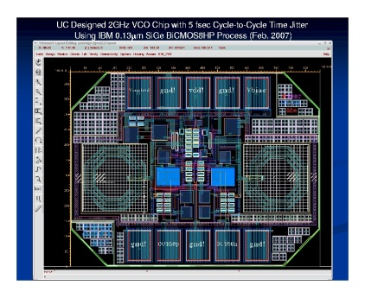
Front-end Electronics
Critical path item- probably the reason psec detectors haven’t been developed
We had started with very fast BiCMOS designs- IBM 8HP-Tang designed two (really pretty) chips
Realized that they are too power-hungry and too ‘boutique’ for large-scale applications
Have been taught by Gary Varner, Stefan Ritt, Eric DeLanges, and Dominique Breton that there’s a more clever and elegant way- straight CMOS – sampling onto an array of capacitors
Have formed a collaboration to do this- have all the expert groups involved (formal with Hawaii and France)- see talks by Tang and Jean-Francois at Lyon

Slide 11
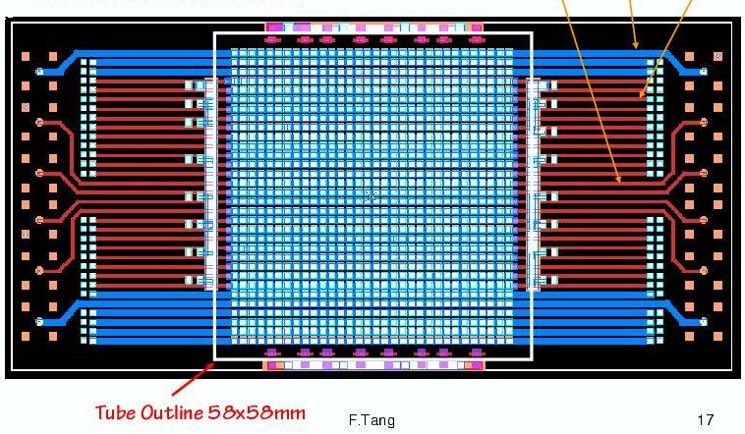
Get position AND time Anode Design and Simulation(Fukun Tang)
Transmission Line- readout both ends=> pos and time
Cover large areas with much reduced channel account.

Slide 12
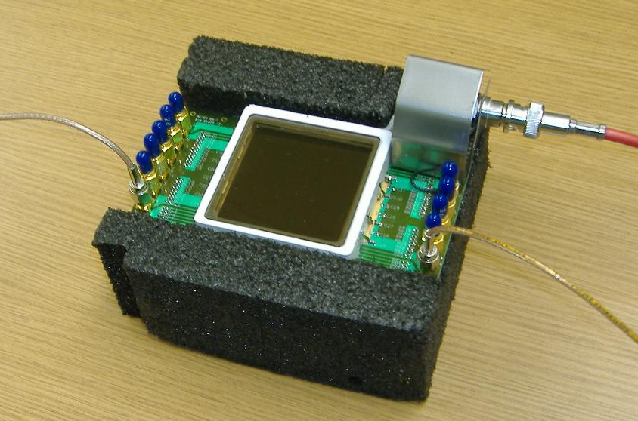
Photonis Planicon on Transmission Line Board
Couple 1024 pads to strip-lines with silver-loaded epoxy (Greg Sellberg, Fermilab).

Slide 13
End Old Slides – back to the present

Slide 14
The Large-Area Psec Photo-Detector Collaboration

Slide 15
Time and Space Points
Pulses from the 2 ends of an 8” silk-screened cheap-glass anode strip
5 nsec/div
50 psec/pt
Matt, Bernhard, Rob; Sasha,Razib, Andrei

Slide 16
Reconstructing the vertex space point: Simplest case- 2 hits (x,y) at wall
Detector Plane
Vertex (e.g. π⁰->γγ)
T_{v}, X_{v}, Y_{v}, Z_{v}
T₁, X₁, Y₁
Photon 1
Photon 2
One can reconstruct the vertex from the times and positions- 3D reconstruction
T₂, X₂, Y₂

Slide 17
The 4 Determinants of Time Resolution
Signal/Noise (S/N)
Analog Band-width (ABW)
Sampling Rate
Signal statistics
5 nsec/div
50 psec/pt
J.F. Genat, F. Tang, H. Frisch, and G. Varner; Picosecond Resolution Timing Measurements, Nucl. Instr. Meth A607, 387 (2009);
Workshop on The Factors that Limit Time Resolution in Photo-detectors, University of Chicago, April 28-29, 2011

Slide 18
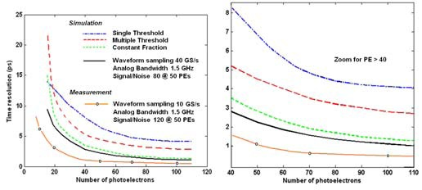
Simulation of Resolution vs abw
Jean-Francois Genat
1 ps
This (brown) line
This (brown) line
Brown line: 10 Gs/sec (we’ve done >15);
1.5 GHz abw ( we’ve done 1.6); S/N 120 (N=0.75mv, S is app specific)

Slide 19
Can we go deep sub-picosec?: the Ritt Parameterization (agrees with JF MC)
Stefan Ritt slide, doctored
100 femtosec
S/N, f_{Z}: DONE
abw: NOT YET

Slide 20
Parallel Efforts on Specific Applications
.
Explicit strategy for staying on task-
Multiple parallel cooperative efforts
PET
(UC/BSD, UCB, Lyon)
Collider
(UC, ANL,Saclay.
LAPD Detector Development
Muon Cooling
Muons,Inc
(SBIR)
ANL,Arradiance,Chicago,Fermilab, Hawaii,Muons,Inc,SLAC,SSL/UCB, UIUC, Wash. U
K->πνν
JPARC
Drawing Not To Scale (!)
Mass Spec
Andy Davis, Mike Pellin, Eric Oberla
Neutrinos
(Matt, Mayly, Bob, John, ..; Zelimir)
Non-proliferation
LLNL,ANL,UC
All these need work- naturally tend to lag the reality of the detector development

Slide 21
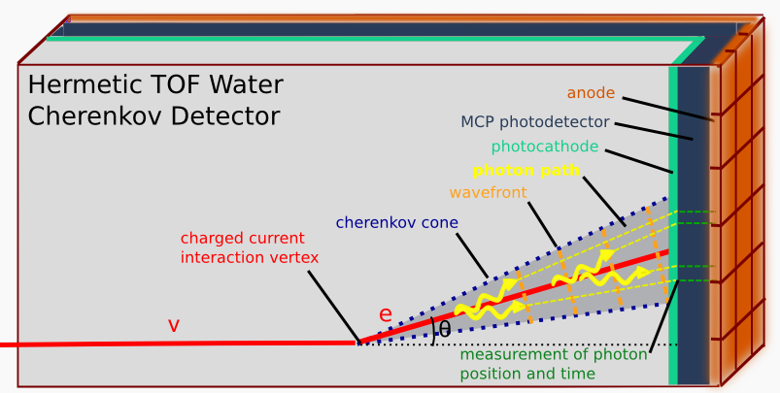
Neutrino Physics
(Howard Nicholson)
Spec: signal single photon, 100 ps time, 1 cm space, low cost/m2 (5-10K$/m2)*

Slide 22
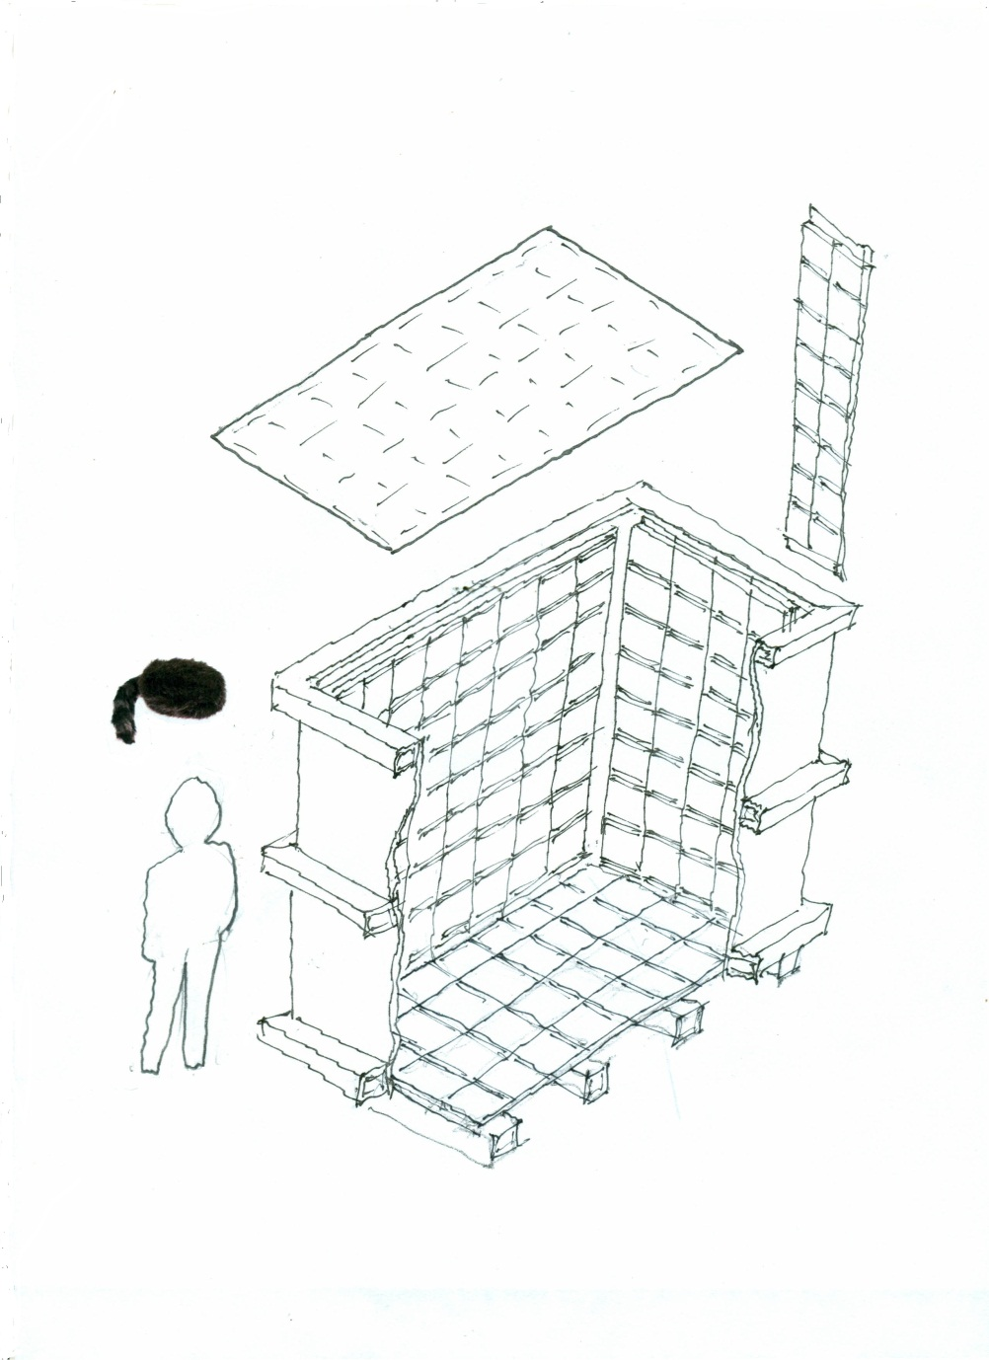
Daniel Boone
Proposal (LDRD) to build a little proto-type to test photon-TPC ideas and as a simulation testbed
`Book-on-end’ geometry- long, higher than wide
Close to 100% coverage so bigger Fid/Tot volume
Δx, Δy << 1 cm
Δt < 100 psec
Magnetic field in volume
Idea: to reconstruct vertices, tracks, events as in a TPC (or, as in LiA).
caps
2 m
ν
2 m
1 m

Slide 23
Can we build a photon TPC?
Work of Matt Wetstein (Argonne,&Chicago) in his spare time (sic)

Slide 24
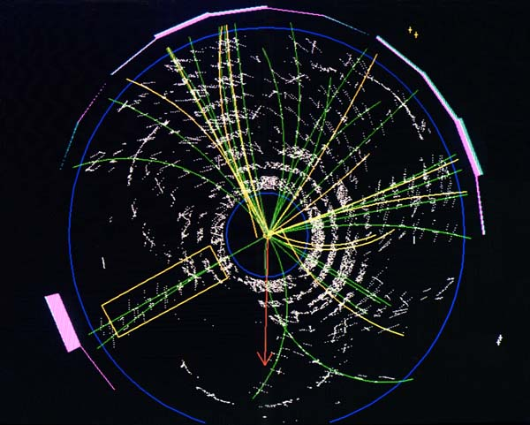
Application to Colliders
At colliders we measure the 3-momenta of hadrons, but can’t follow the flavor-flow of quarks, the primary objects that are colliding. 2-orders-of-magnitude in time resolution would all us to measure ALL the information=>greatly enhanced discovery potential.
A top candidate event from CDF- has top, antitop, each decaying into a W-boson and a b or antib. Goal- identify the quarks that make the jets.
Specs:
Signal: 50-10,000 photons
Space resolution: 1 mm
Time resolution 1 psec
Cost: <100K$/m2:
t-tbar -> W⁺bW⁻bbar-> e+ nu+c+sbar+b+bbar

Slide 25
Colliders: Differential TOF
Rather than use the Start time of the collision, measure the difference in arrival times at the beta=c particles (photons, electrons and identified muons) and the hadrons, which arrive a few psec later.

Slide 26
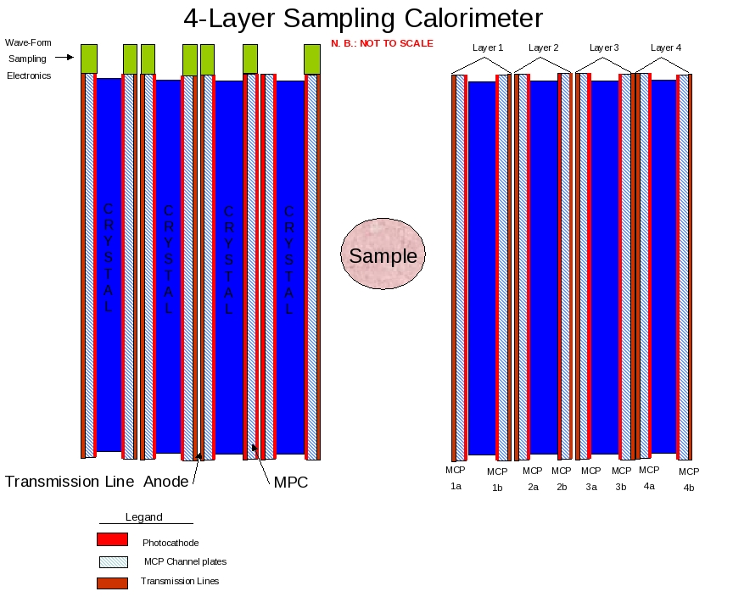
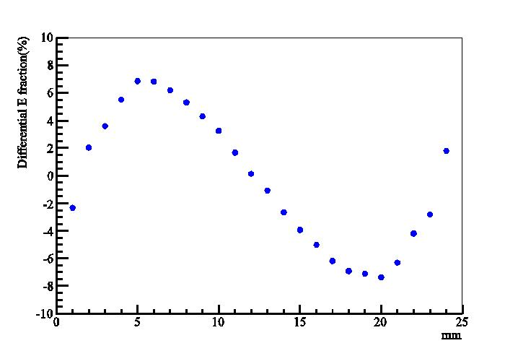
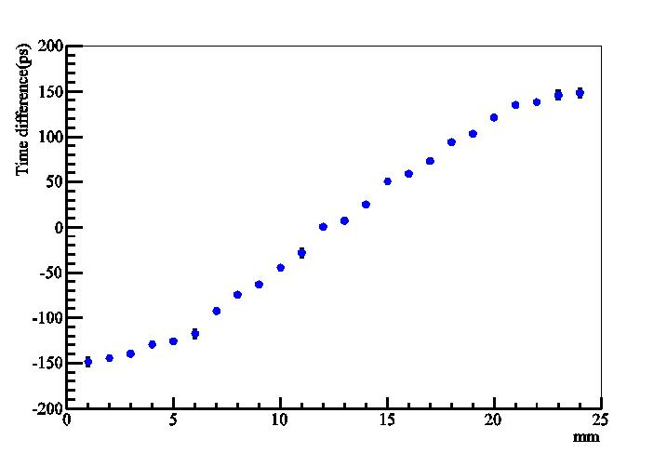
Medical Imaging (PET)
Alternating radiator and cheap 30-50 psec planar mcp-pmt’s on each side
Can we solve the depth-of-interaction problem and also use cheaper faster radiators?
Simulations by Heejong Kim (Chicago)
Heejong Kim
Heejong Kim
Depth in crystal by energy- asymmetry
Depth in crystal by time-difference

Slide 27
Sampling calorimeters based on thin cheap photodetectors with correlated time and space waveform sampling
Bill Moses (Lyon)
Proposal: Alternating radiator and cheap 30-50 psec thin planar mcp-pmt’s on each side (needs simulation work)

Slide 28
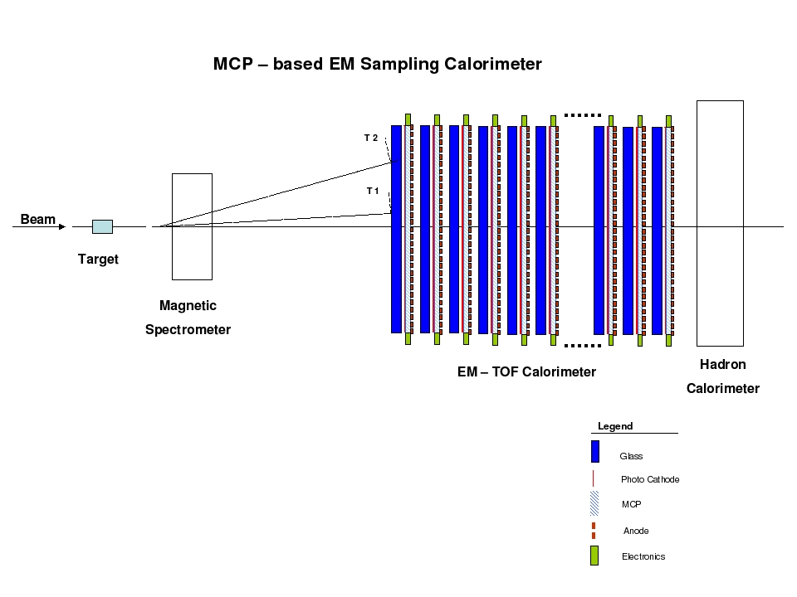
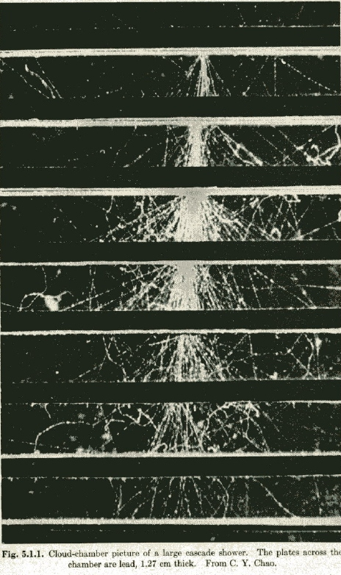
Cherenkov-sensitive Sampling Quasi- Digital Calorimeters
A picture of an em shower in a cloud-chamber with ½” Pb plates (Rossi, p215- from CY Chao)
A `cartoon’ of a fixed target geometry such as for JPARC’s KL-> pizero nunubar (at UC, Yao Wah) or LHCb

Slide 29
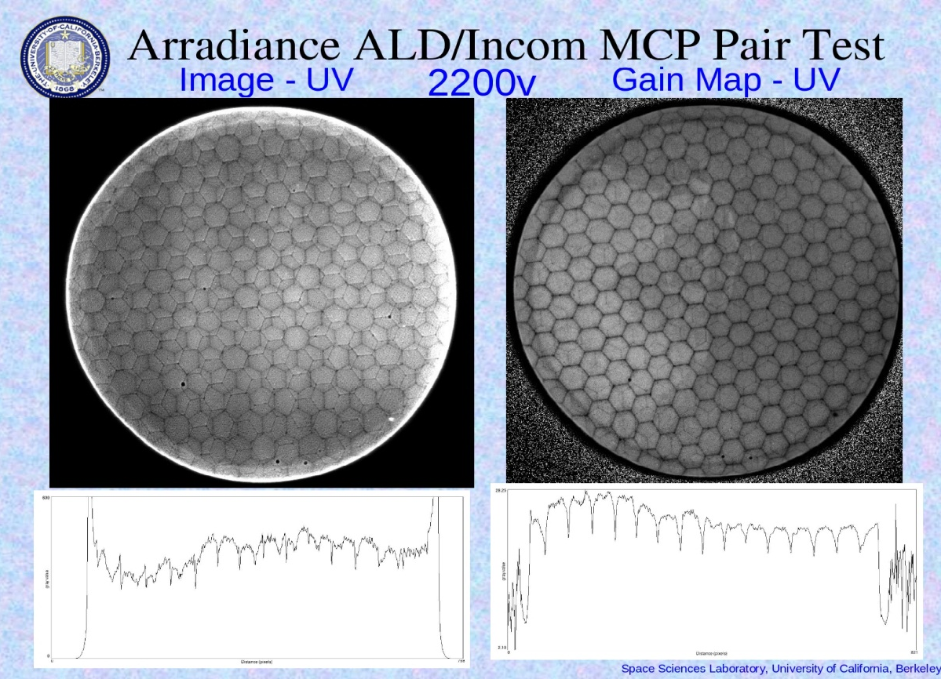
A `Quasi-digital’ MCP-based Calorimeter
Idea: can one saturate pores in the the MCP plate s.t.output is proportional to number of pores. Transmission line readout gives a cheap way to sample the whole lane with pulse height and time- get energy flow.
Oswald Siegmund, Jason McPhate, Sharon Jelinsky, SSL (UCB)
Note- at high gain the boundaries of the multi’s go away
Electron pattern (not a picture of the plate!)- SSL test, Incom substrate, Arradiance ALD. Note you can see the multi’s in both plates => ~50 micron resolution

Slide 30
Challenges-

Slide 31
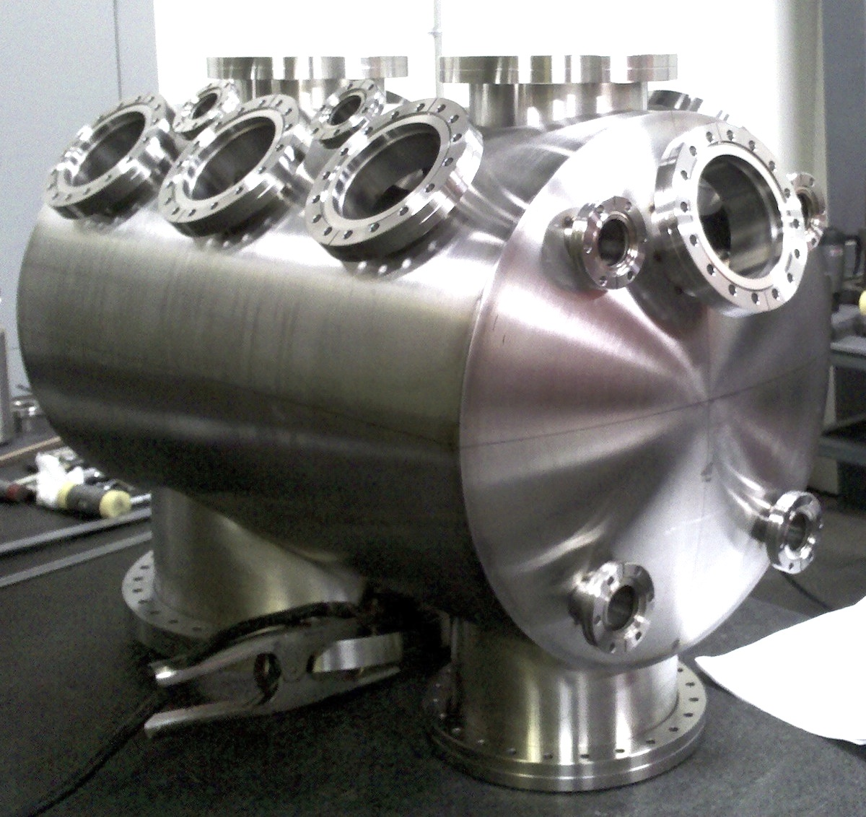
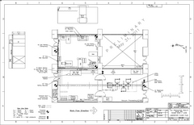
Challenge 1- Making this generation of detectors
3 parallel paths
Tile Development Facility at ANL
Production Facility at SSL/UCB
Commercial RFI for 100 tiles
(Have had one proposal for 7K- 21K tiles/yr)

Slide 32
Challenge 2- Exploiting the disruptive potential (s)
Performance:
(what is the
limit?)
Cost: Can we make a truly frugal tile? (what is the limit?)

Slide 33
Challenge 3- the most important
People, Funding, Schedule, Satisfaction, and Fun

Slide 34
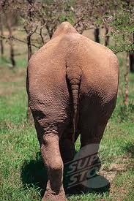
The End

Slide 35
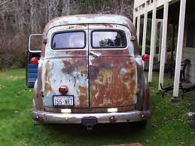
Backup slides

Slide 36
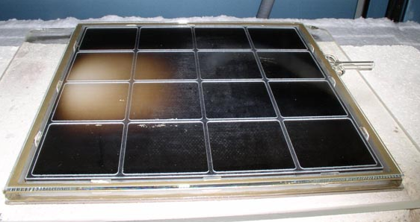
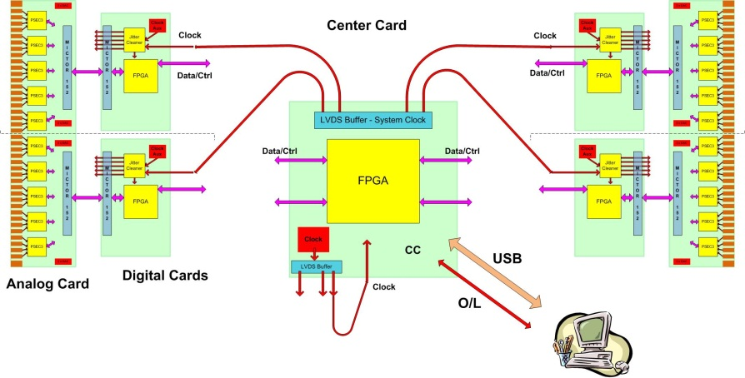
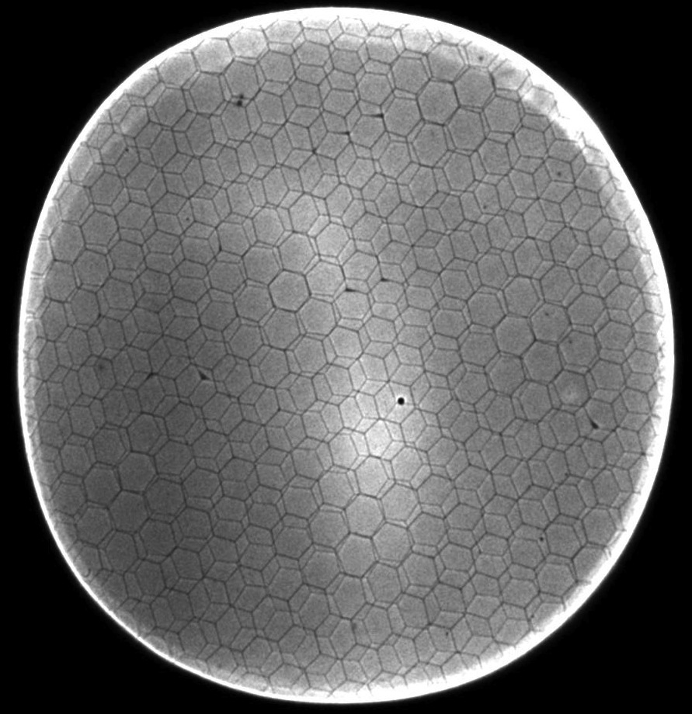
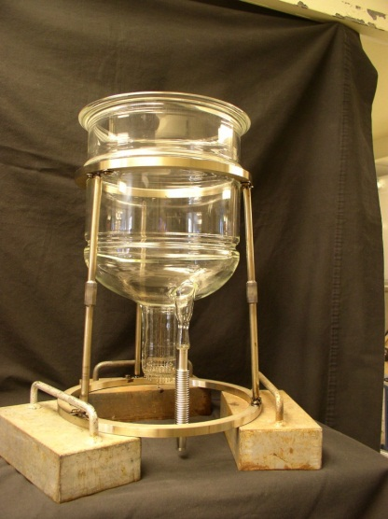
The 4 `Divisions’ of LAPPD
CV
CV
Hermetic Packaging
Electronics/Integration
See Bob Wagner’s talk
This talk
CV
CV
MicroChannel Plates
Photocathodes
See (hear) Bob Wagner’s talk
See (hear) Klaus Attenkofer’s talk

Slide 37
The Large-Area Psec Photo-Detector Collaboration

Slide 38
Microchannel Plates-3
SSL (Berkeley) Test/Fab Facilities
Ossy Siegmund, Jason McPhate, Sharon Jelenski, and Anton Tremsin-
Decades of experience
(some of us have decades of inexperience?)

Slide 39
Microchannel Plates-4b
Performance:
Noise (bkgd rate).
<=0.1 counts/cm²/sec; factors of few > cosmics (!)
Ossy Siegmund, Jason McPhate, Sharon Jelinsky, SSL/UCB

Slide 40
Microchannel Plates-4d
Performance: burn-in (aka `scrub’)
Measured ANL ALD-MCP behavior
(ALD by Anil Mane, Jeff Elam, ANL)
Measurements by
Ossy Siegmund,
Jason McPhate,
Sharon Jelinsky, SSL/UCB
Typical MCP behavior- long scrub-times

Slide 41
First Pulses From an 8” MCP
Matt Wetstein, Bernhard Adams, Razib Obaid, Sasha Vostrikov (ANL and UC)
TOA (psec)
TrueError bar prob.
like this
(ask Matt)
Note
c= 0.3mm/ps
1/c=3.3 psec/mm
From the time difference of the 2 ends of the strip one gets the longitudinal position, from the average of the 2 ends the time (and of course from which strip(s) one gets the transverse position) => so have 2D at wall plus Time-of-Arrival
Position of laser (mm)

Slide 42
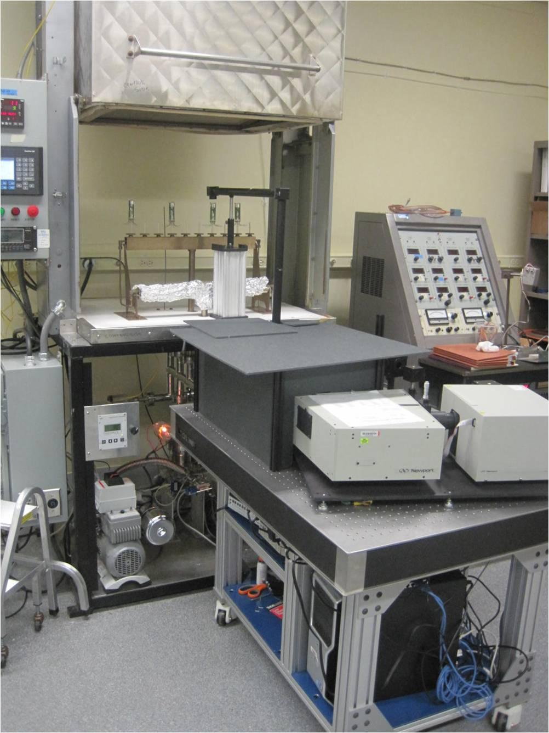
Photocathodes Subject of next talk by Klaus- touch on here only briefly
LAPPD goal- 20-25% QE, 8”-square
2 parallel efforts: SSL (knows how), and ANL (learning)
ANL
Optical stand
Burle commercial
equipment
First cathodes made at ANL

Slide 43
Photocathodes- 2 Subject of next talk by Klaus
SSL has years of experience making bialkali photocathodes-
They are our treasury bonds (Swiss francs?) in the LAPPD `portfolio of risk’

Slide 44
`Photo-multiplier in a Pore’
Idea is to build a PMT structure inside each pore- have a defined dynode chain of rings of material with high secondary emissivity so that the start of the shower has a controlled geometry (and hence small TTS)
One problem is readout- how do you cover a large area and preserve the good timing?
Proposed solution- build anode into pores, capacitively couple into transmission lines to preserve pulse shape.

Slide 45
The PSEC4 Waveform Sampling ASIC
PSEC4: Eric Oberla and Herve Grabas; and friends…
Eric Oberla, ANT11

Slide 46
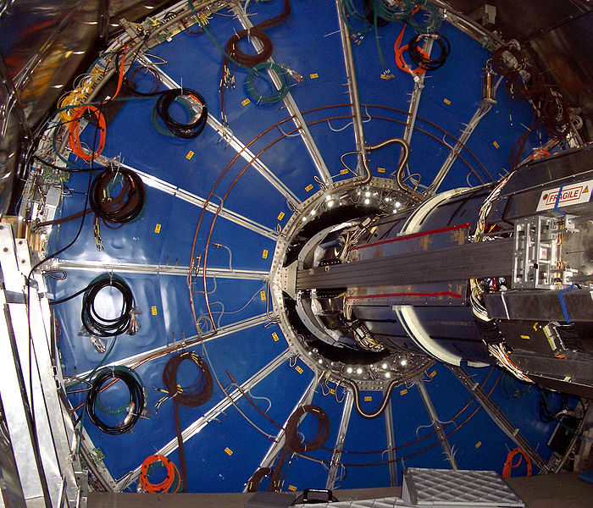
Good timing alone doesn’t do it-
The ALICE TPC:
Drift electrons onto wires that measure where and when for each electron.
Good time resolution would buy nothing if one integrated over a whole (blue) TPC sector- ie didn’t correlate when and where
when and where
Correlated time and space points allow 3D reconstructions

Slide 47
Anode Testing for ABW, Crosstalk,..
ABW
Crosstalk
Razib Obaid, Herve’ Grabas, Dave McGinnis

Slide 48
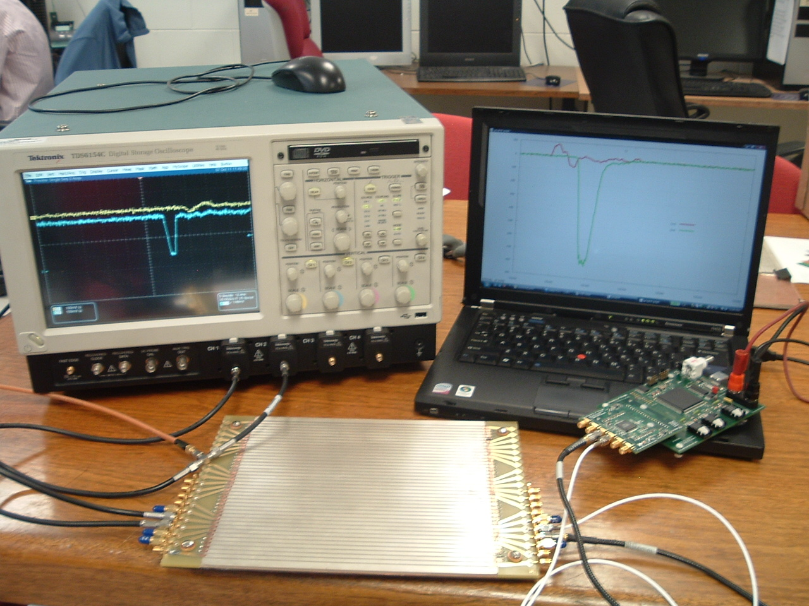
6-channel `Scope-on-a-chip’
Eric Oberla
(grad student)
Real digitized traces from anode
20 GS/scope
4-channels (142K$)
17 GS/PSEC-4 chip
6-channels ($130 ?!)

Slide 49
Signal- want large for S/N
We see gains > 10⁷ in a chevron-pair
Ossy Siegmund, Jason McPhate, Sharon Jelinsky, SSL/UCB
ALD by Anil Mane and Jeff Elam, ANL

Slide 50
Hermetic Packaging
Top Seal and Photocathode- this year’s priority
3 parallel paths
Tile Development Facility at ANL
Production Facility at SSL/UCB
Commercial RFI for 100 tiles
(Have had one proposal for 7K- 21K tiles/yr)

Slide 51
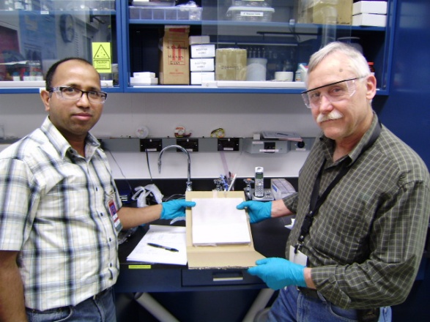
Microchannel Plates
Argonne ALD and test Facilities
In situ measurements of R (Anil)
Femto-second laser time/position measurements (Matt, Bernhard, Razib, Sasha)
33 mm development program
8” anode injection measurements
Anil Mani and Bob Wagner

Slide 52
Microchannel Plates-SSL
SSL (Berkeley) Test/Fab Facilities
Ossy Siegmund, Jason McPhate, Sharon Jelenski, and Anton Tremsin-
Decades of experience
(some of us have decades of inexperience?)

Slide 53
Microchannel Plates
Performance: First, the gain. We see gains > 10⁷ in a chevron-pair;
> 10⁵ in a single plate (attractive possibility for cost/simplicity)
Ossy Siegmund, Jason McPhate, Sharon Jelinsky, SSL/UCB

Slide 54
Microchannel Plates
Performance: burn-in (aka `scrub’)
Measured ANL ALD-MCP behavior
(ALD by Anil Mane, Jeff Elam, ANL)
Measurements by
Ossy Siegmund,
Jason McPhate,
Sharon Jelinsky, SSL/UCB
Typical MCP behavior- long scrub-times

Slide 55
First Pulses From an 8” MCP (!)
Caveats- this is the first time…
TDIITDs- don’t over analyze this
Pulses from the 2 ends of an 8” anode strip
Matt Wetstein, Bernhard Adams, Razib Obaid, Sasha Vostrikov (ANL and UC)

Slide 56
Photocathodes
LAPPD goal- 20-25% QE, 8”-square
2 parallel efforts: SSL (knows how), and ANL (learning)
ANL
Optical stand
Burle commercial
equipment
First cathodes made at ANL

Slide 57
Photocathodes- 2
SSL has years of experience making bialkali photocathodes-
They are our treasury bonds (Swiss francs?) in the LAPPD `portfolio of risk’

Slide 58
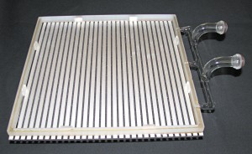
Hermetic Packaging
We have solved sealing over the anode strips
Bottom seal by Joe Gregar, ANL master glass-blower with help from Michael Minot (Minotech, Incom) and Ferro Corp

Slide 59
MCP+Transmission Lines Sampled at Both Ends Provide Time and 2D Space
Field Programable Gate Arrays
(not as shown- PC cards will be folded behind the panel- not this ugly…
Single serial Gbit connection will come out of panel with time and positions from center of back of panel
10-15 GS/sec Waveform Sampling ASICS
8” Tiles

Slide 60
2003- Aspen Exptl Summary Talk
Invitation from Joe Lykken and Maria Spiropulu- led to psec TOF

