Slide 1
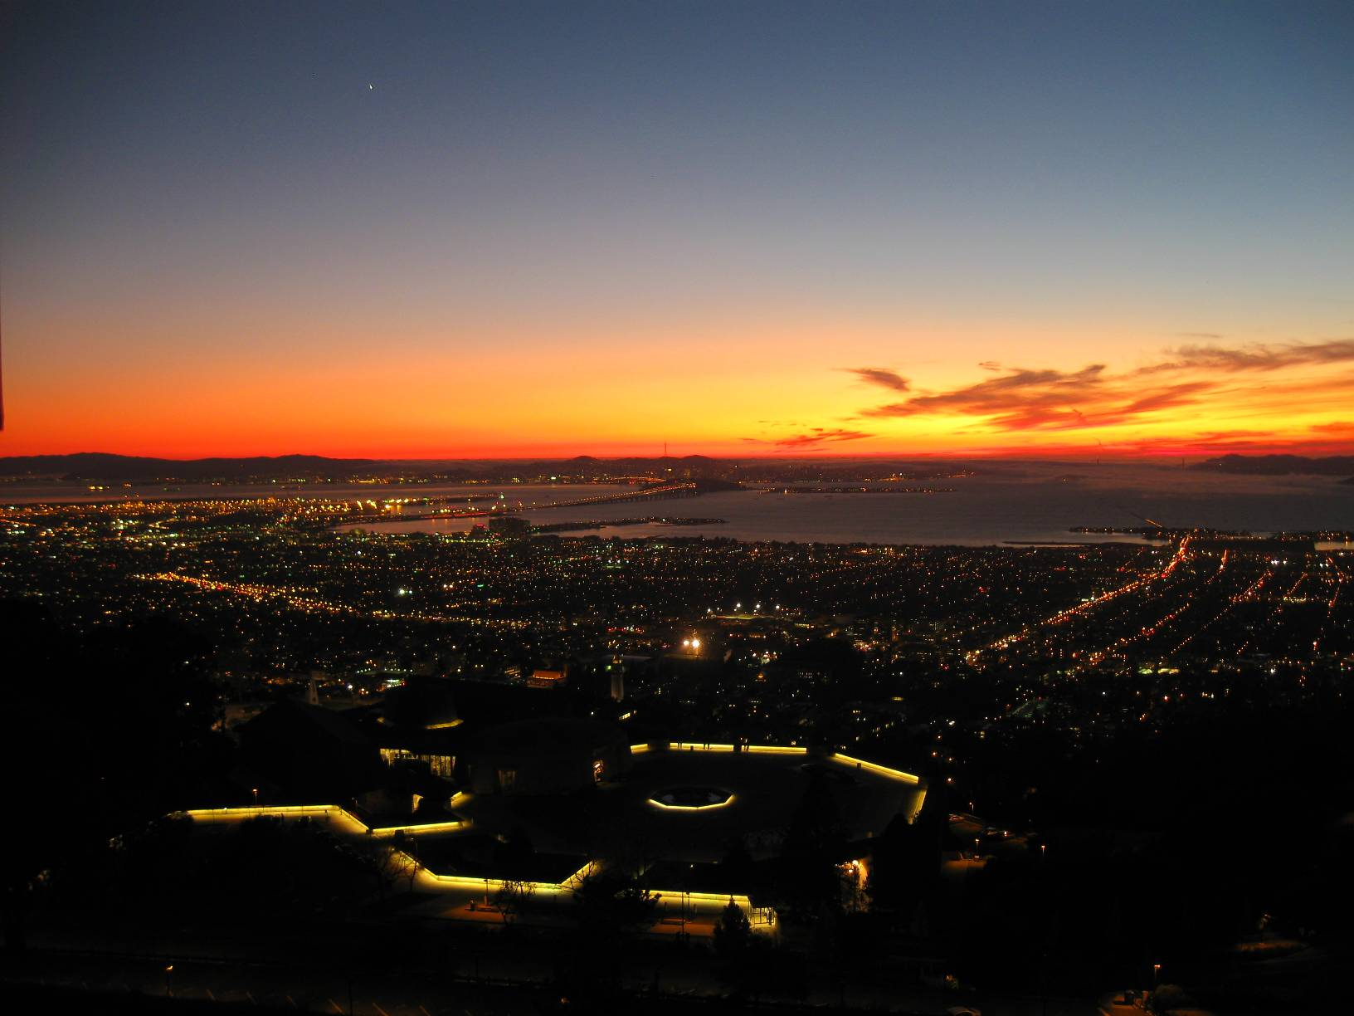
20cm Sealed Tube Schedule at SSL
Ossy Siegmund,
Experimental Astrophysics Group,
Space Sciences Laboratory,
U. California at Berkeley

Slide 2
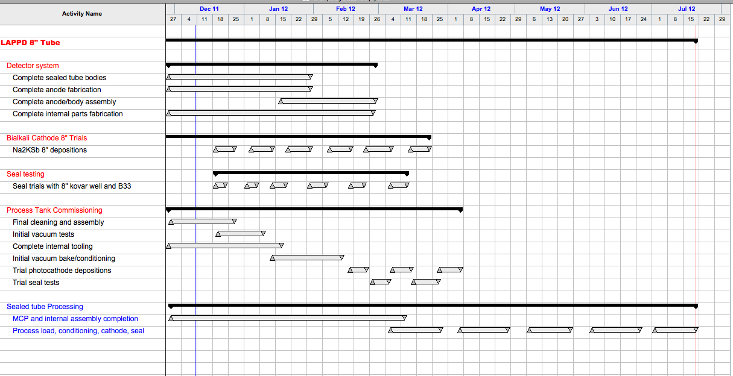
20cm Ceramic Sealed Tube Schedule

