Slide 1
Progress with Bialkali Photocathode Development
Ossy Siegmund, Sharon Jelinsky, Jason McPhate, Joe Tedesco
Experimental Astrophysics Group,
Space Sciences Laboratory,
U. California at Berkeley

Slide 2
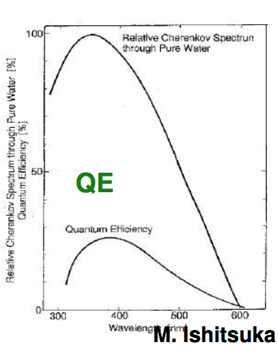
Biakali Cathode - Configurations
Photocathode Operation Schemes
Bialkali is a few 100Å thick, and is nominally a deposition as a semitransparent layer on the window, with a proximity gap to the first MCP.
Nominal Cherenkov emission spectrum compared with bialkali

Slide 3
Typical Bi-Alkali Cathode Characteristics
Lyashenko, Chicago 7/09
2*10⁶Ohm/square
6*10⁹Ohm/square
Cathode Noise vs Temp expect 10,000 to 40,000 events/sec for 8” tube bialkali!
QE and resistivity for various bialkali’s We will use Na₂KSb – Why? Resistivity,
noise, temperature robustness, uniformity.

Slide 4
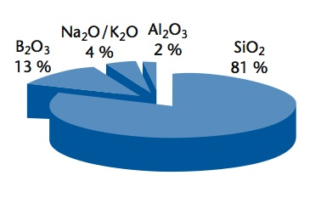
Window of choice B33 - General Parameters
The cathode substrate, window or window coating, affects the photocathode performance. Borofloat B33 Borosilicate has been
tested, and it is a good photocathode substrate. BUT - it has Tin
diffused into one side, so we polish it. Anti-reflection coatings
not baselined, (5 to 9% reflectance in bandpass).
Samples coated by Joe Libera, measured by Lisa Pawlowicz
_{Refractive index} _{@400nm}
_{B33 1.47}
_{Air ~1.0}
_{Water ~1.32}
B33 Composition
B33 Transmittance is typical of boro-silicate glasses. We have found no good under-layers yet. Will try MnO.

Slide 5
Bialkali Cathode Development Program
Small window cathode development, 1.22” samples, 4 per run
Process samples to optimize QE and bandpass
Study Na₂KSb, K₂CsSb cathodes
Used several substrate materials, SiO₂, verified B33
Tested MgO/ITO/conductor underlayer for cathodes
Large size window cathode study, 8.7” windows.
Developed source alkali design for large cathodes
Developing techniques to make larger area uniform QE
Optimization cathode QE levels started
Decide if metal conductor underlayer is needed
Test window metalization and sealing techniques
Notes:
The sensitivity of the activated photocathode is considerably higher, with a quantum efficiency of as high as 37% at about 450 Å and a sensitivity cut off energy of about 6.2 eV. The observed decrease of sensitivity at 988 and 520 Å (and probably not observed at ~670 Å) is likely to correspond to 2xE_{gap}+E_{aff,}, 4xE_{gap}+E_{aff,}, and 3xE_{gap}+E_{aff,}, respectively. A much better spectral continuity of the illumination source is required in order to study the UV absorption fine structure.

Slide 6
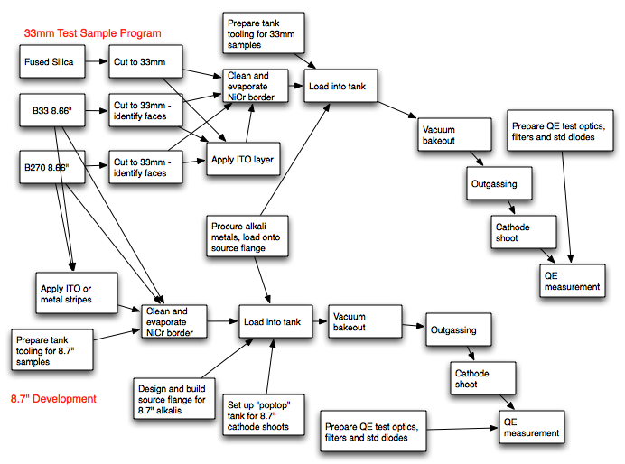
Work Flow Program for Bialkali
Cathode Development
We have
run all the processes. Now we need to optimize the 20cm depositions.

Slide 7
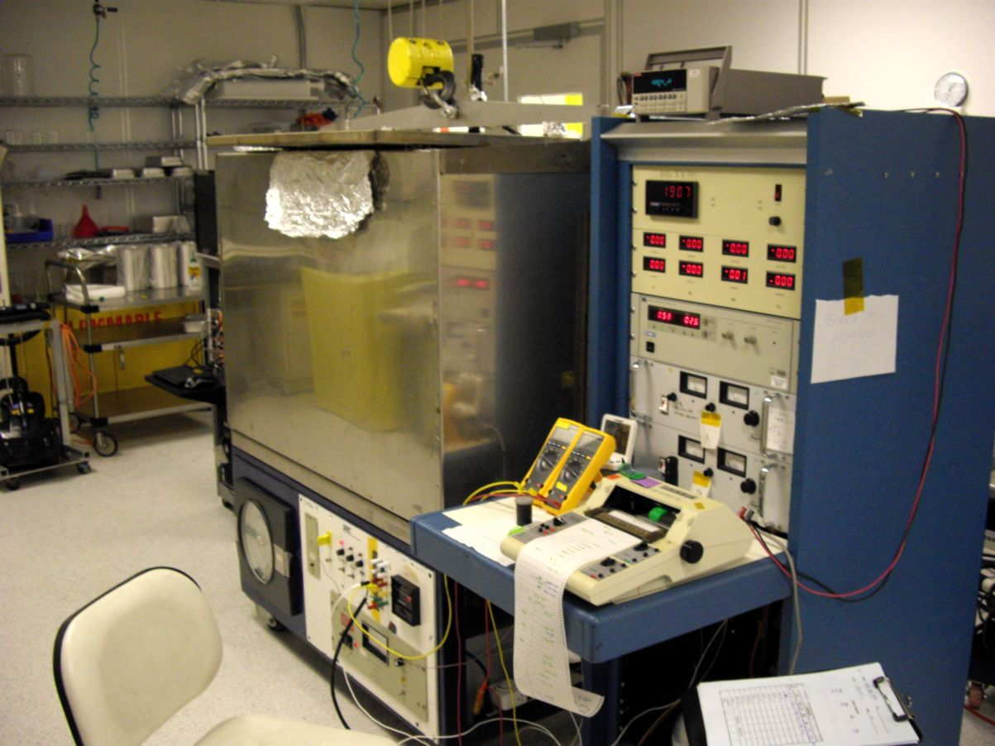
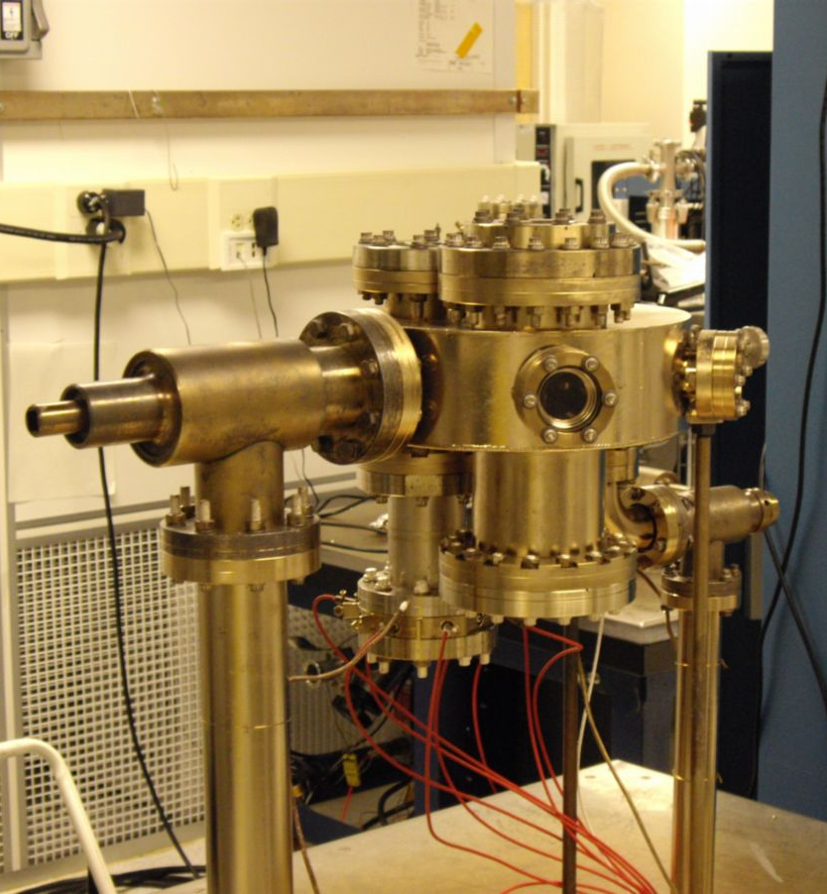
Tube Lab, 1.2” old sample test/process station.
Small tank used to process alkali cathodes (33mm) and tubes of small area. Can take 4-8 samples/run. 7 runs done, more than 30 substrate coatings.
Small sample test runs
Substrate material tests
7

Slide 8
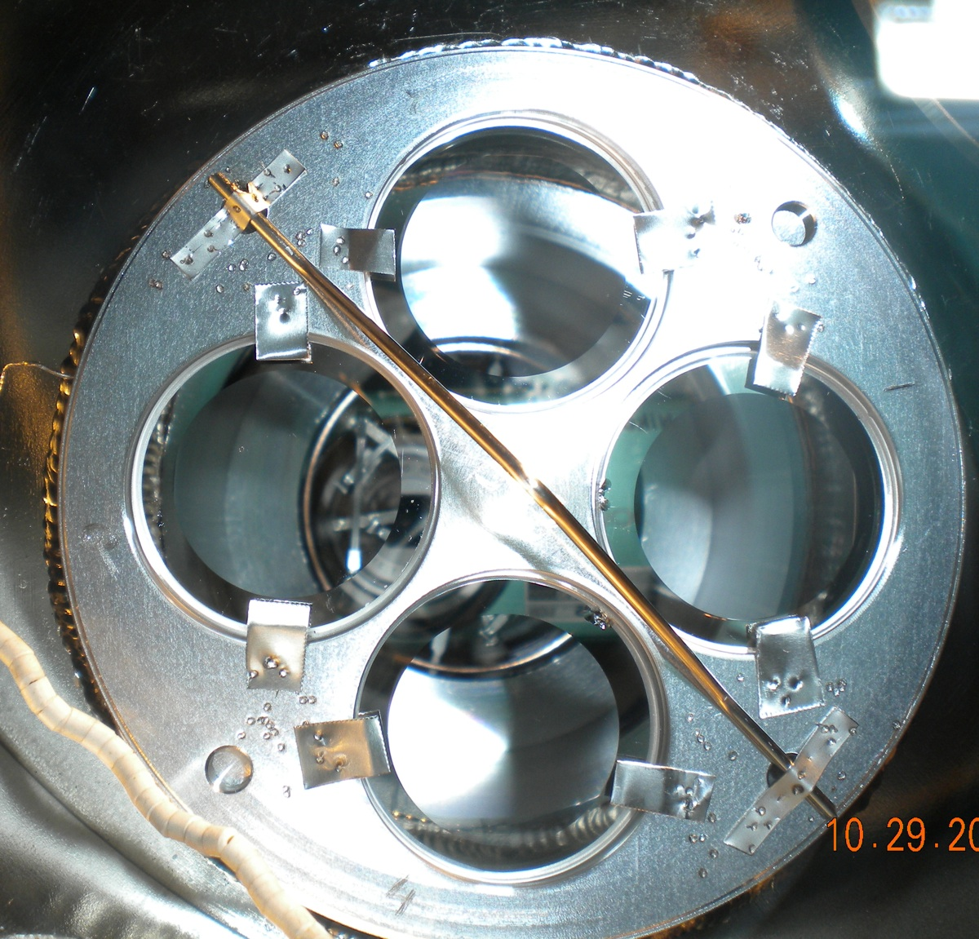
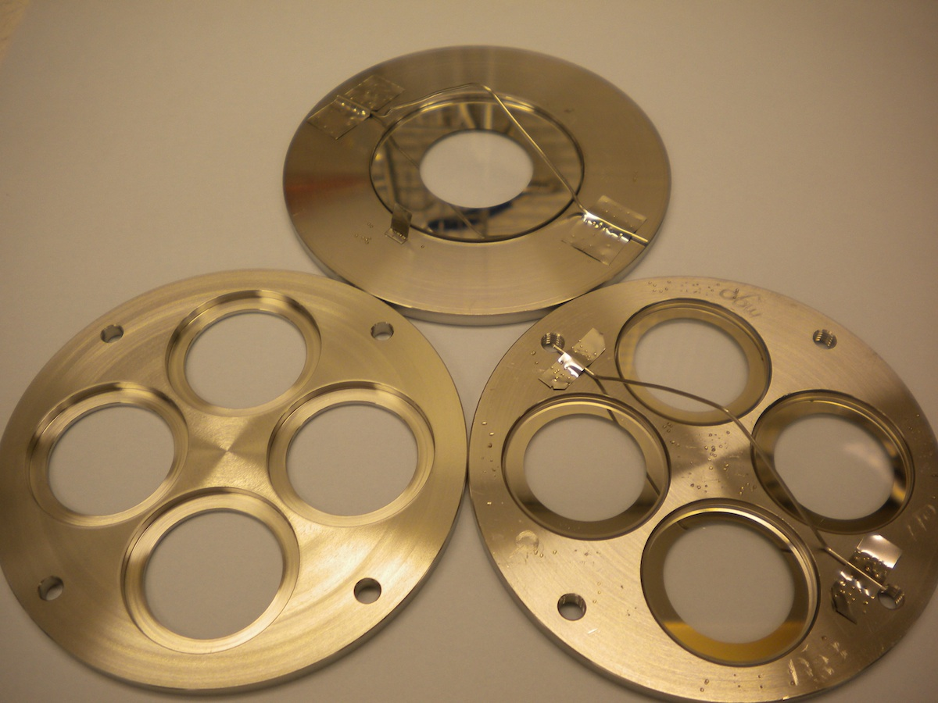
Bialkali Cathode Process Development Program
Small window cathode development, 1.22” samples
Processed samples to optimize QE and bandpass
Window holder inside tank
Window holders and mask
We cut up 8.7” B33 windows to make ~50 ea 1.22” test samples. Inconel annular electrodes were evaporated just as they would be for In seals
Notes:
The sensitivity of the activated photocathode is considerably higher, with a quantum efficiency of as high as 37% at about 450 Å and a sensitivity cut off energy of about 6.2 eV. The observed decrease of sensitivity at 988 and 520 Å (and probably not observed at ~670 Å) is likely to correspond to 2xE_{gap}+E_{aff,}, 4xE_{gap}+E_{aff,}, and 3xE_{gap}+E_{aff,}, respectively. A much better spectral continuity of the illumination source is required in order to study the UV absorption fine structure.

Slide 9
Bialkali Photocathode Sample Tests
Cathode test runs with KCsSb and Na₂KSb cathodes on borofloat-33 windows. Na₂KSb >20% QE achieved, QE uniformity better than ± 15%.
Bialkali test cathodes made on polished 31mm B33 windows gave the best results. The KCsSb does not perform as well as Na₂KSb in the transfer cathode situation expected for the 8” tubes. Na₂KSb hot, right after deposition, also improves after cool down.

Slide 10
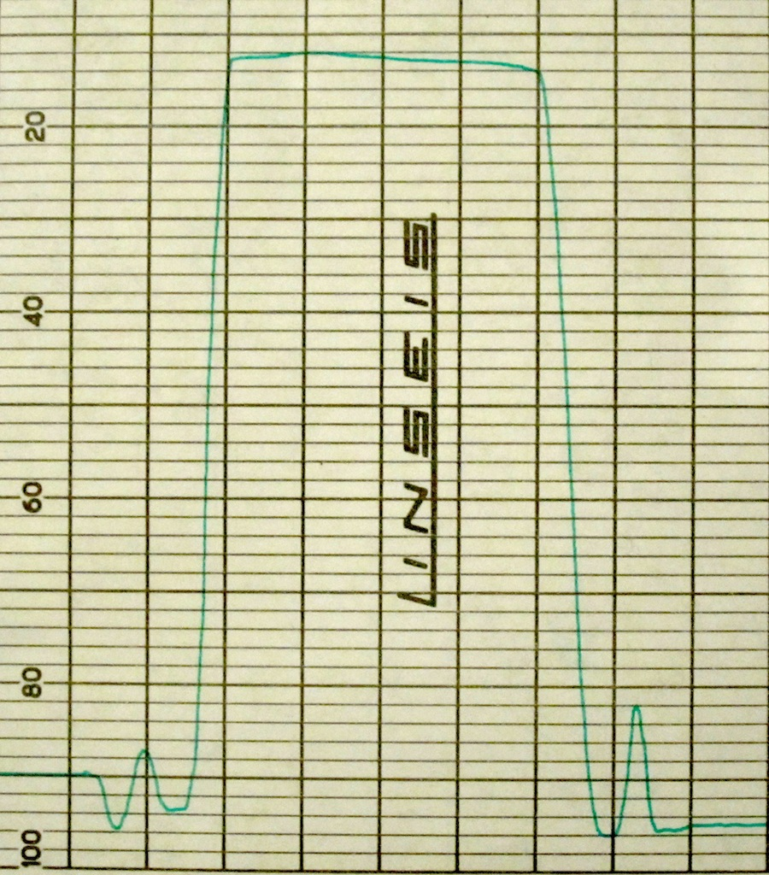
Cathode run #6B, Na₂KSb Uniformity
845
B33 substrate, 1” aperture, 395nm light, QE uniformity is good
839
842
848
822

Slide 11
Cathode/Substrate Materials Summary
ITO and MgO, 5nm are QE are deficient
No problems with inconel evaporated borders good adhesion/conduction
K₂CsSb cathode fabrication is problematic, lower temp
non-uniformity, less stability, poor conductivity, more noise.
B33 is a good substrate material
Going to try MnO (ALD, and sputtered) as underlayer to enhance QE
Work with Na₂KSb as baseline, Inconel stripes if needed, arranged on same “X” as support. OK for rigorous cleaning, high temp, stable, uniform, high conductivity, good QE.
Notes:
The sensitivity of the activated photocathode is considerably higher, with a quantum efficiency of as high as 37% at about 450 Å and a sensitivity cut off energy of about 6.2 eV. The observed decrease of sensitivity at 988 and 520 Å (and probably not observed at ~670 Å) is likely to correspond to 2xE_{gap}+E_{aff,}, 4xE_{gap}+E_{aff,}, and 3xE_{gap}+E_{aff,}, respectively. A much better spectral continuity of the illumination source is required in order to study the UV absorption fine structure.

Slide 12
8” Cathode Process Development
Large window cathode development, 8.7” square
Commissioned 8” cathode/window seal process tank
Objectives:-
Repeat small sample depositions for verification
Verify alkali sources for large cathode areas
Confirm 8” wet cleaning and plasma cleaning processes
Test metal stripe/MnO underlayers for cathodes
Develop techniques to make 8” area uniform QE
Optimize cathode QE levels and test stability and uniformity
Trial window seals on 8.7” “frames”
Then:-----
Transfer techniques to large tube processing station
Notes:
The sensitivity of the activated photocathode is considerably higher, with a quantum efficiency of as high as 37% at about 450 Å and a sensitivity cut off energy of about 6.2 eV. The observed decrease of sensitivity at 988 and 520 Å (and probably not observed at ~670 Å) is likely to correspond to 2xE_{gap}+E_{aff,}, 4xE_{gap}+E_{aff,}, and 3xE_{gap}+E_{aff,}, respectively. A much better spectral continuity of the illumination source is required in order to study the UV absorption fine structure.

Slide 13
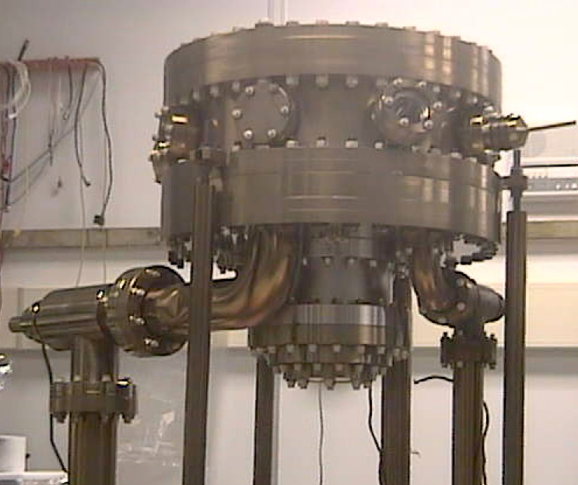
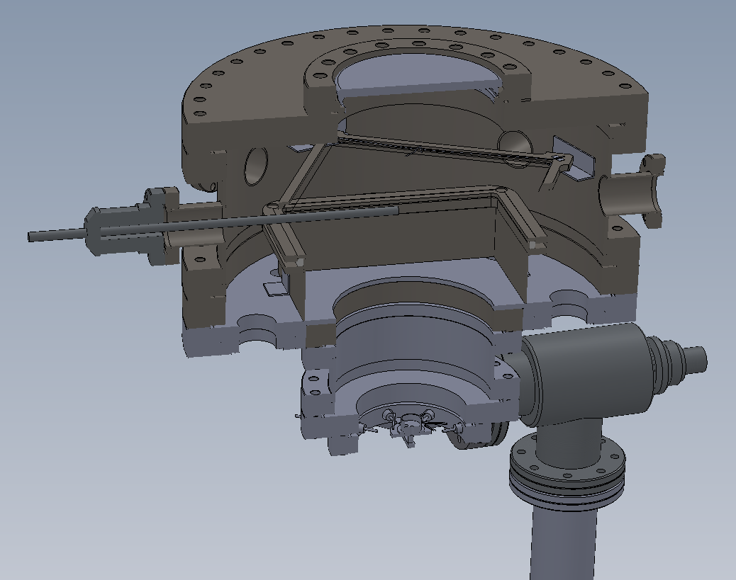
8.7” Photo-Cathode / Seal test Chamber
8.7” Square PC/seal test process chamber with 14” Dia. Capability 16.5” Dia. Chamber on exact same process cart as the previous chamber.
16.5” Flange Chamber Access
Alkali sources
All-Metal Valves
Larger 16” flange tank, to test
Quantum efficiency
QE Uniformity
Seal tests
Forming Well - 6”
Ion Pump Port

Slide 14
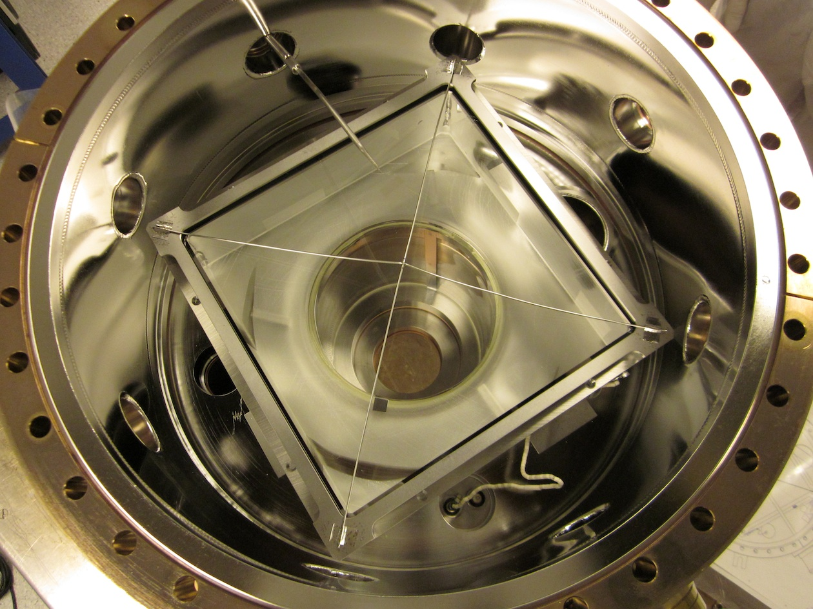
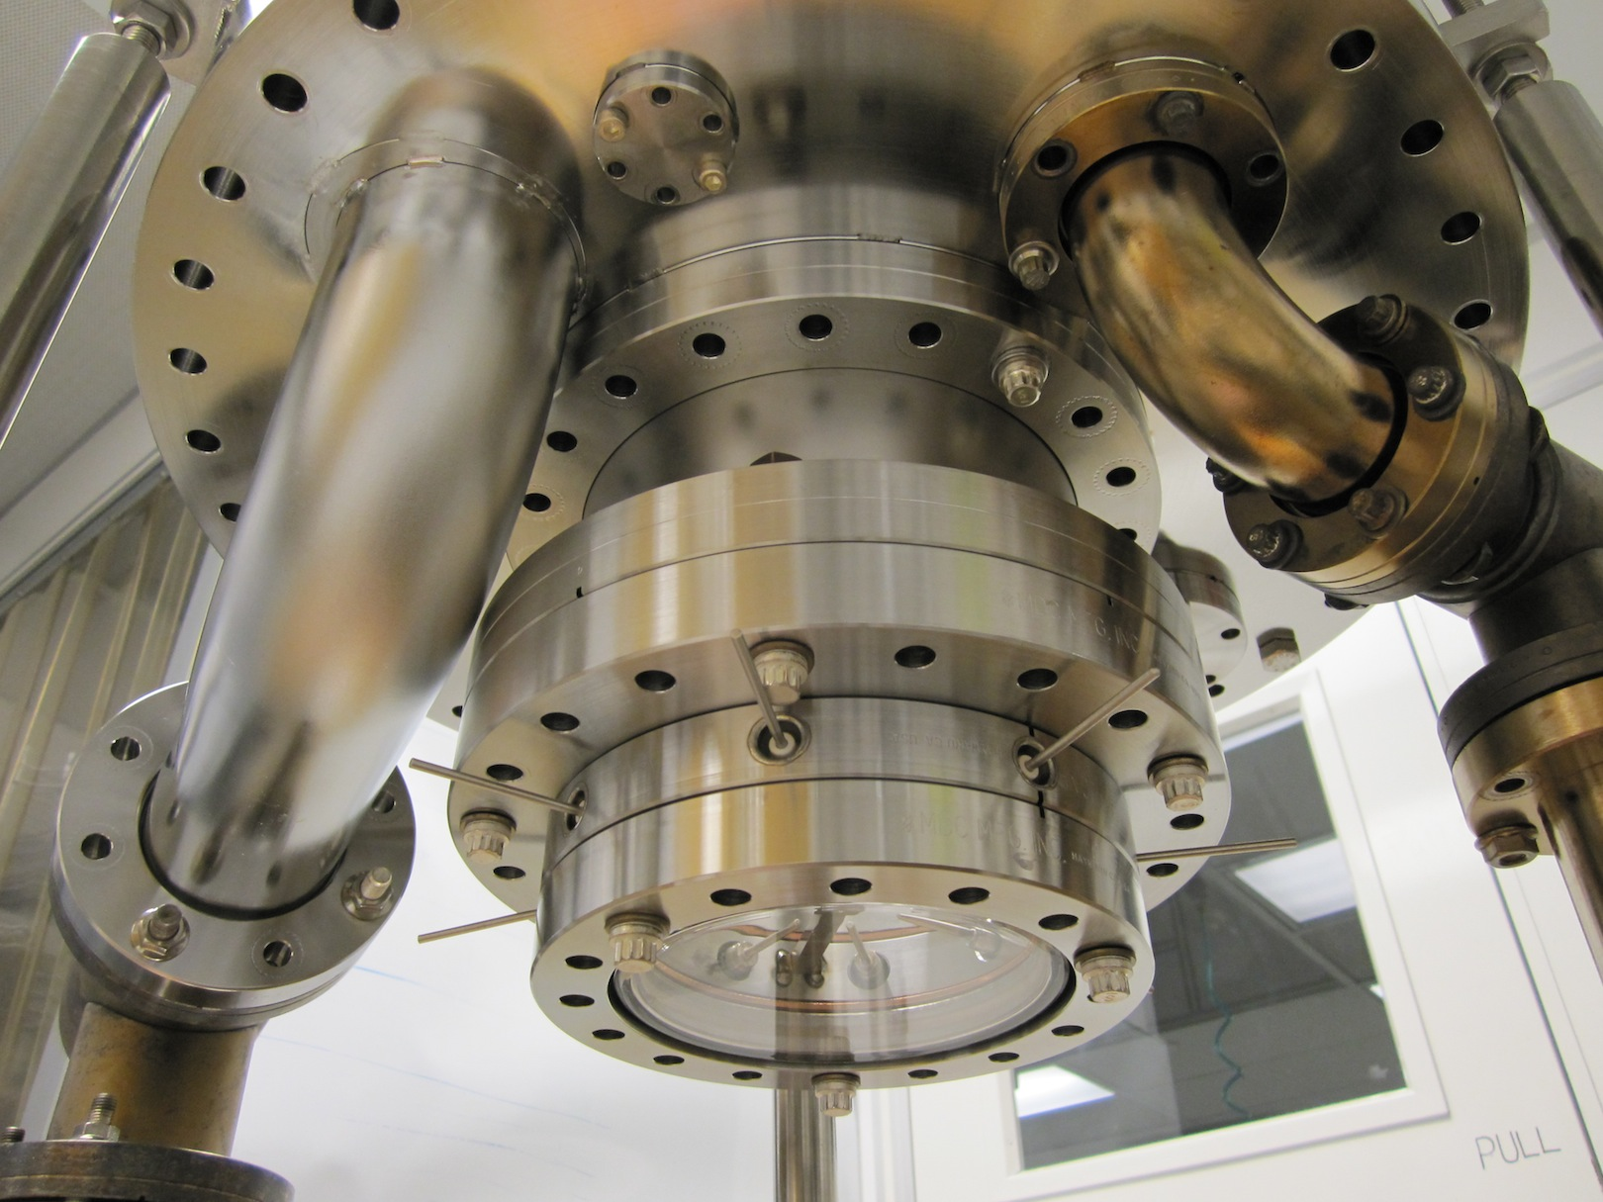
8.7” Photo-Cathode / Seal test Chamber
Final assembly done, spent 3 weeks in initial cleanup bakeout up to 375°C to get the chamber conditioned.
Used SAES alkalis & SbPt beads. Employed old source flange to verify process, then move to new larger sources
and flange for next run.

Slide 15
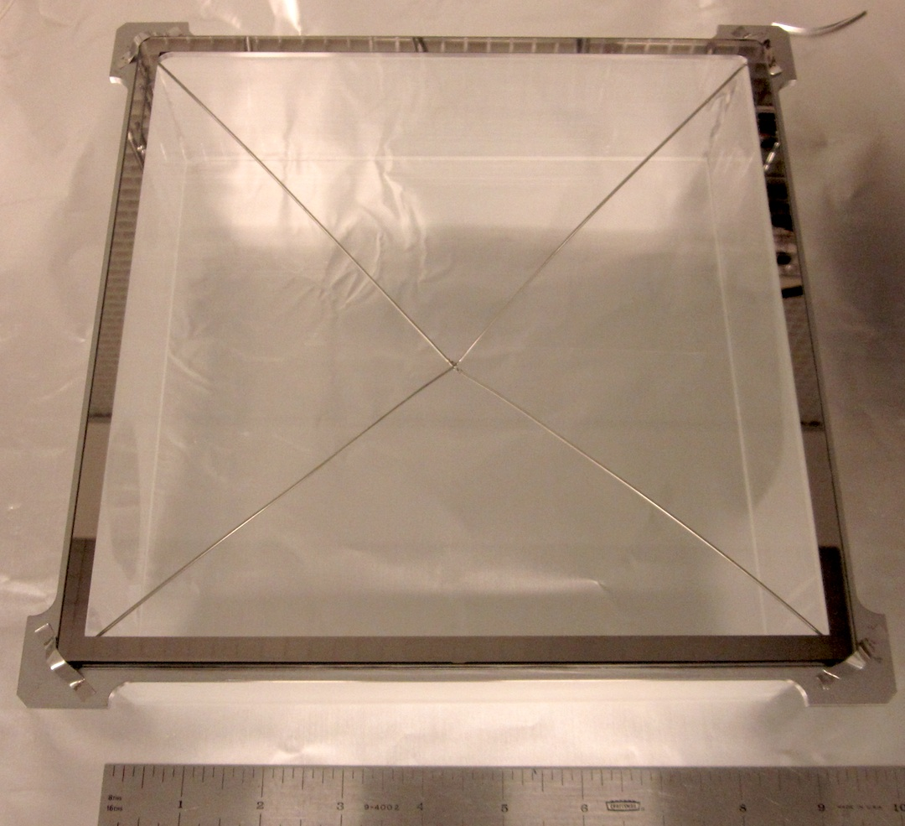
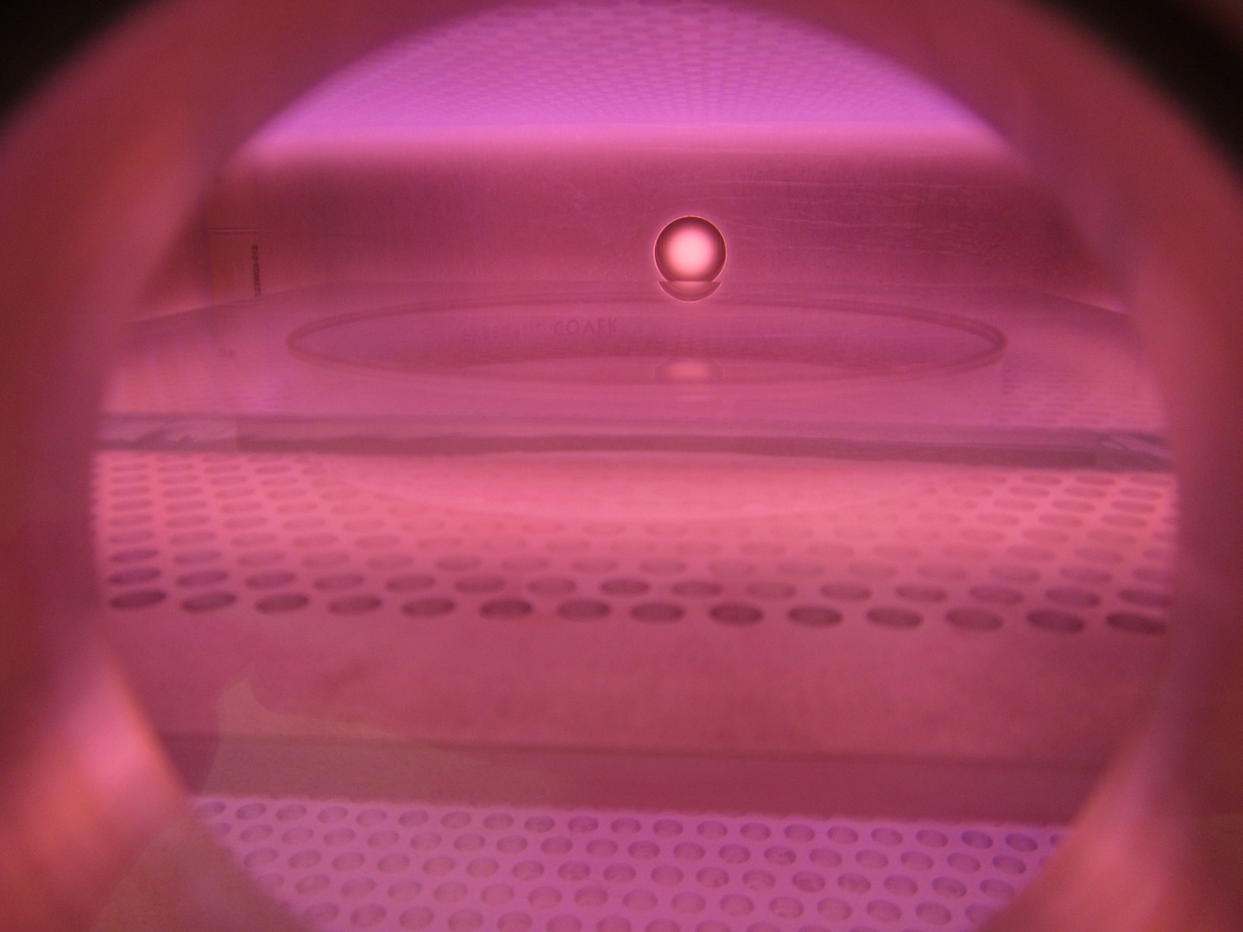
Preparation of 8.7” B33 Windows for Cathodes
All the tooling is in place. We have wet cleaned, plasma cleaned, and evaporated NiCr on a window, and loaded into the holder for photocathode processing.
NiCr electrode border on B33
Plasma cleaning

Slide 16
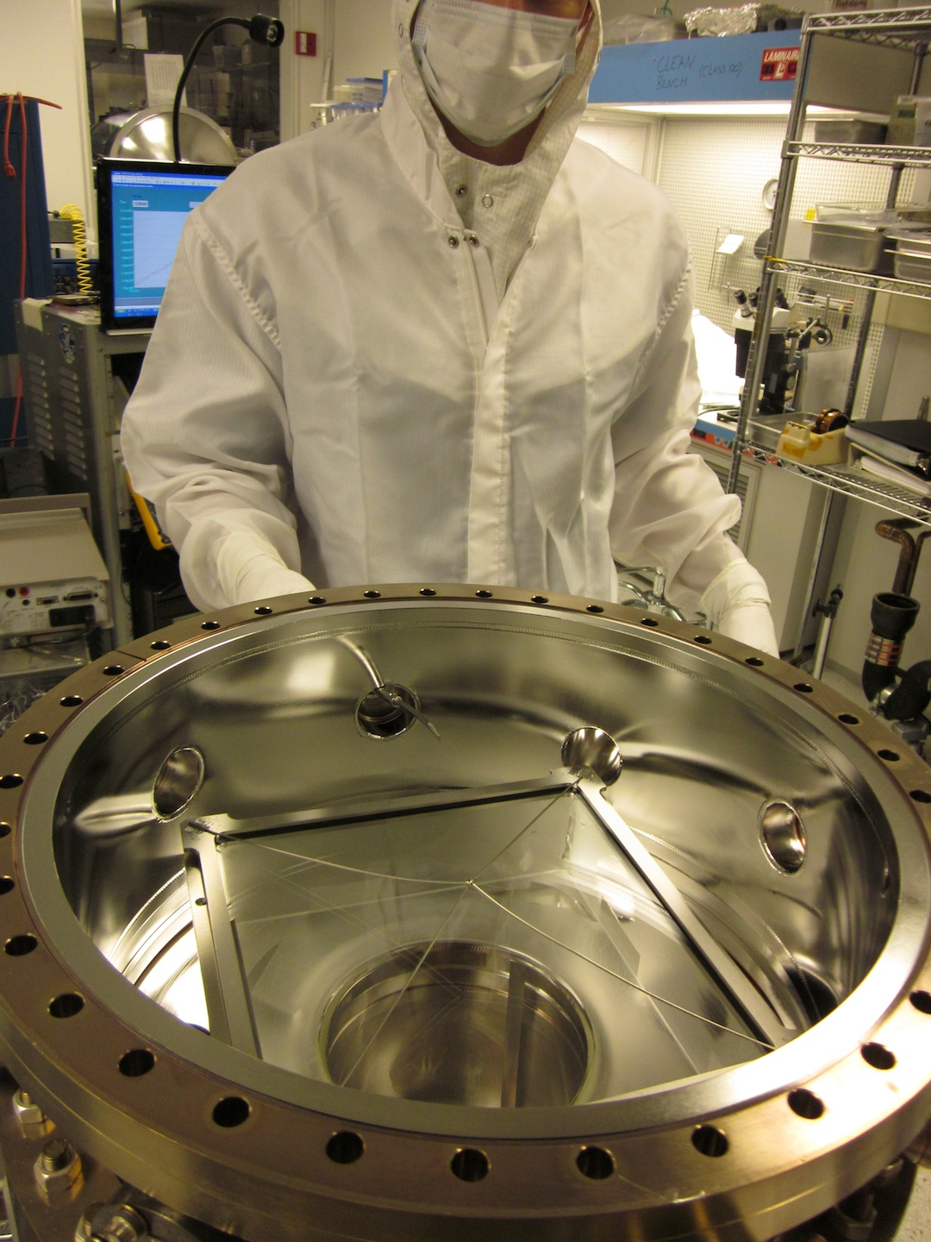
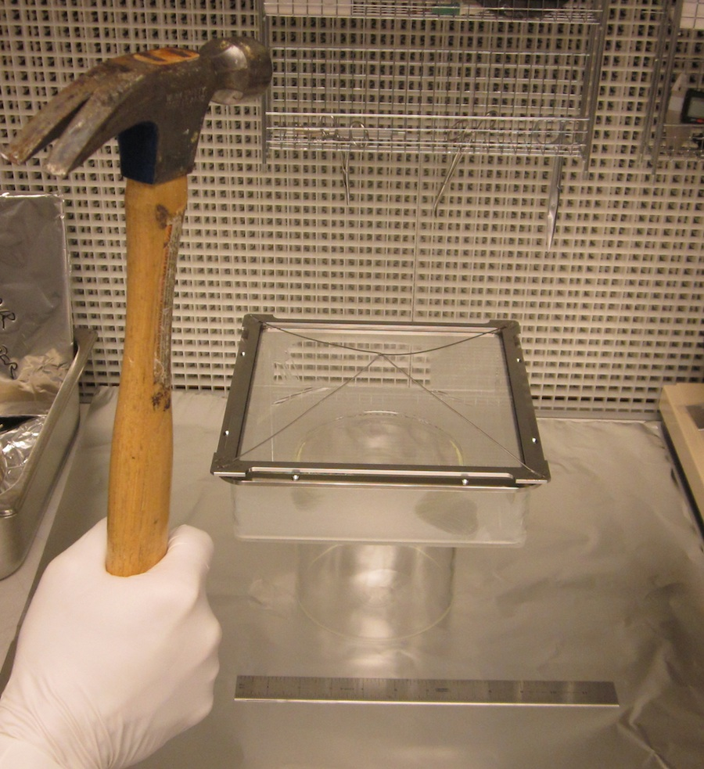
8” Photocathode First Process, System Load
Final window adjustments
8.7” window loaded

Slide 17
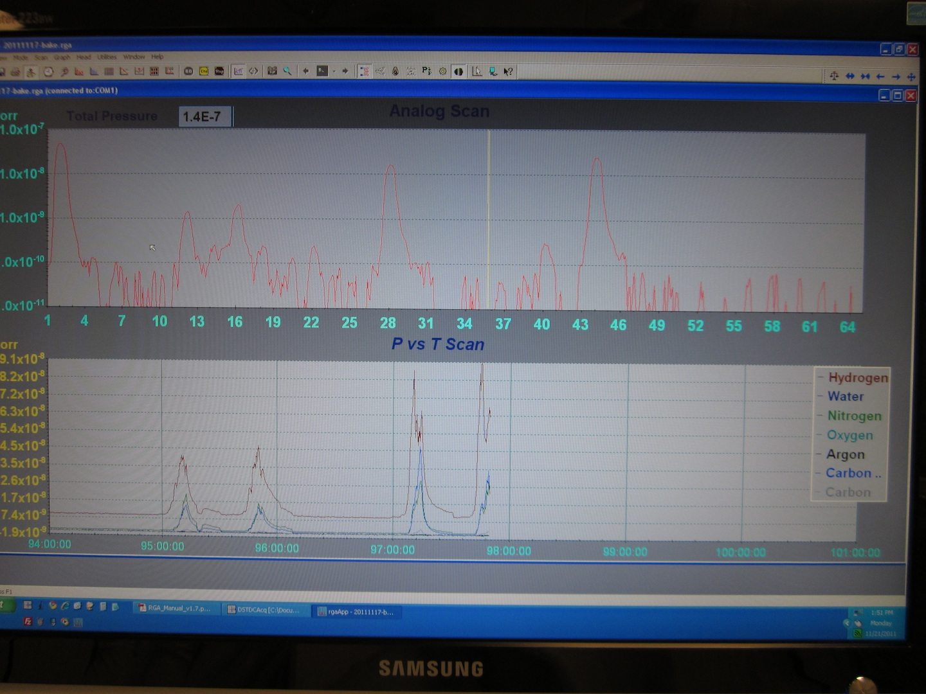
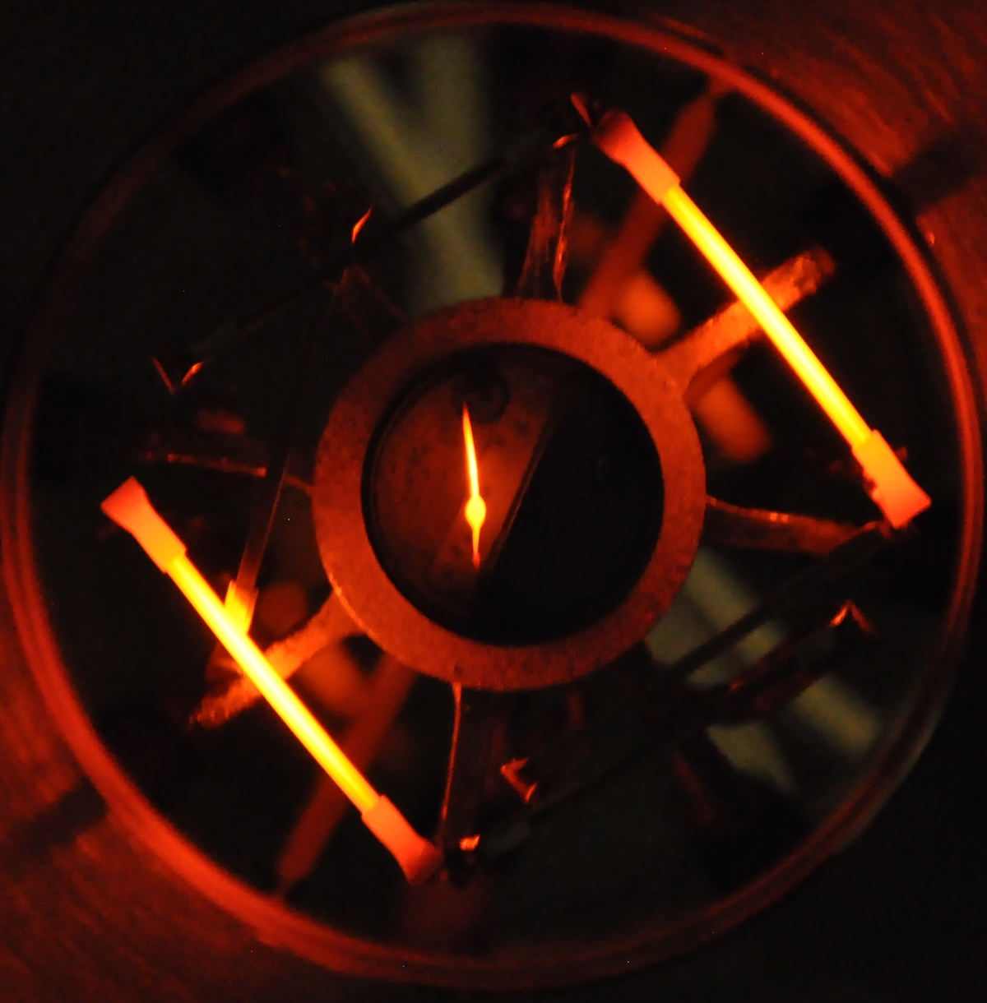
Photocathode Preparation and Deposition
Outgassing of SAES Alkalis
Na
K
Alkali / Sb sources in action

Slide 18
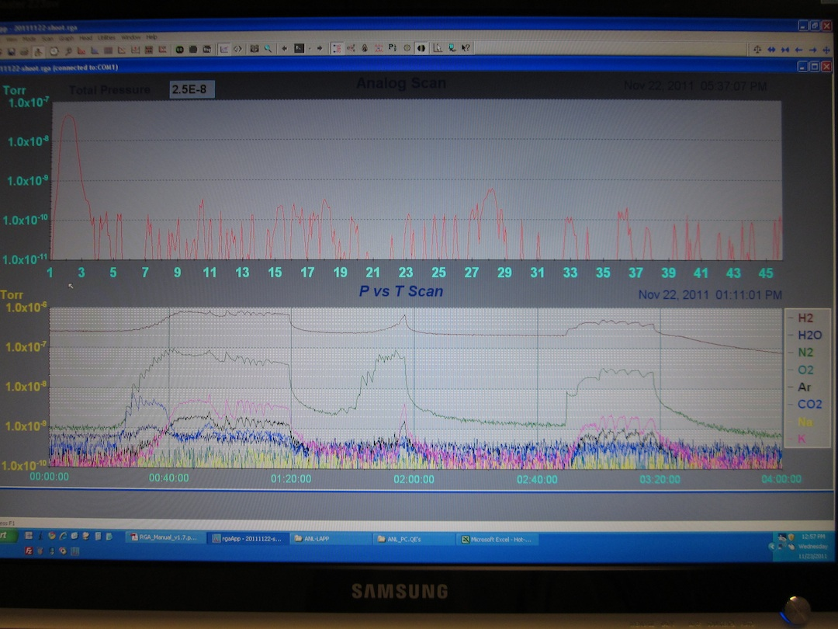
Photocathode Deposition
K
Sb
Na
K
Sb

Slide 19
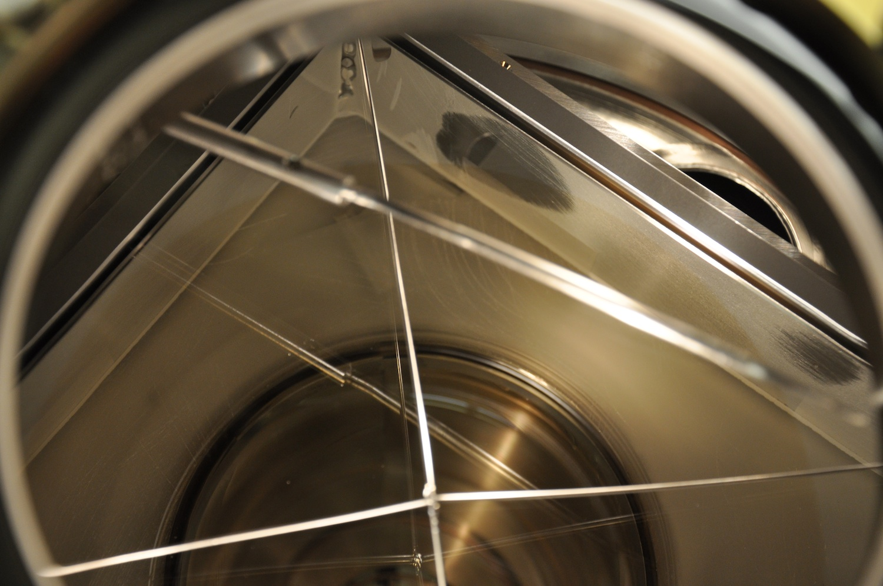
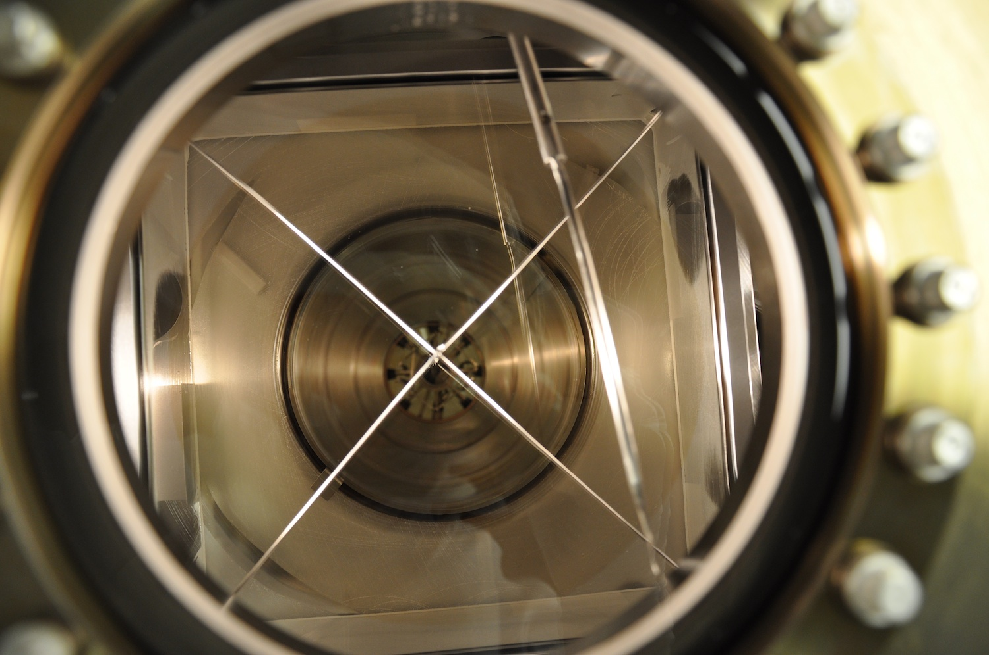
First 8” 7.5” Bialkali Photocathode
Extra flange to couple alkali flange increased distance and caused vignetting of the deposition. No proper contact with cathode! Fix and repeat!
Uniformity is good
8”
Relative %
transmission
of PC vs
position
(~corrected for
window transmission)
82
82
83
82
81
82.5
81
79
79
Photocathode Process

Slide 20
8in Photocathode First Try
8” PC/Seal Test Chamber
<10⁻⁹ Torr base vacuum, RGA operational, fully baked
Chamber configured for 8in depositions
5mm thick, 8.7” polished B33 window
NiCr border electroded
Deposited Na₂KSb photocathode
RGA record for entire process
Very good first run – BUT cathode not big enough – only 7.5”, lots of useful data

