Slide 1
PSEC5 Technical Review
Andrew Arzac
Ahan Datta
Jinseo Park
Notes:
Hello again. I will present the details of the analog part of the chip for 30 minutes, and after that Ahan and Andrew will present the digital part for another 15 minutes.

Slide 2
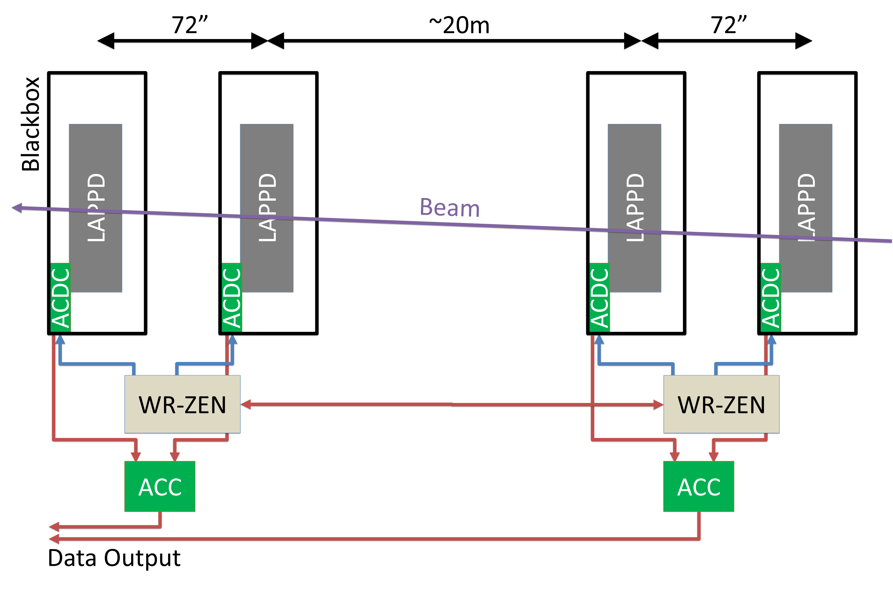
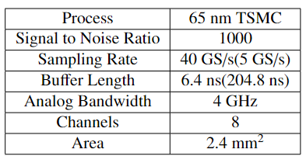
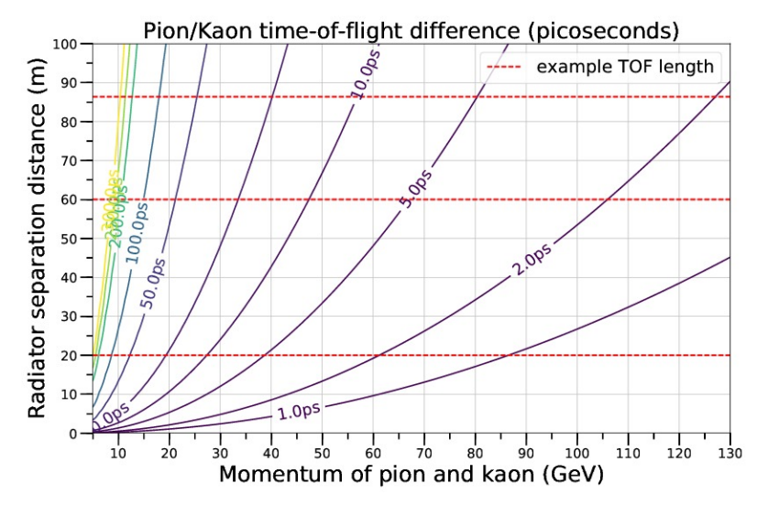
Introduction

Slide 3
Table of Contents
Single Channel Overview
Signal Entry
Input Source Follower
Sampling Switch
Sampling Capacitor
Output Source Followers
Sampling Switch Control
Clock Distribution
SPI communication
Pin Layout

Slide 4
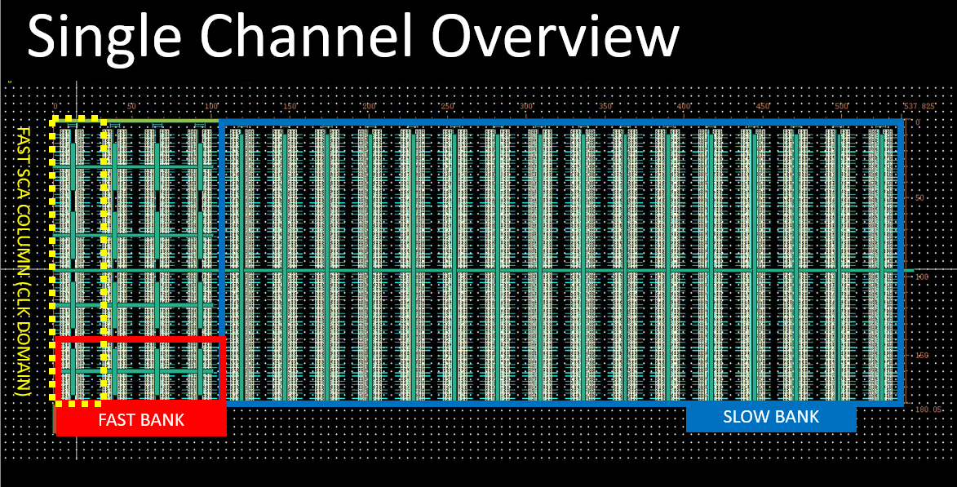
10GHz 180˚
10GHz 270˚
10GHz 90˚
10GHz 0˚
5GHz, 1024 Samples
64 Samples

Slide 5
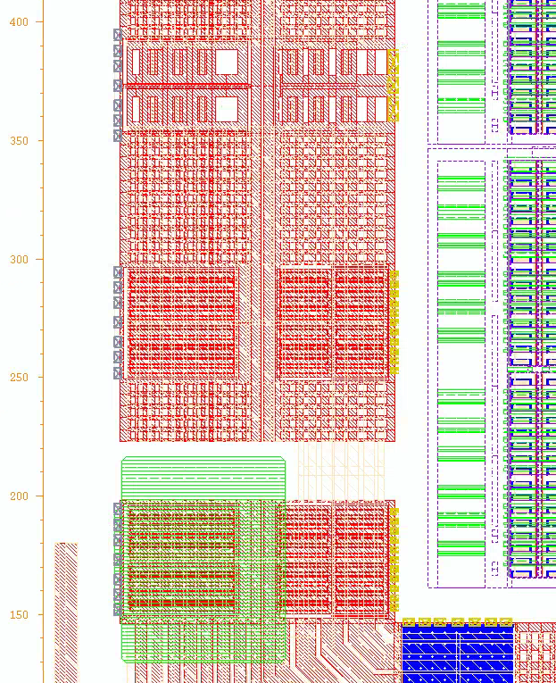
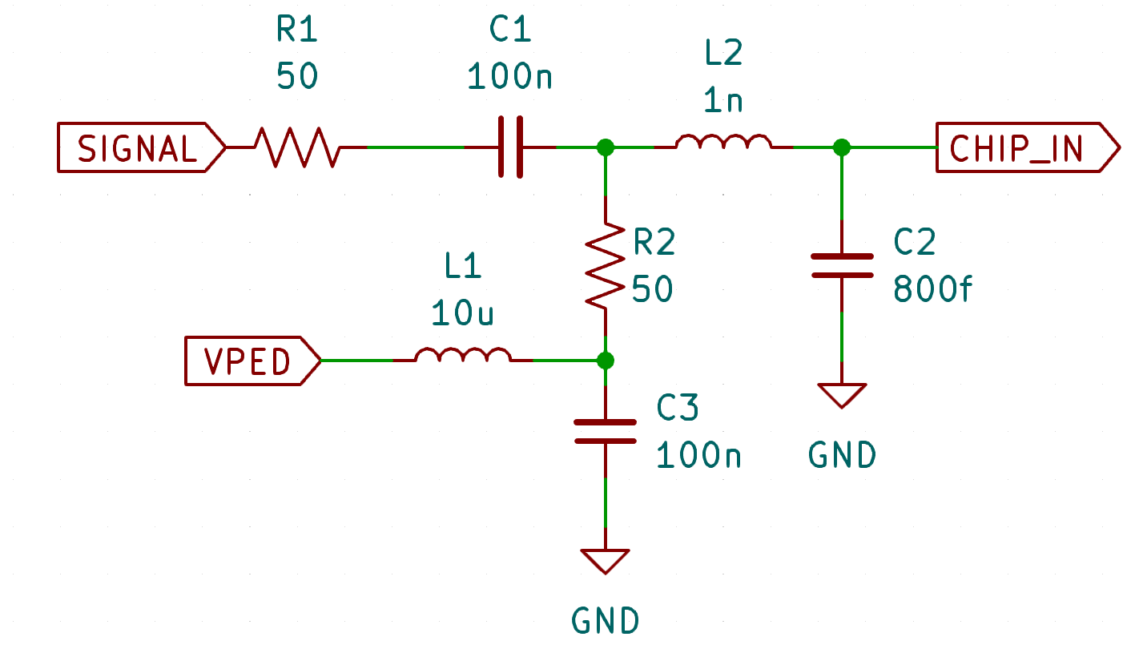
2. Signal Entry
ESD Device
Equiv. of
Wire Bond + Pad + ESD
Onboard Components
Analog/Digital
Domain Separation
Custom Wire Bond Pad,
90μm×70 μm
(Pitch 100 μm)

Slide 6
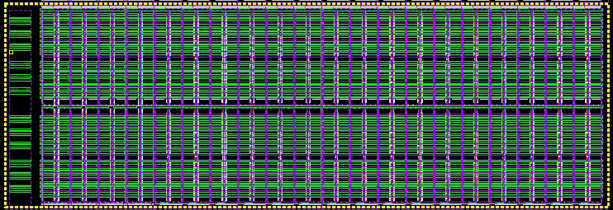
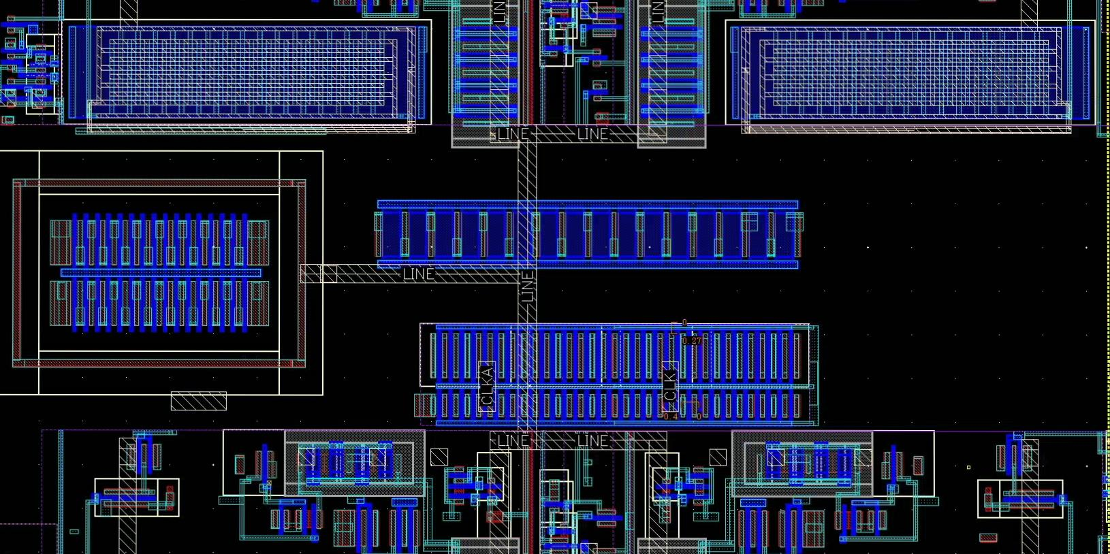
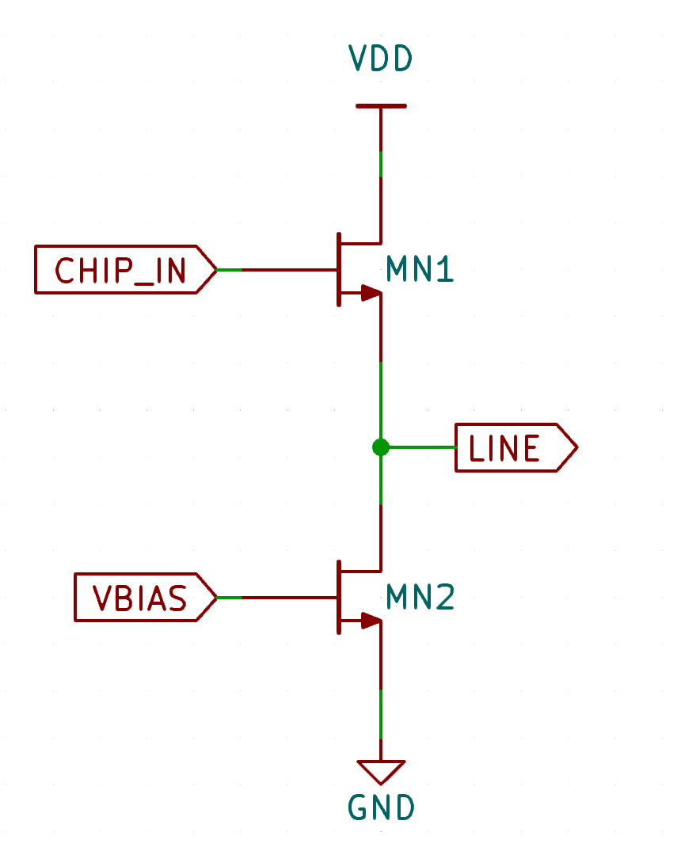
3. Input Source Follower
5 source followers
4 for each fast SCA column(4GHz BW), 1 for the slow SCA bank(1.5GHz BW)
Line(Signal To Capacitors)
MN1(1μm×32)
MN2

Slide 7
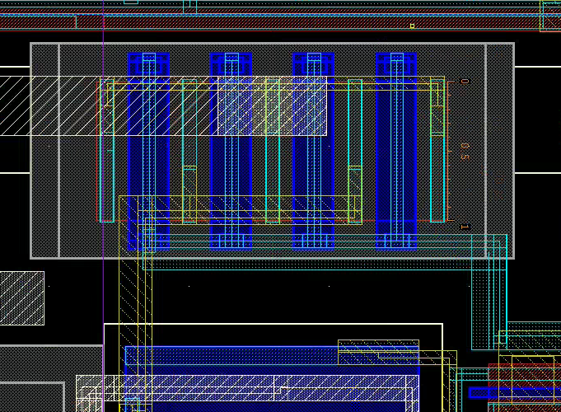
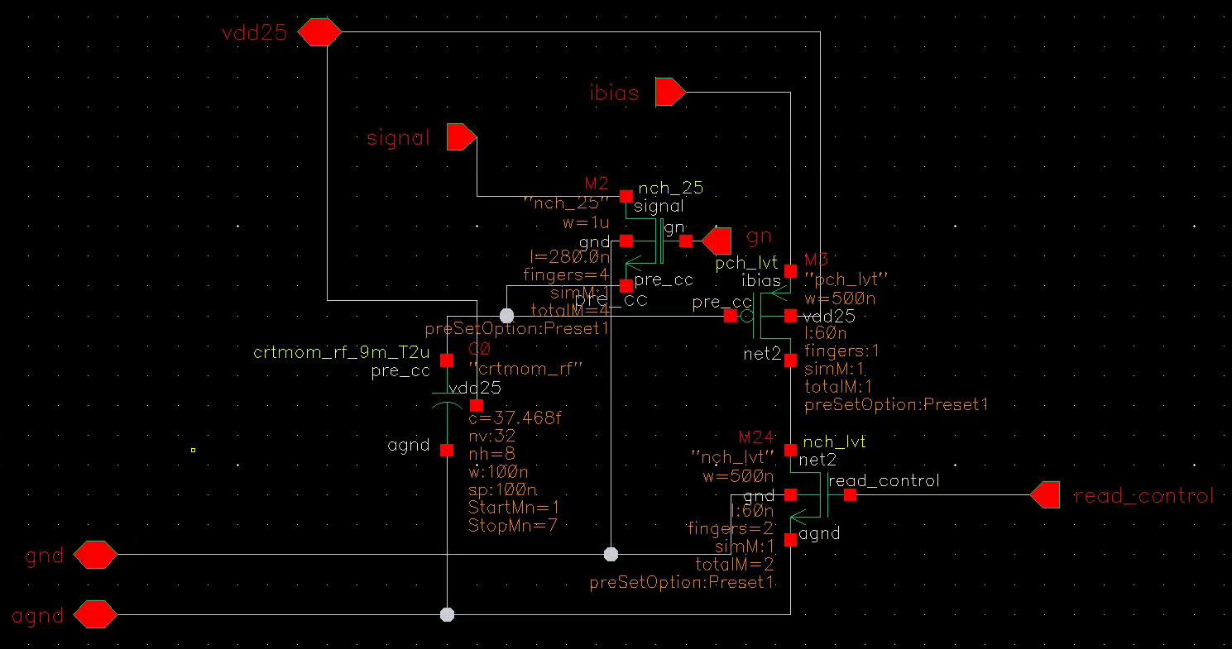
3. Sampling Switch
Thick Oxide
SIGNAL
gn(Control)
Capacitor

Slide 8
3. Sampling Switch
 | Cmos | Cmos-2.5v | Cmos-lvt | Nmos | Nmos-2.5v | Nmos-lvt | Nmos-hvt
V Range | 1.2v | 2.5v | 1.2v | <1.2v* | <2.5v* | <1.2v* | <1.2v*
Cutoff Freq** | 0.6GHz | 3.4GHz | 2.3GHz | 1GHz | 6GHz | 3.4GHz | <0.1GHz
Length | 60n | 280n | 60n | 60n | 280n | 60n | 60n
Hold Time**** | 68ns | >10us | 1.7ns | 71ns | >20us | 2.6ns | 2us
*Higher impedance as the signal voltage reaches vdd, noticeable at V>0.6vdd
****ff corner, 10% decay after sampling vdd.
**(Capacitor V Amplitude / Signal V Amplitude) reaches 0.7. ss corner, 0.1V amplitude , DC bias = 0.5vdd

Slide 9
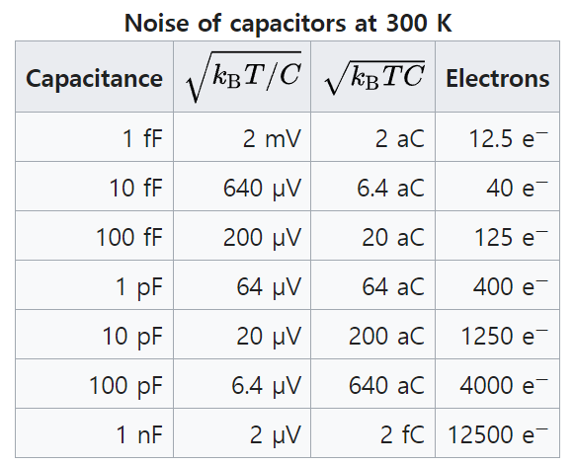
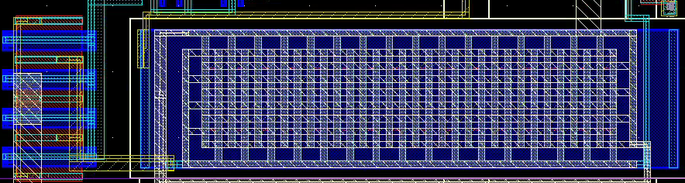
4. Sampling Capacitor
NWELL(2.5V)
AGND SHIELD
POLY
SHIELD
(2.5V)
AGND SHIELD
35fF Metal-Oxide-Metal, M1-M7

Slide 10
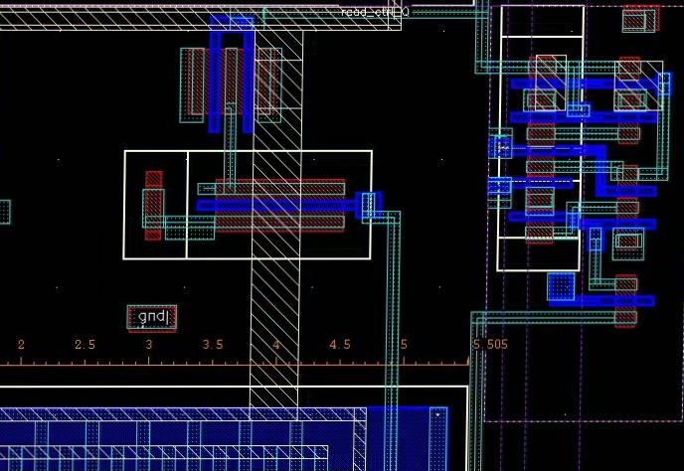
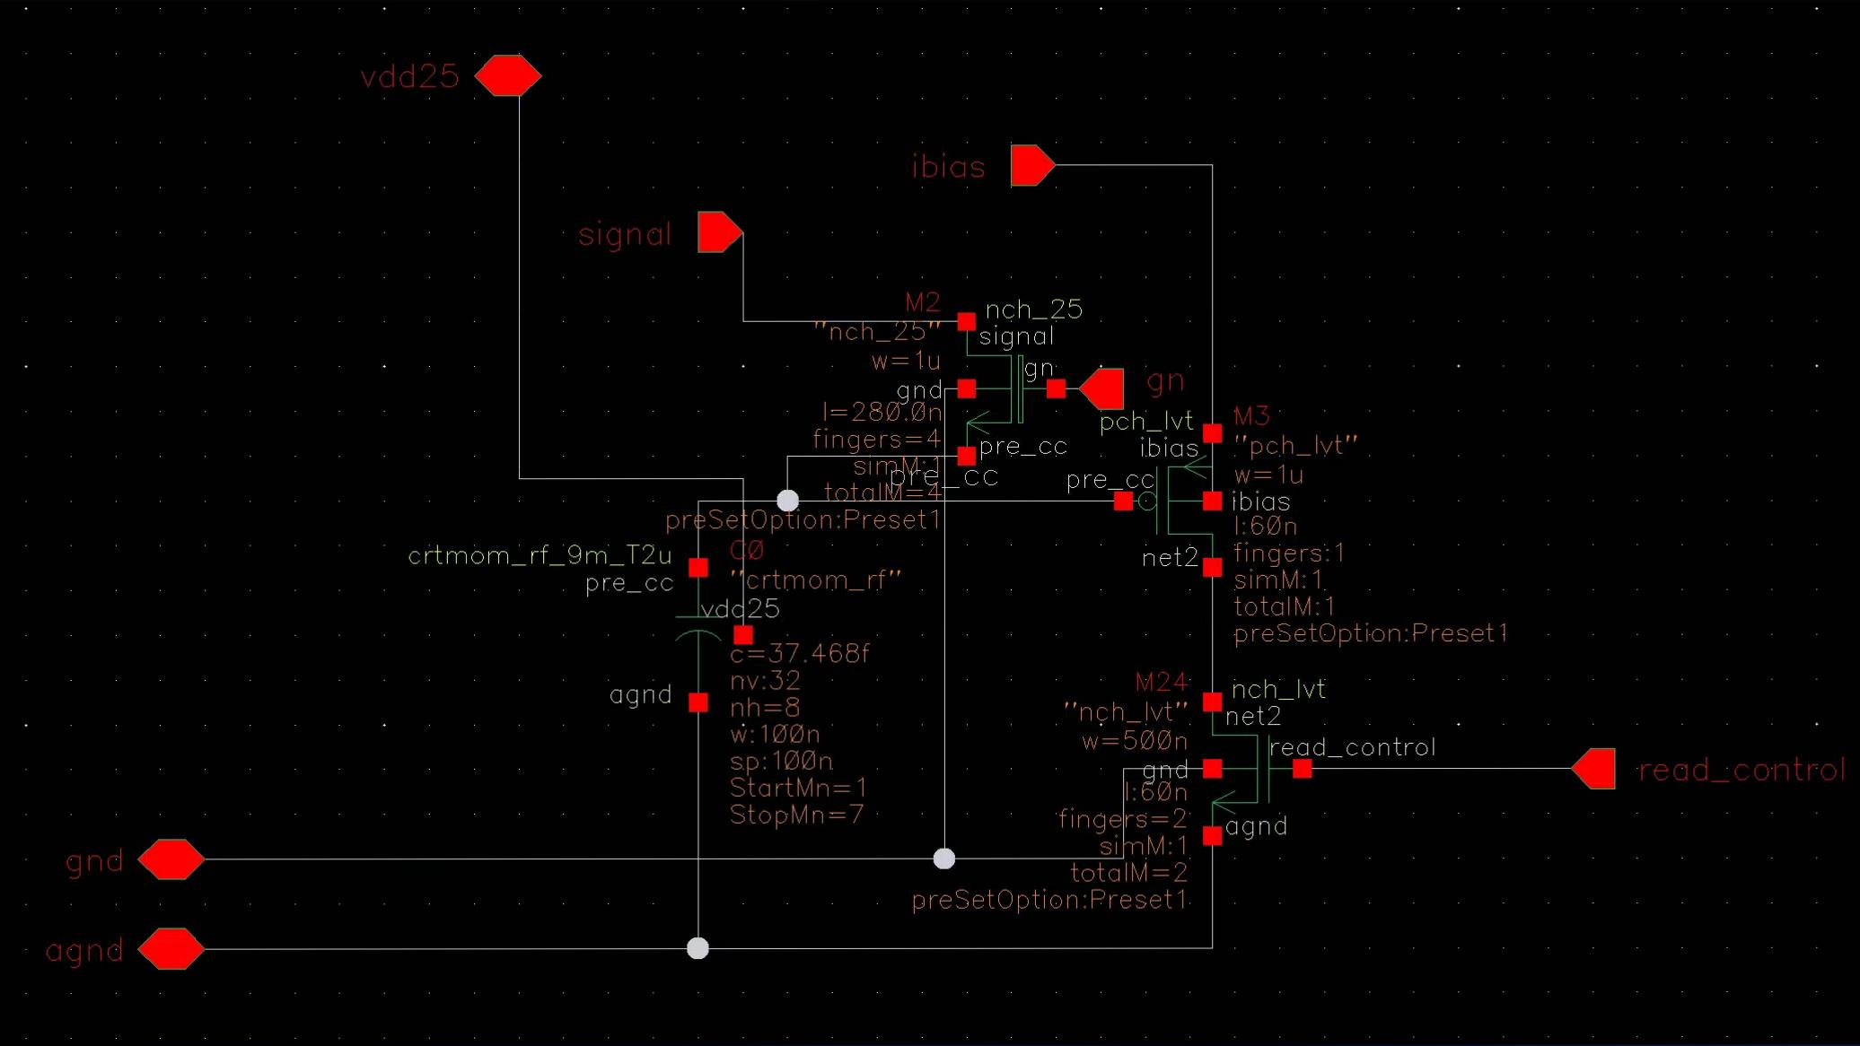
5. Output Source Followers
P Substrate
A. Stage 1
Switch
NWELL(PMOS Follower)
1μm
Switch-Control
D Flip Flop
Follower
Follower
Capacitor
Switch

Slide 11
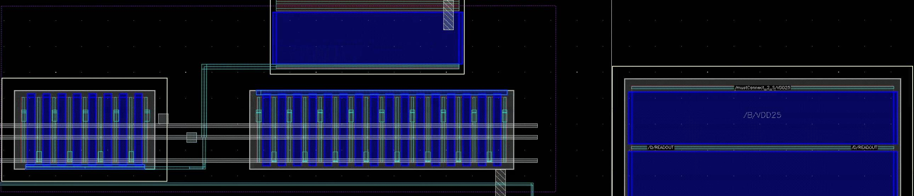
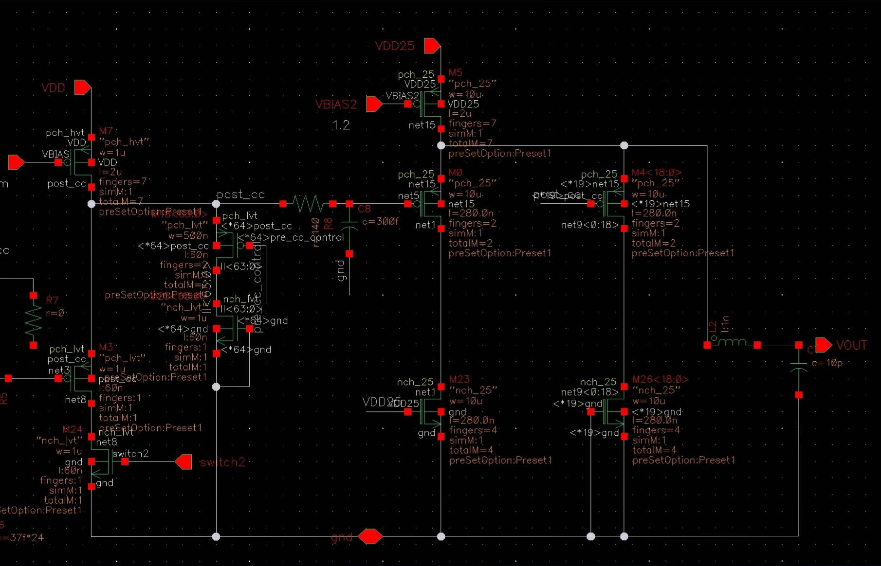
Stage 2 Follower
0.5μm
VOUT
VBIAS2
Stage 2 Switch
Stage 1 Current Source
Stage 2 Current Source
Stage 2
Inactive
Stage 2 ×19
Stage 1
Inactive
Stage 1 ×63

Slide 12
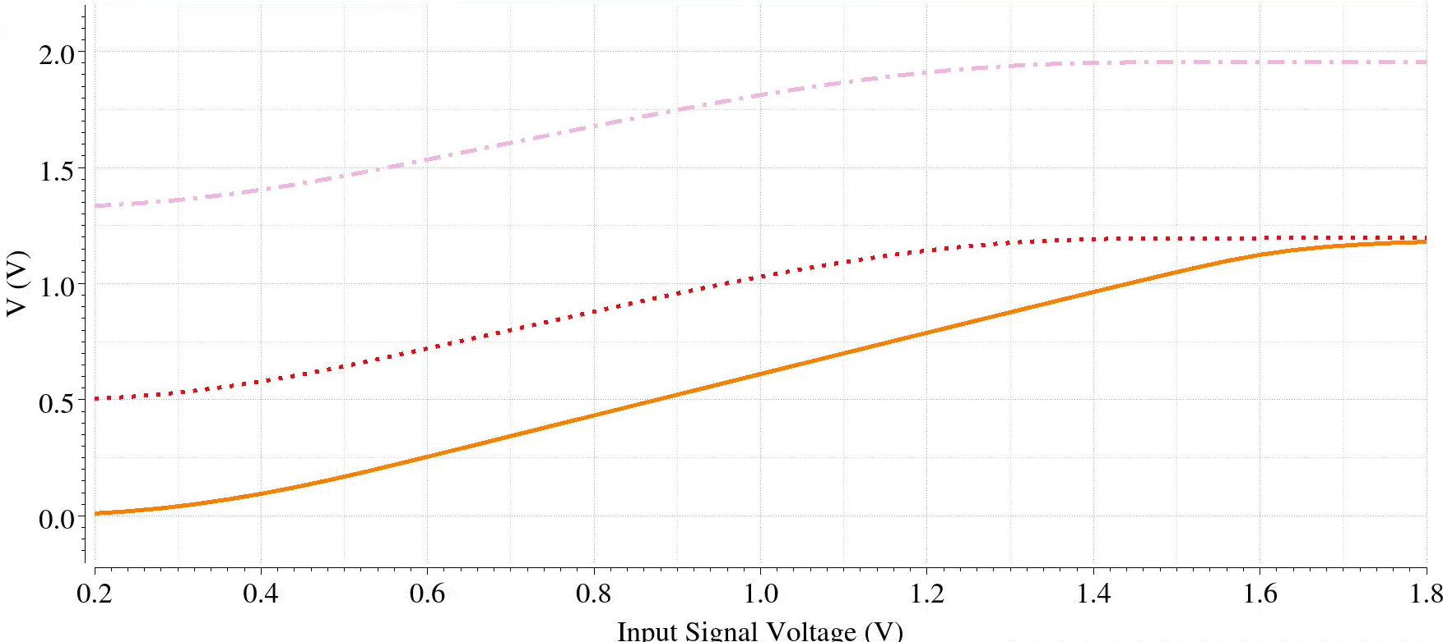
Input
Input
SF
A
Output
SF1
B
Output
SF2
C
C
B
A

Slide 13
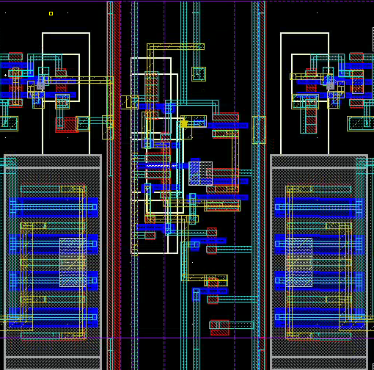
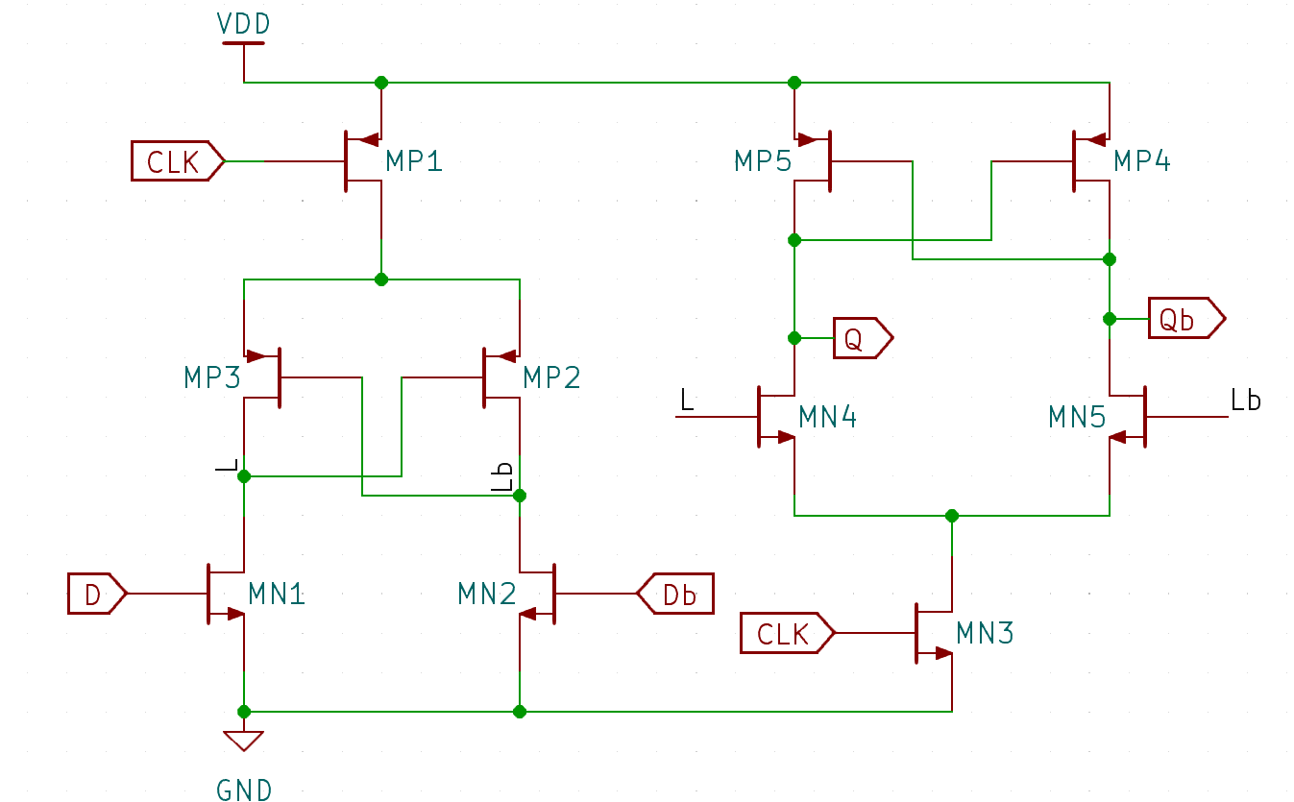
6. Controlling Sampling Switch
Dual Edge Triggered Flip Flop
D Flip Flop
Guard Ring (GND)
Guard Ring (GND)
Operates at
CLK = 5GHz (Fast SCA Column)
CLK = 2.5GHz (Slow SCA Column)
Sampling Switch
Sampling Switch

Slide 14
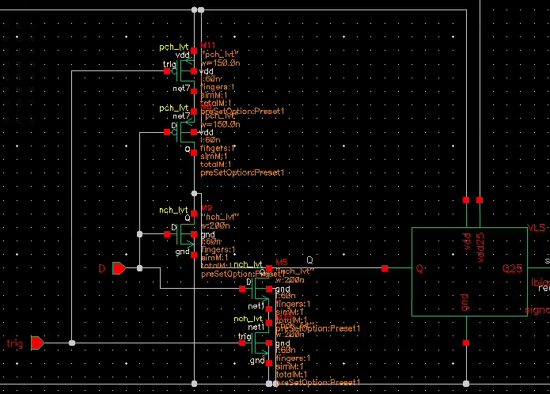
Control Logic
Control
Logic
Control
Logic
PMOS
PMOS
NMOS
NMOS
NMOS

Slide 15
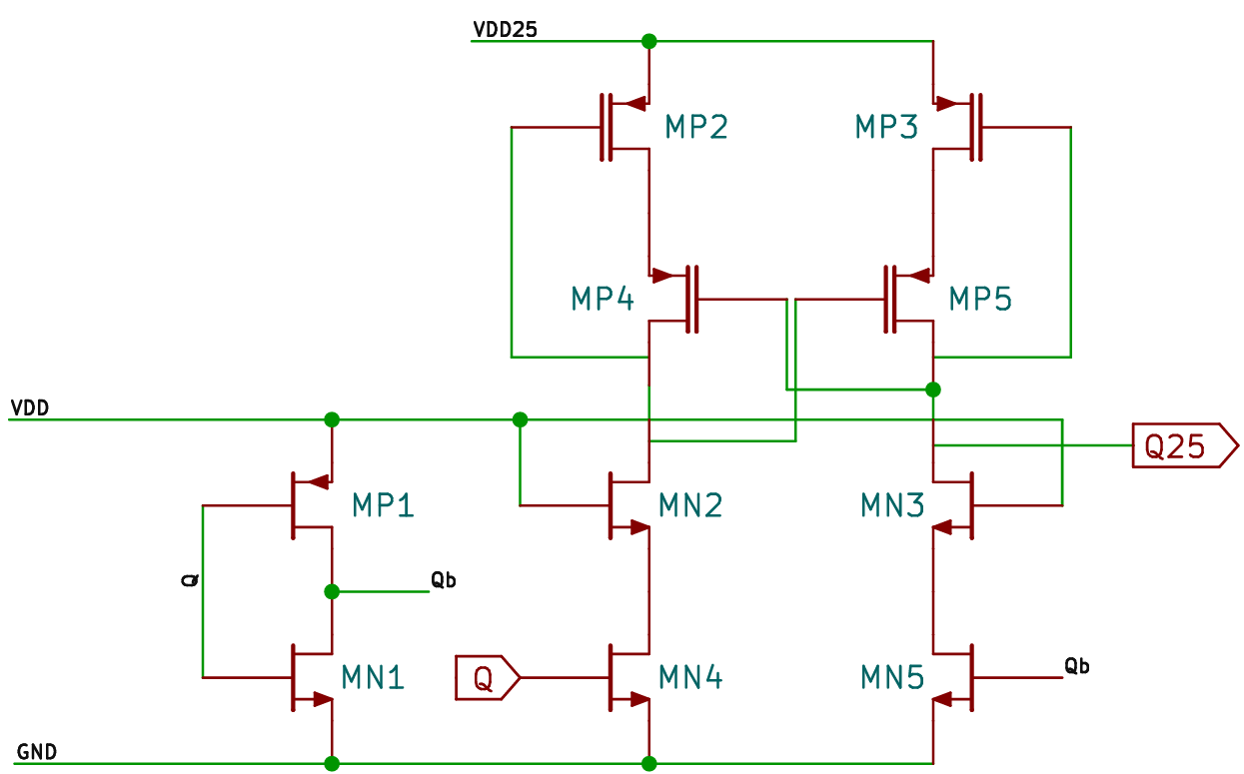
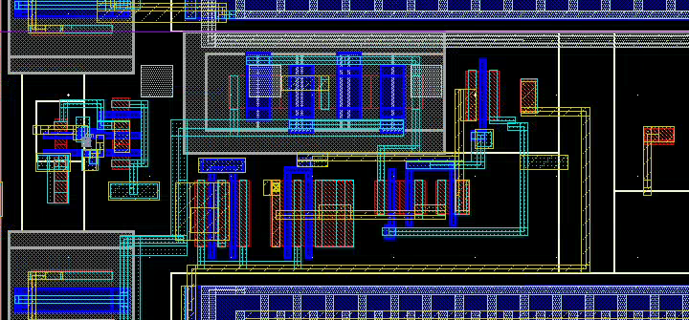
1.2V to 2.5V Voltage Level Shifter
Control Logic
Switch
NMOS
PMOS
Stage 1 Follower

Slide 16
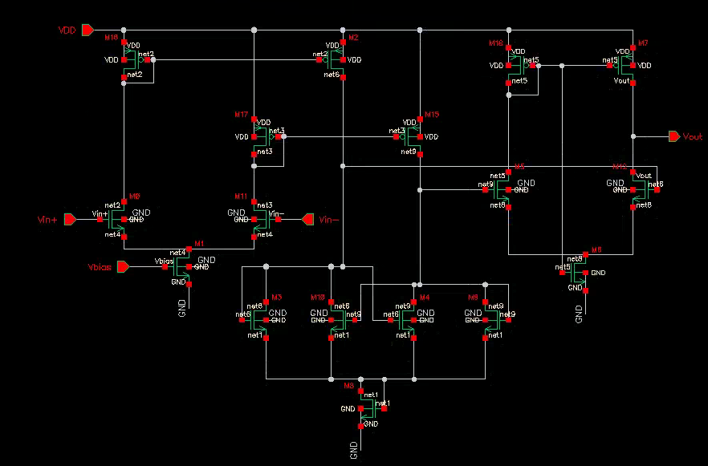
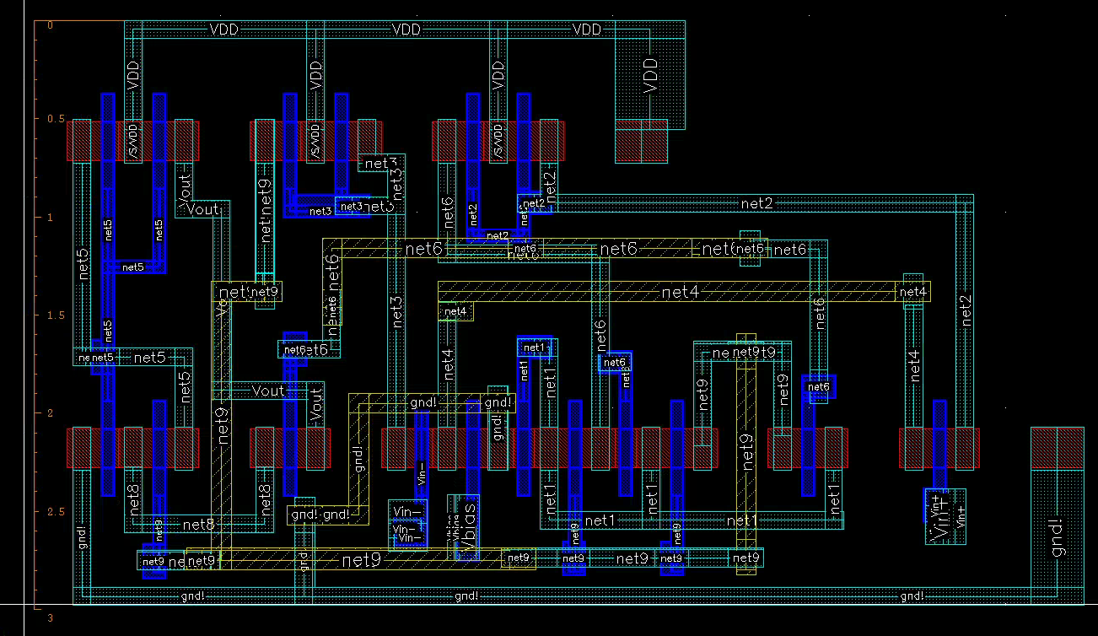
8. Discriminator

Slide 17
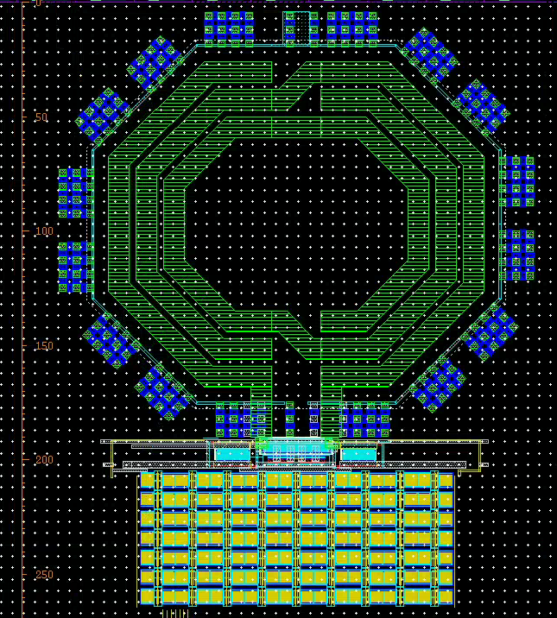
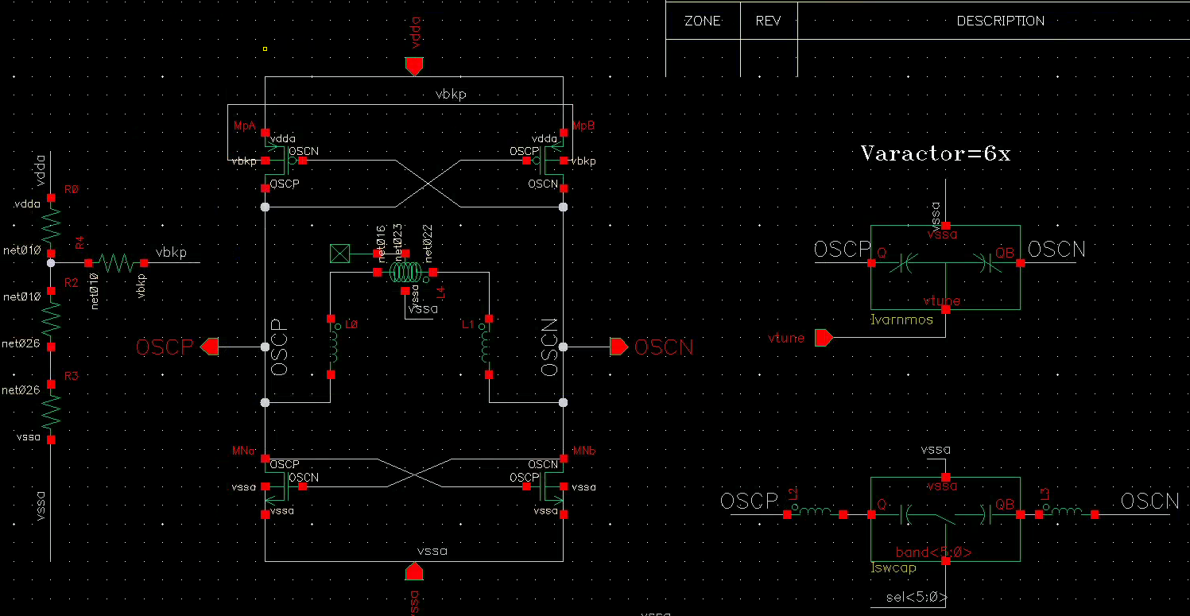
7. Clock Distribution
10 GHz VCO (Fermilab)
Control Voltage is sourced from the FPGA to create a feedback loop.

Slide 18
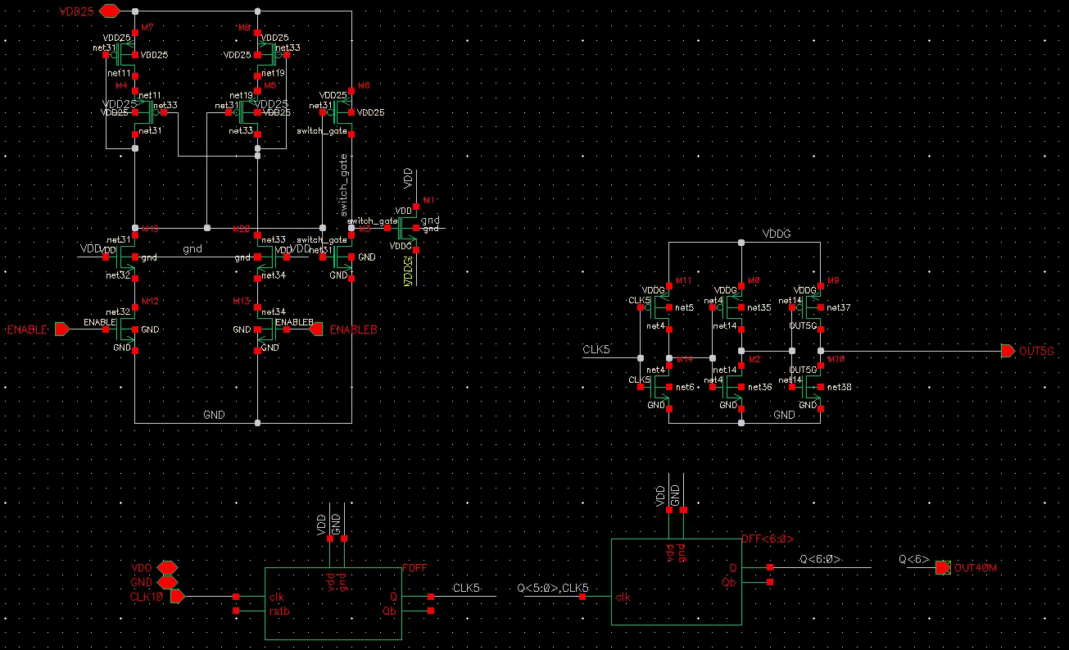
Power Gated Primary Clock Buffer
Power Gating w/ 2.5V Devices
Primary 5GHz Buffer
Async. Divide by 2
Async. Divide by 128

Slide 19
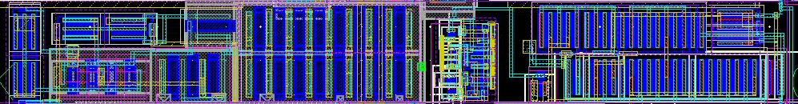
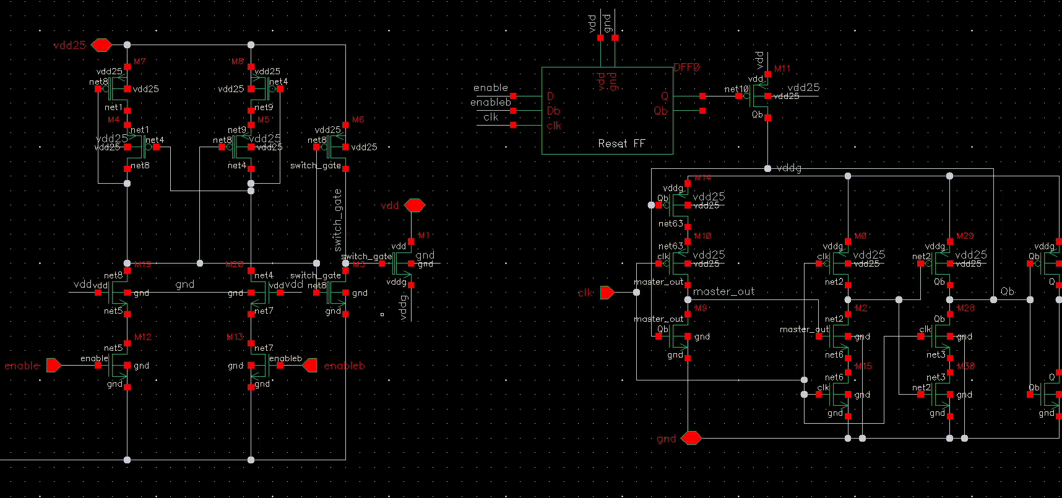
Power Gated Secondary Clock Buffer
VLS
Power Gate
Divide by 2 with Dynamic FF

Slide 20
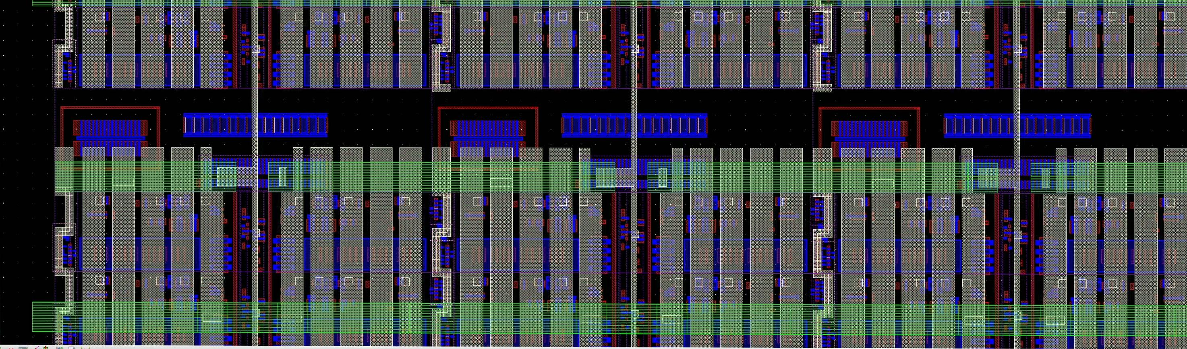
5GHz Clock Skew Generation
Buffers are sized so that it’s skew is 25ps in tt corner.
To Flip Flops
Buffer 2 OUT = Buffer 3 IN
Buffer 1 OUT = Buffer 2 IN
Buffer 1 IN

Slide 21
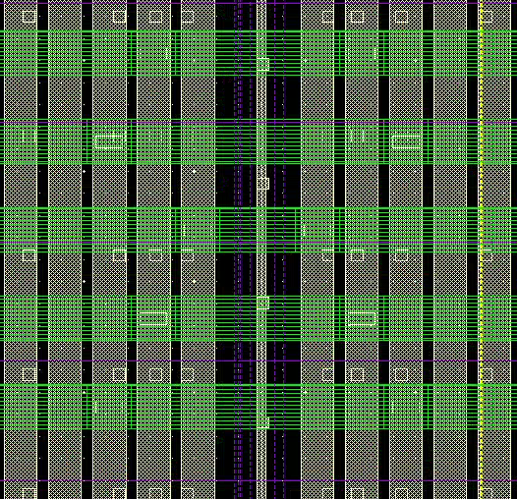
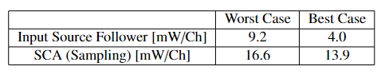
8. Power Distribution & Consumption
M8(1.5μm wide, 2μm pitch)
M9(2μm wide, 4μm pitch)
VDD25, VDD, GND(Substrate)
AVDD, AGND

Slide 22
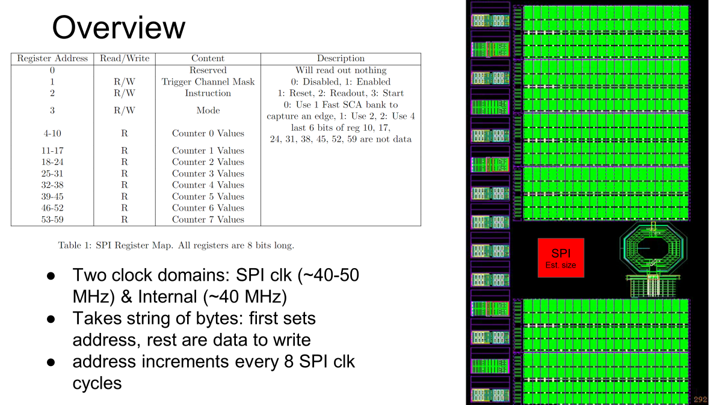
8. SPI Communication

Slide 23
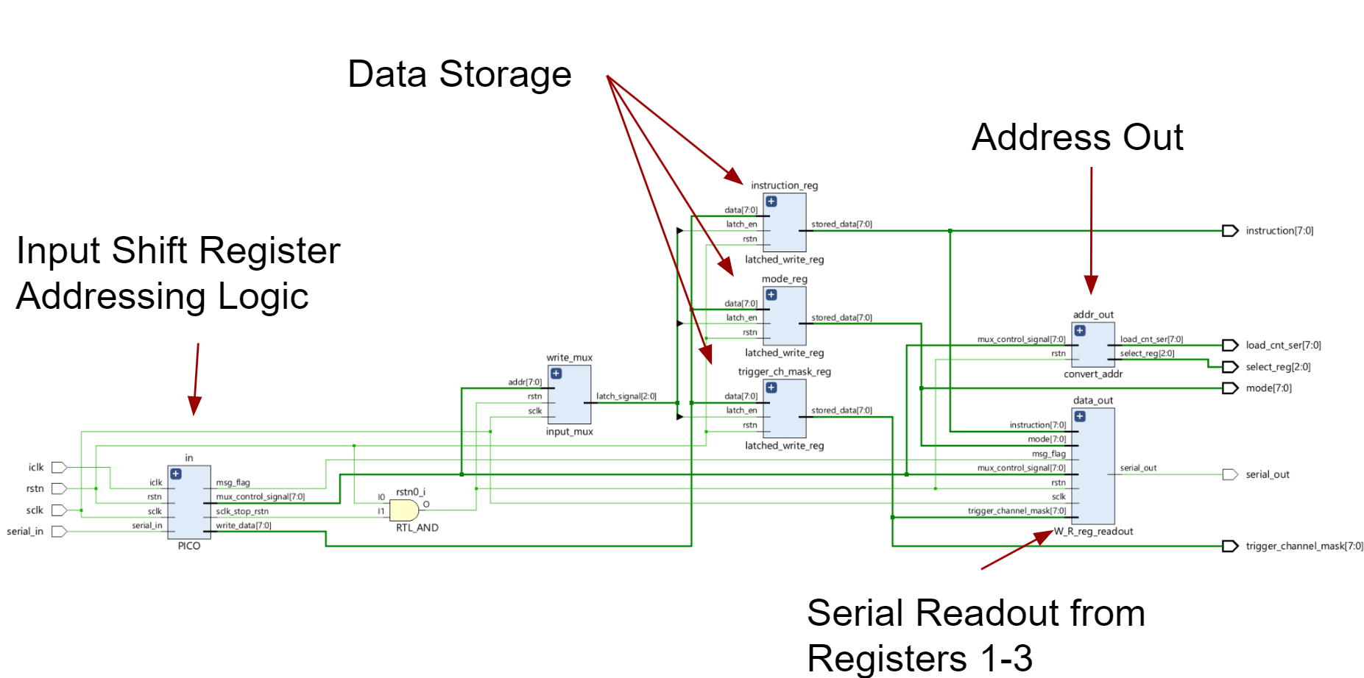
Schematic
Reading
Reading
Writing
Notes:
External rstn on startup
Time breaks represent at minimum 7 iclk cycles without an sclk edge
Only one internal reset after every transaction
Talk about addressing scheme

Slide 24
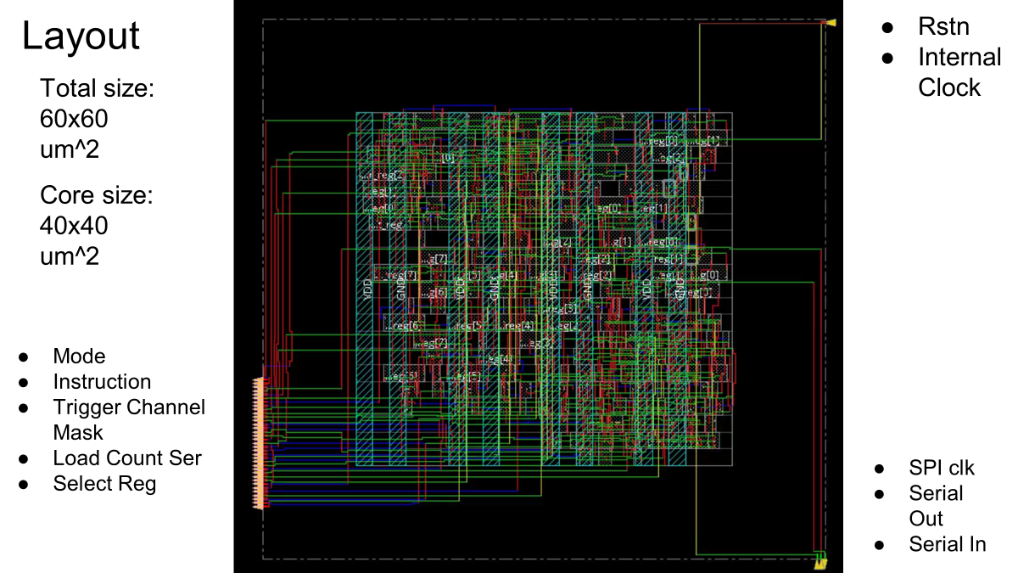

Slide 25
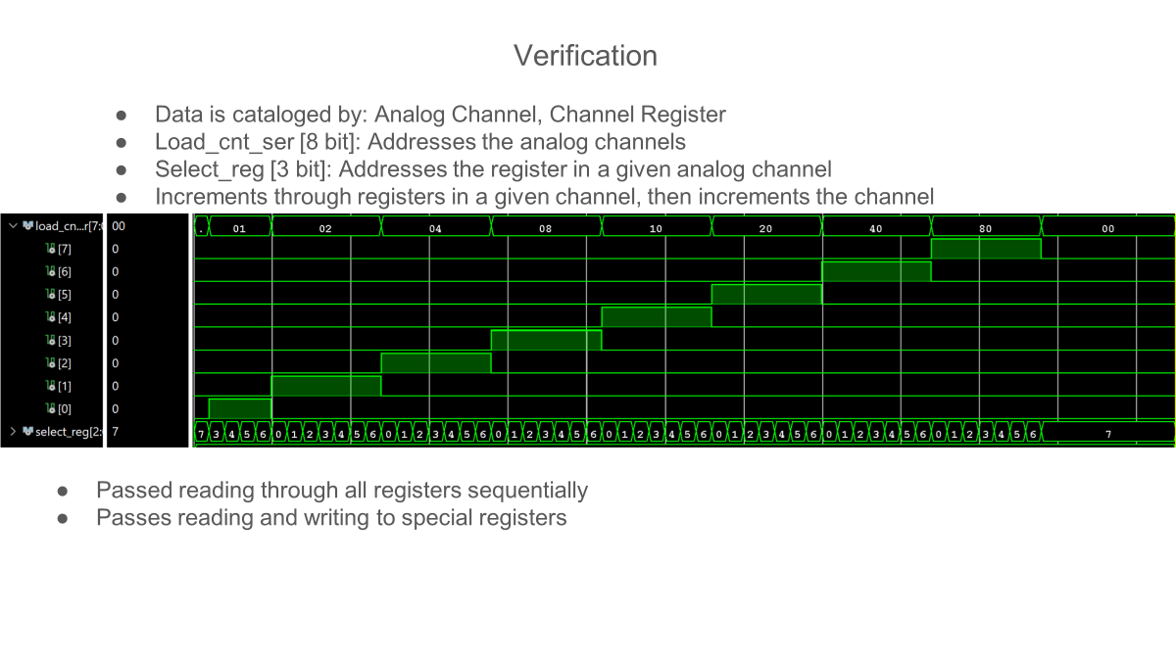
Notes:
Address is a binary number (0-59)
Load_cnt_ser holds which analog channel is active (00000001, 00000010, 00000100…)
Only 1 bit will be a 1, all others will be a 0
Select reg is a 3 bit number that will increment 0 through 6, going through all of the registers in a given channel
After all registers are incremented through, Load_cnt_ser increments, starting in a new analog channel
After channel 8, register 6 is incremented through, Address = 60, an invalid address and nothing will happen
Will be required to wait for iclk reset
Address is a binary number (0-59)
Load_cnt_ser holds which analog channel is active (00000001, 00000010, 00000100…)
Only 1 bit will be a 1, all others will be a 0
Select reg is a 3 bit number that will increment 0 through 6, going through all of the registers in a given channel
After all registers are incremented through, Load_cnt_ser increments, starting in a new analog channel
After channel 8, register 6 is incremented through, Address = 60, an invalid address and nothing will happen
Will be required to wait for iclk reset

Slide 26
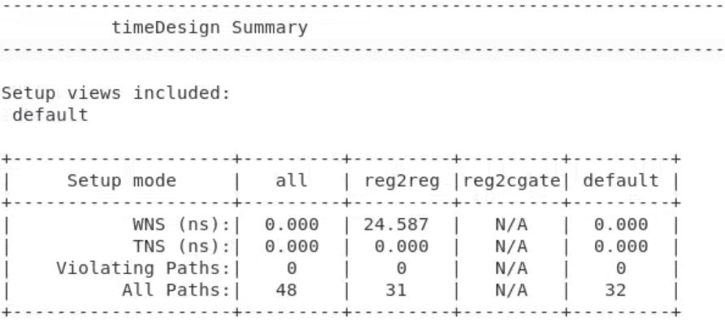
Time Analysis
Time Analysis
*WNS: Worst Negative Slack
*TNS: Total Negative Slack
*WNS: Worst Negative Slack
*TNS: Total Negative Slack
25ns period sclk; 23ns input delay; 2ns output delay
Synthesized clock tree for SPI clk and internal clk
25ns period sclk; 23ns input delay; 2ns output delay
Synthesized clock tree for SPI clk and internal clk

Slide 27
Q: How to reset the address?
A: Wait for 7 iclk cycles without sending sclk. Then send another address.
Q: What if an invalid address is sent?
A: load_cnt_ser <= 00000000, select_Reg <= 111. This means no data is read out.
Q: Is there any error correction?
A: We don’t have any. This shouldn’t be a problem.
Q: How to reset the address?
A: Wait for 7 iclk cycles without sending sclk. Then send another address.
Q: What if an invalid address is sent?
A: load_cnt_ser <= 00000000, select_Reg <= 111. This means no data is read out.
Q: Is there any error correction?
A: We don’t have any. This shouldn’t be a problem.

Slide 28
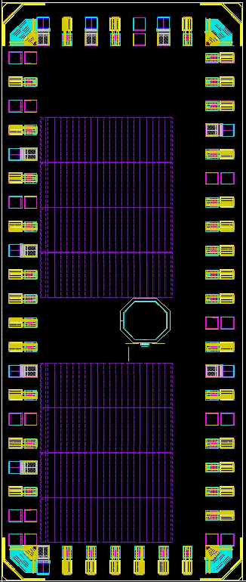
dvdd
dgnd
vdd25
Trig in
Trig out
clkout
agnd
readout
signal
Discr. Thres
agnd
readout
signal
avdd
avdd
readout
Pin Layout (54 pins)
agnd
signal
agnd
readout
signal
bufferbias
avdd
readout
signal
VCO vdd
VCO gnd
VCO ctrl
2400u, 21 pins
VCO vdd
agnd
signal
readout
avdd
avdd
signal
readout
agnd
agnd
signal
readout
avdd
bias1
signal
readout
agnd
bias2
vdd25
dgnd
1000u
Read
CLK
dvdd
RESET
SPICLK
POCI
PICO

Slide 29
Executive Session
Analog
Clock Skew Generation: Is it reliable? Is there a better way to do it?
Inevitable clock skew between channels (O(10ps)): Will it affect the calibration?
Signal Integrity: Is it reliable considering mismatch and process variation?

Slide 30
Executive Session
Application
Length of a fast SCA bank (1.6 ns): Is it good for LAPPDs? What about other detectors?
SCA banks can be used as 4* 1.6 ns, 2* 3.2 ns, or 1* 6.4 ns, where the multiplier means the number of edges captured within 208.4 ns window. Is this feature useful?
Readout rate: Is 30kHZ event rate good enough? (w/ 40MHz readout clock)
Do we need a feature which disables slow SCA bank readout? (156kHz) Do we need a feature which supports pipelined readout (simultaneous read/write) of four fast SCA banks? (625kHz)
How high a readout clock frequency shall we support? (Currently 40MHz max due to RC, higher frequency bad for signal integrity.)

Slide 31
Executive Session
Digital
What to do with the last 6 bits of the digital registers?
Would the design benefit from running faster?
How often should internal reset occur if no data is sent in?
How to make sure a transaction is complete before starting the next one (how does one count 7 iclk cycles from the FPGA)?

Slide 32
Supplementary Slides

Slide 33
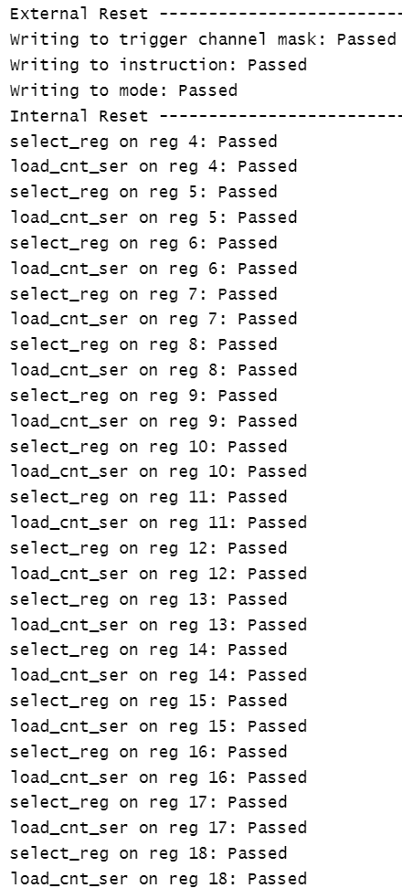
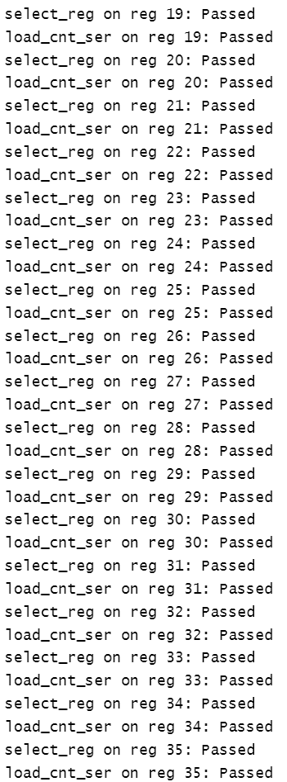
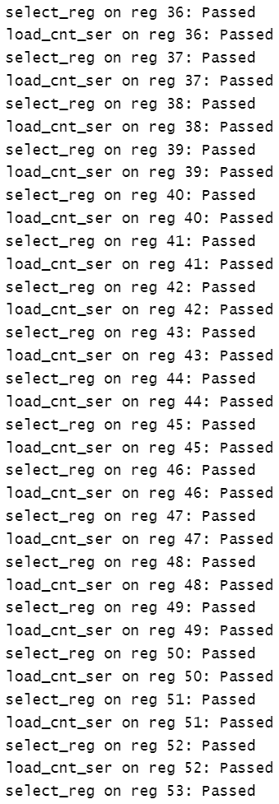
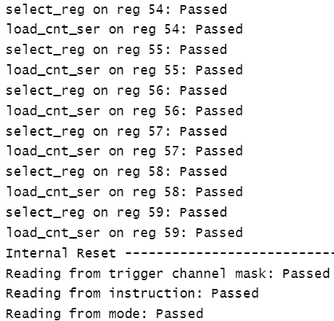

Slide 34
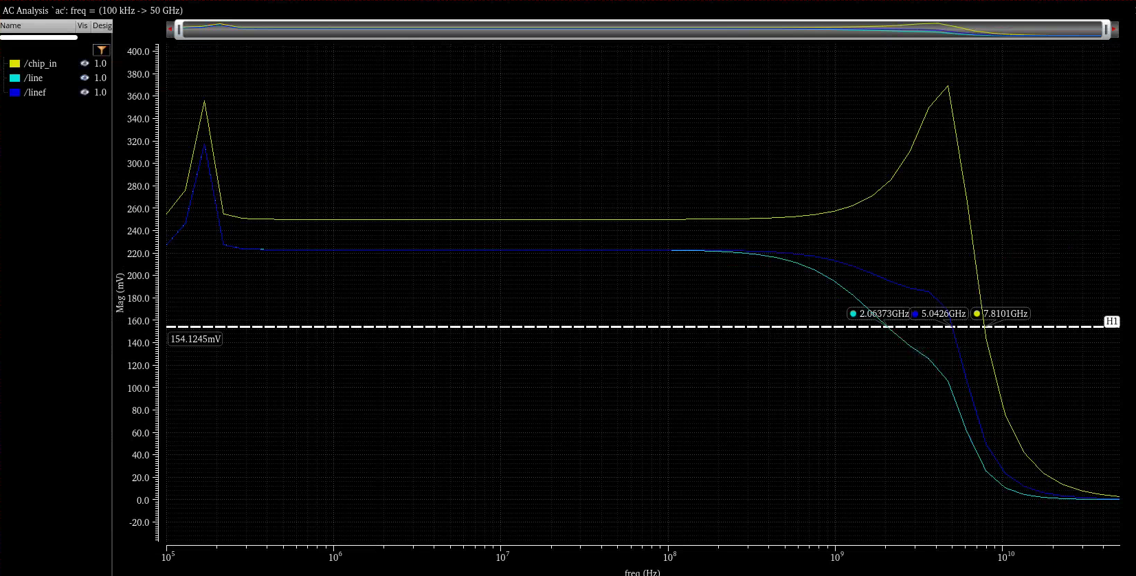
Analog BW

Slide 35
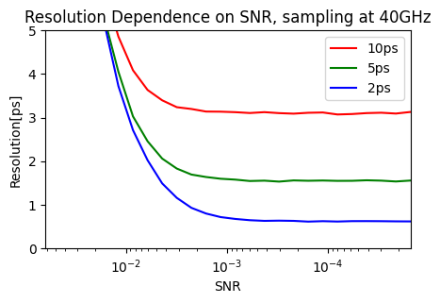
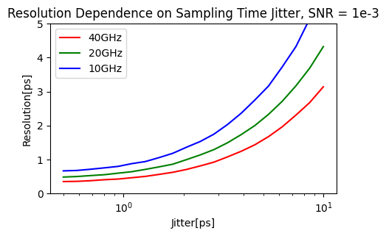
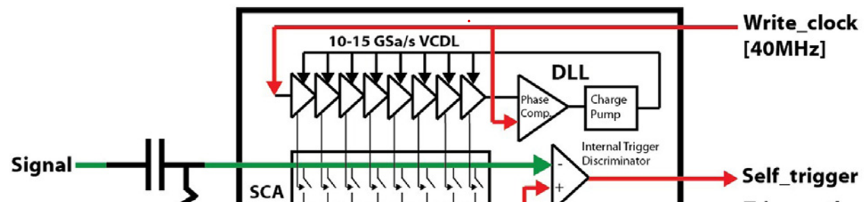
Point 2. Sampling Jitter
At <1ps timing resolution region, sampling jitter is a dominant component of the overall uncertainty.
PSEC4 employs Delay Loop Lines (DLL) to control sampling switches.
Diminishing return above 10 ENoB
Monte Carlo results based on Delagnes, arXiv:1606.05541
Notes:
We concluded that in terms of timing resolution, the return diminishes as Signal to noise ratios reach 1/1000 or 10 effective bits. (next) In this region, sampling time jitter has a greater impact on the overall timing resolution.
Time differences between samples are determined by a voltage-controlled delay line, which is an array of transistors, usually MOSFETs, in which a signal propagates through the array at a desired rate.
However, no chip manufacturing process is perfect, so each element of the VCDL has a different time offset.
It is necessary to measure each time offset to correctly sample a signal.

Slide 36
1 Sync Channel
+ 7 Normal Channels
250MHz White Rabbit Sine Wave, synchronized across stations.

Slide 37
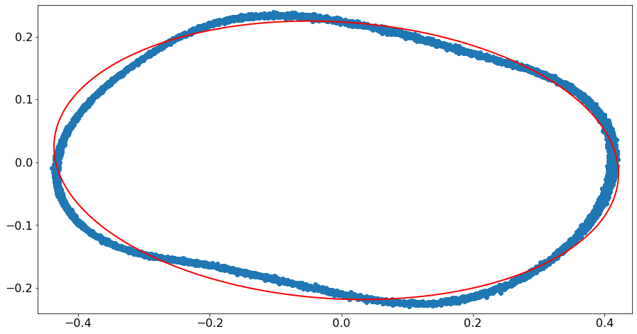
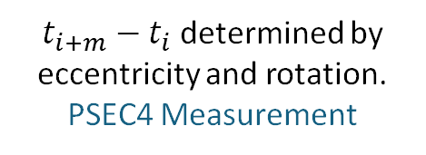



Bandwidth affects sample time uncertainty!
1. Measure many events of a sine wave.
2. Sum vs. Difference of two adjacent samples, over all events, form an ellipse.
3. Time offset can be determined from the coefficients.
Event 1
Event 2
Input Voltage
$t_{i+m}−t_{i}$ determined by eccentricity and rotation.
PSEC4 Measurement
$$V_{i}−V_{i+m}[V]$$
Event 3
Event 4
$$V_{i}+V_{i+m}[V]$$
$$t_{i}{ t}_{i+m}$$
Low SNR → fainter, more spread curve.
Nonlinearity → distorted curve
Time
Notes:
To reduce the sample time uncertainty, we have developed a method to measure the time offset of each sample.
1. Measure many events of a sine wave.
2. Plot Summation vs. Difference of two adjacent samples, over all events, should form an ellipse.
3. Time offset can be determined from the coefficients.
The diagram explains which event corresponds to which dot in the ellipse plot, which is the actual measurement data of PSEC4.
When you think about it, the plot does not have to be on two adjacent samples, but samples that are m samples apart. This way the effect of voltage noise of each sample on the time offset is smaller.
In other words, the sampled curve is more like a smooth ellipse as m gets larger.
However, the time difference cannot be larger than one fourth of the period of the sine wave, which in our case corresponded to m equal to about 10.
When we look at the right ellipse plot,
Higher voltage Noise results in a fainter, more spread curve.
The nonlinearity of the overall system results in a distorted curve

Slide 38
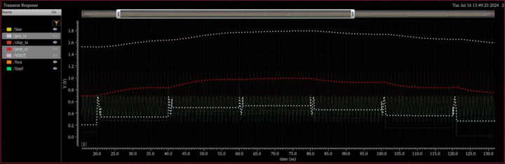
Output Analog Characteristic

Slide 39

Clock Skew

